Slide 1

Quantum lego powerup
ICERM Workshop: Coding for Fault-Tolerant Quantum Computing,
Brown University
Apr 11, 2026
Charles Cao (Virginia Tech)
2603.03542

Slide 2

Reductionist coding theorist
Are there atoms of quantum codes?
If so, what are they?
How do they “interact”?
How do we synthesize bigger codes with them?
Why are you talking about it in this workshop?

Slide 3
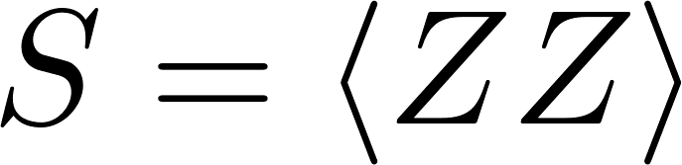
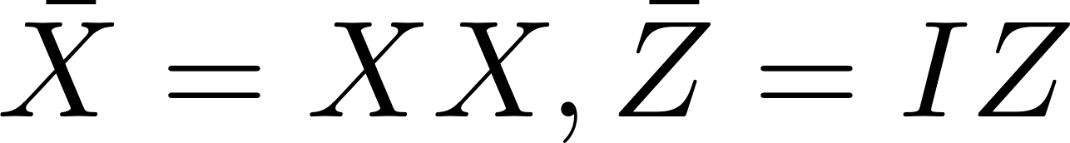
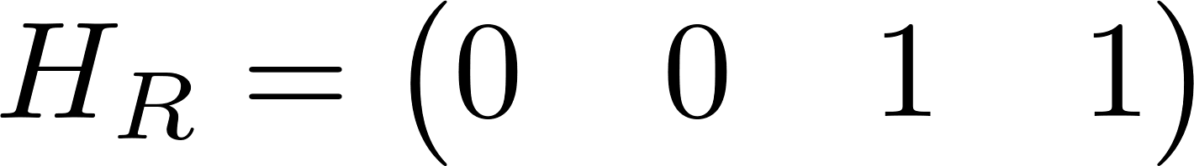
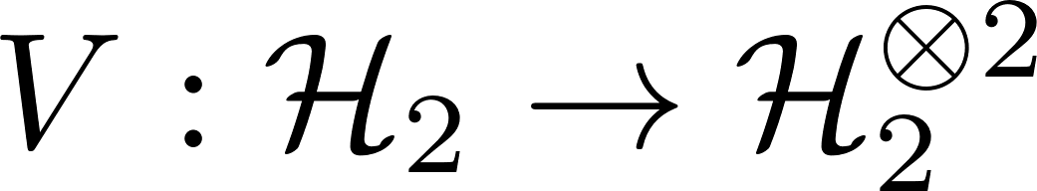

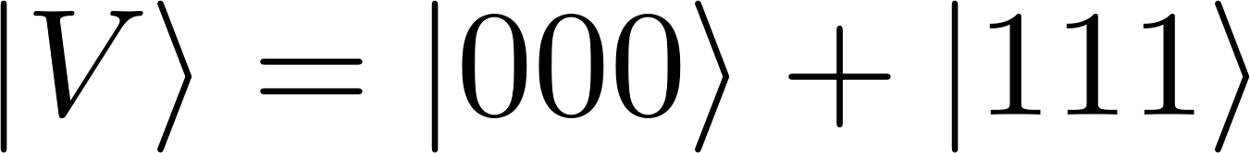
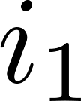

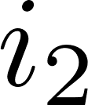
Atomic codes
[[2,1]] Repetition code
Tensor diagram
(Choi) state
isometry

Slide 4
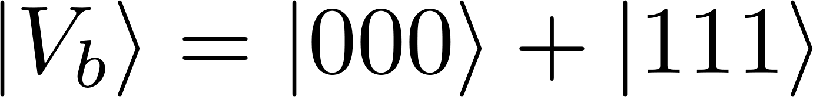
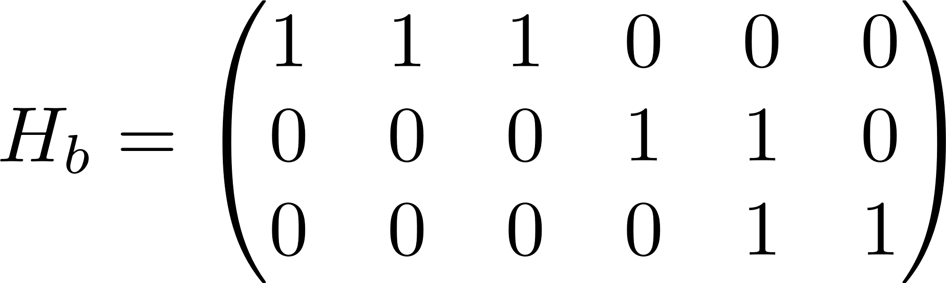
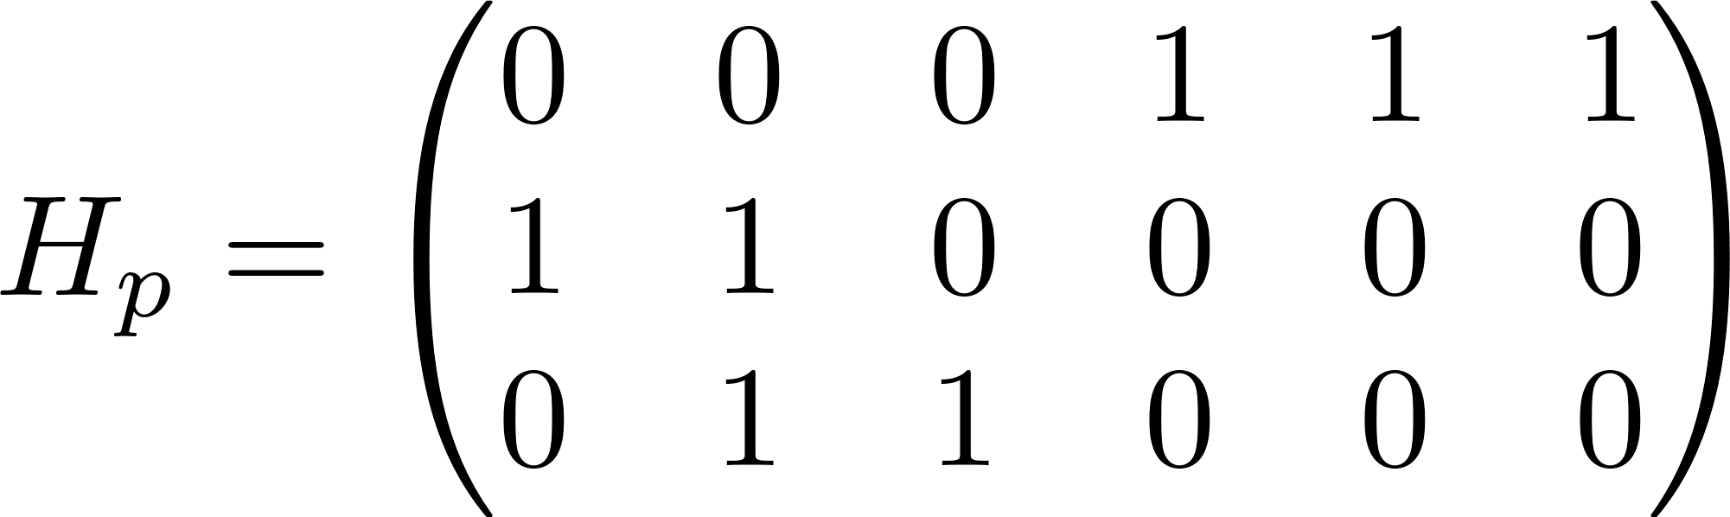
Atomic codes
Bit-flip and phase-flip code (will track their Choi states from now on)

Slide 5

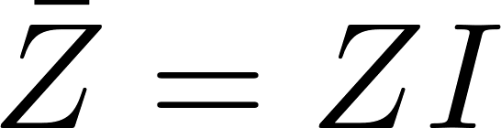
symmetries
Pauli symmetries give me transversal Pauli gates (in this case)
X
=
X
X
Z
=
Z

Slide 6
Symmetries
More generally, I can read off the logical operator from the symmetry of a Choi state
Suffices to work with Choi states and their symmetries
“transversal operators” ← Symmetries

Slide 7
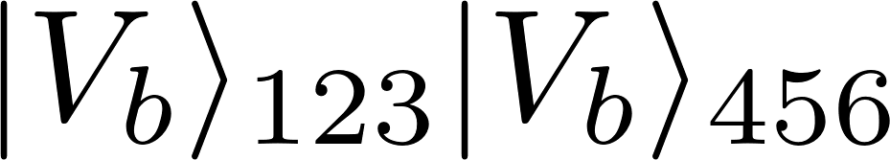

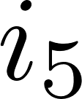
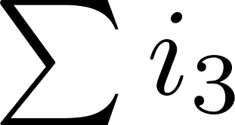
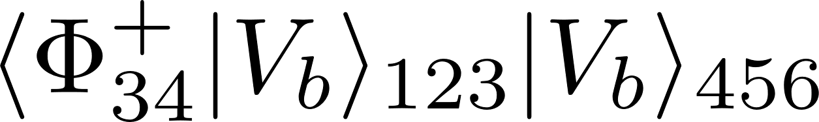

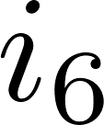
What are the Atomic interactions?
We can interact the codes by connecting bonds
Tensor trace
Bell fusion
Conjoining

Slide 8
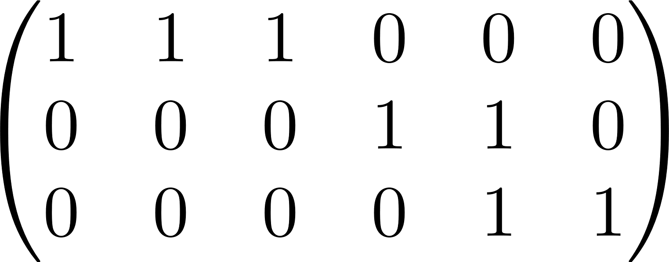
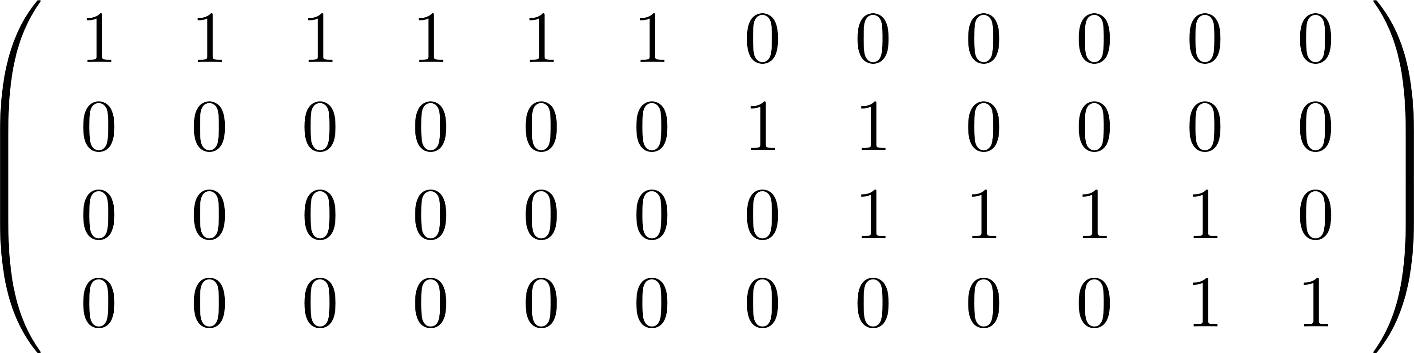
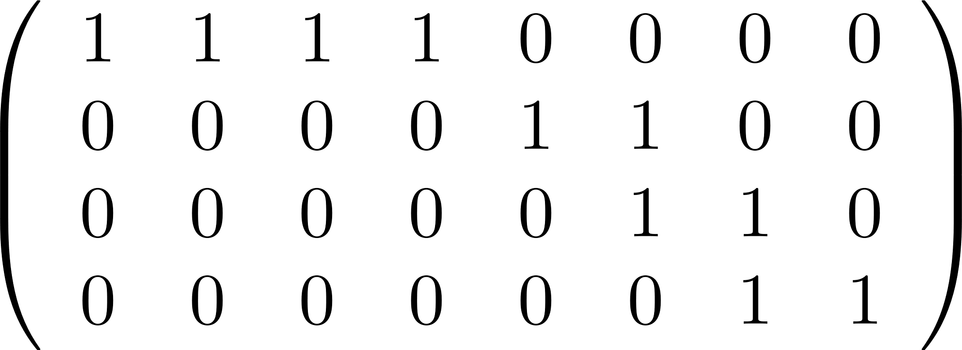
conjoining
Example
Identify qubits/cols we trace
Keep matching rows
Remove cols of qubits we trace

Slide 9
Symmetries and conjoining
Diagrammatic (matched operators):
X
X
X
X
X
X
X
X
X
X
Z
Z
Z
Z
Z
Z

Slide 10
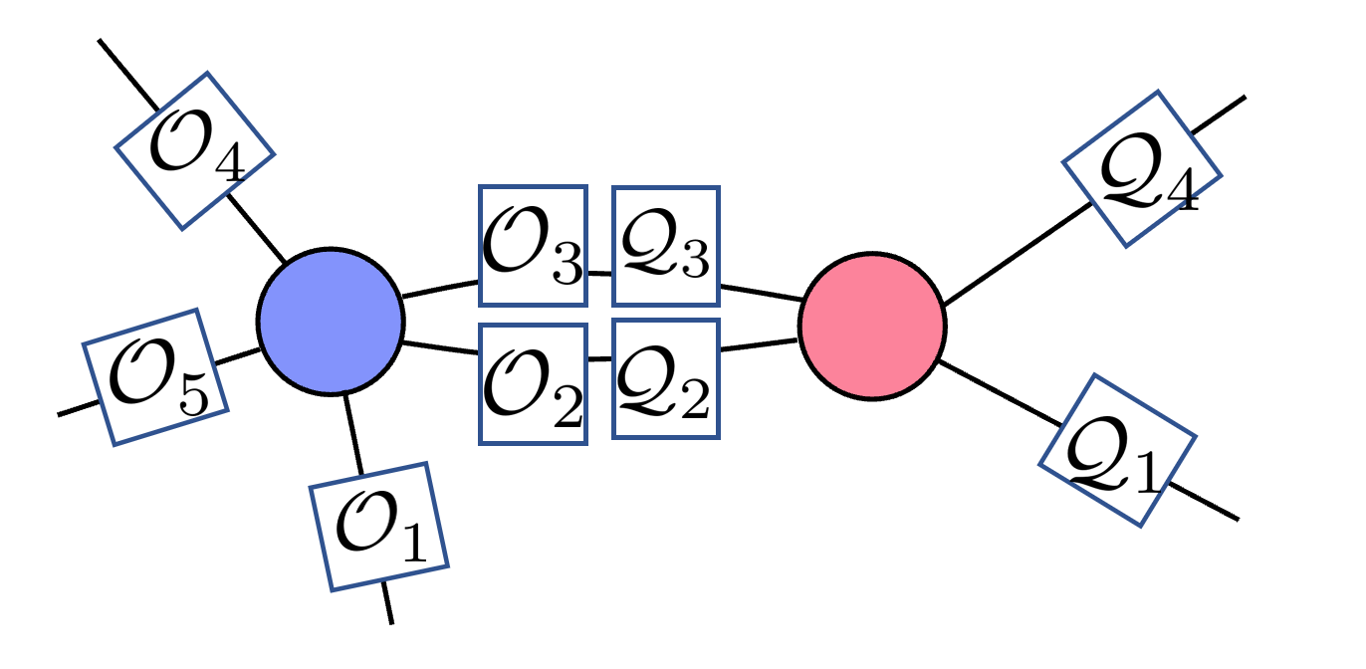
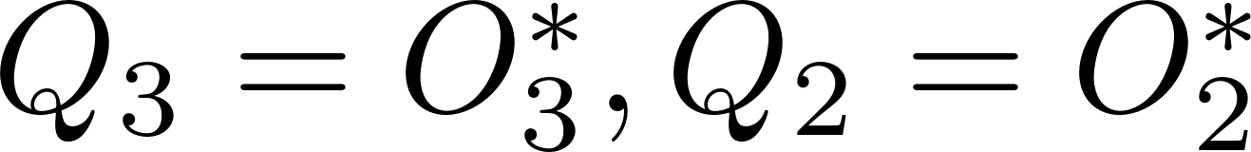
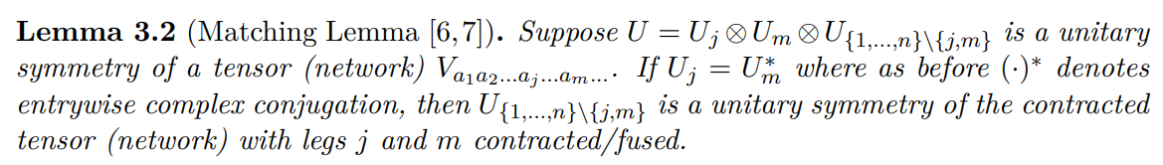
Matching lemma
Generalizes to non-Pauli operators

Slide 11
What can we build?
Repetition codes as atoms
Conjoining as interatomic interaction
????

Slide 12
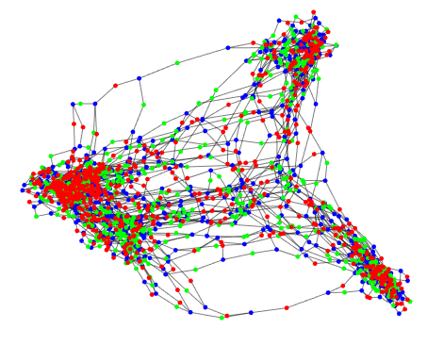
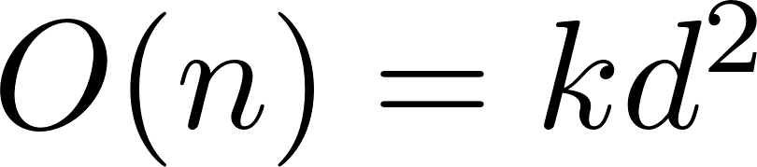
What can we build?
CC, Lackey 2109.08158
Kissinger 2204.14038
Shen, Wang, CC 2310.19538
CC, Lackey 2507.13496
All CSS codes can be built from 2-qubit phase/bit-flip codes under conjoining
  Can build more in fact: sparse subsystem codes w/ iteratively
  w/ worst case bound
All stabilizer codes can be built with addition of H and S tensors (1 qbit stab)
  Conjoining stabilizer(CSS) codes always give stabilizer(CSS) codes
Any qubit code can be built from the 2-qubit rep code + single qubit trivial codes
Non-Pauli stabilizer codes: dihedral group extension
  Conjoining XP codes: with non-Abelian stabilizer group that have P and X

Slide 13
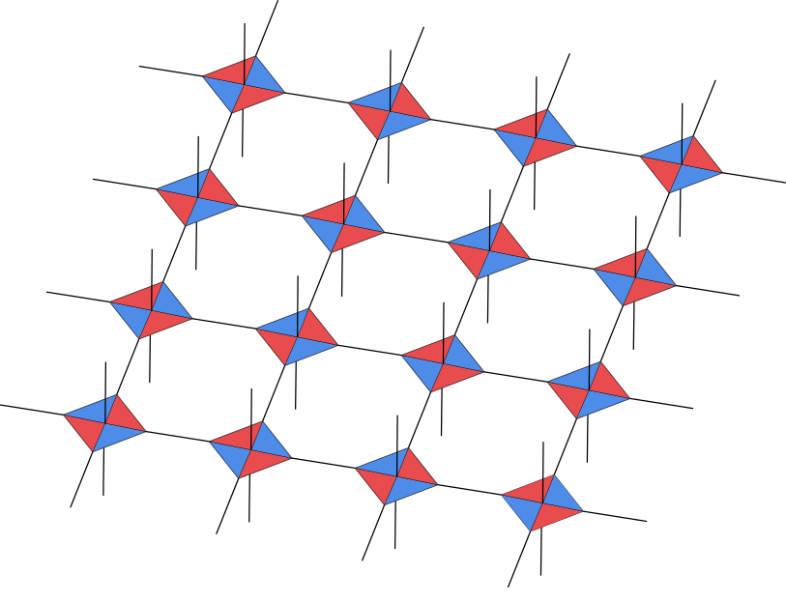
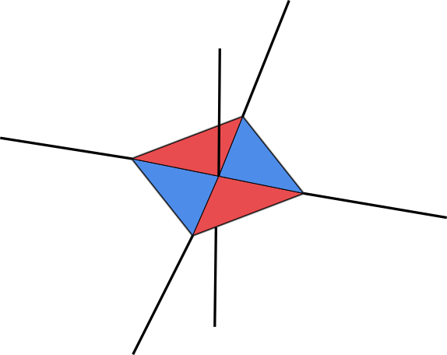
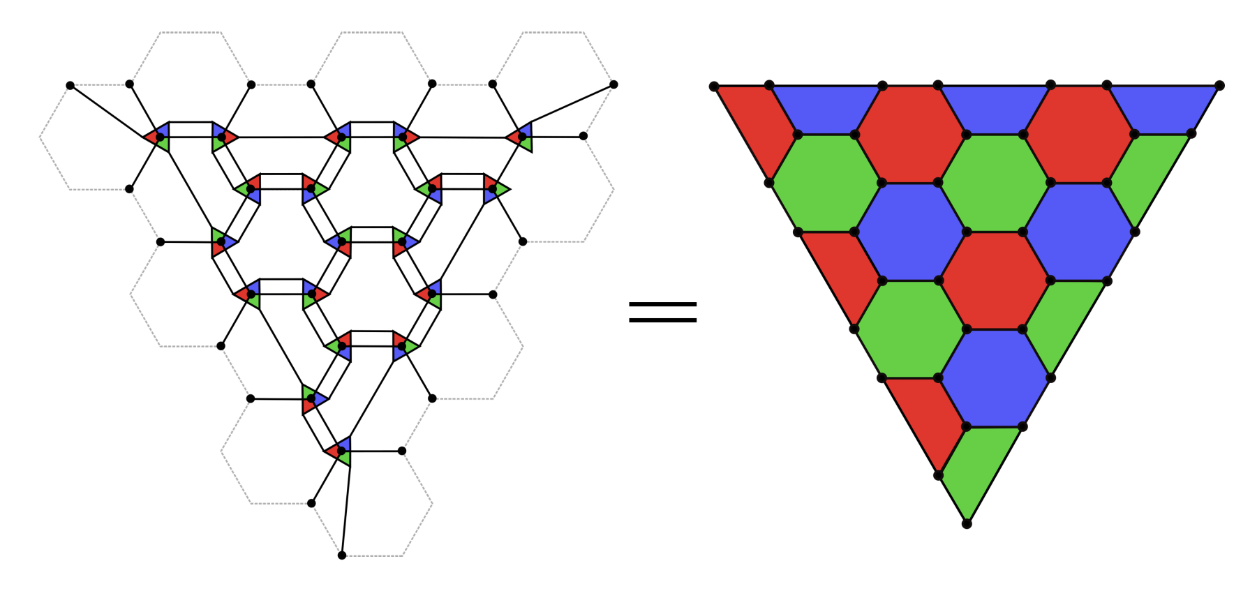
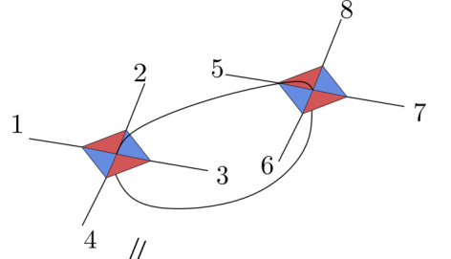
Easier to work with “molecular” codes
Don’t have to always start with atoms (ZX diagrams)
  If we built a bigger “molecule”, we want to work with them directly
Surface code/toric code
=
[[4,2,2]] choi state tensor
Choi state of Steane code
2d color code
Notes:
Example
422 molecule from rep codes → surface
Steane from 422 → color code
Molecular synthesis
Find small lego blocks with more interesting properties
Code design from molecular codes

Slide 14
Transversal gates as TN symmetry
Why bother with tensor networks?
  The formalism works well with transversal+addressable unitary gates
  Needed for many FT protocols, easy to implement
Transversal gates as symmetries: (we really mean depth 1 circuit)
  Non-Pauli gates might be trickier to deal with in Pauli stab/CSS
  But not a problem for QL/TN (provided we know the symm of atoms well)
1. Find lego blocks that have interesting symmetries
2. Conjoin blocks with compatible symmetry (any unitary)
3. Profit $$$

Slide 15
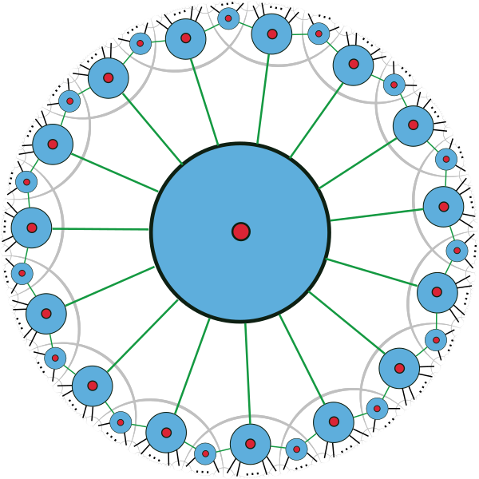

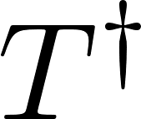
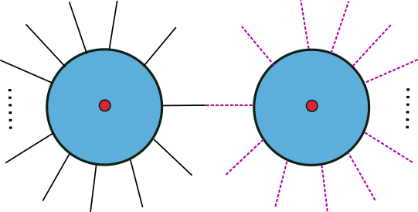
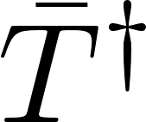

Single qubit transversal gates
Example: QRM codes as molecules (starting lego blocks)
We just need to make sure the operators match properly (then code given by conjoined check matrix is CSS-T
X
Finite rate holograph QRM

Slide 16




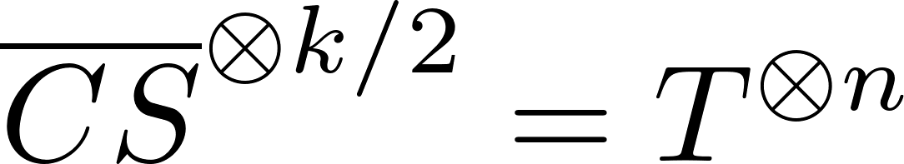
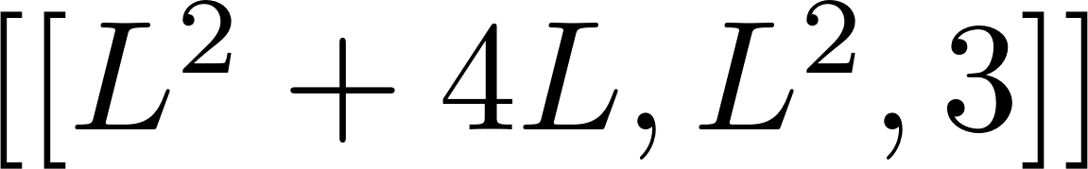
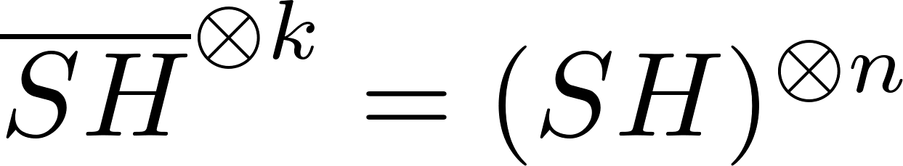
mixed gates
Can link the legos in different graphs
Line: each node [[8,3,2]] with
Get with
With different lego [[12,2,2]] with
Get with
2D: use perfect tensor (5-qbit code)
Get with
…
…
…
…
…
…
Notes:
SH gate
Or more general U gate (e.g. Bei Zeng?) limited by our knowledge of the lego blocks

Slide 17


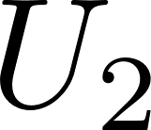
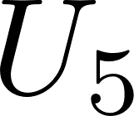

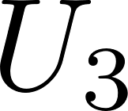

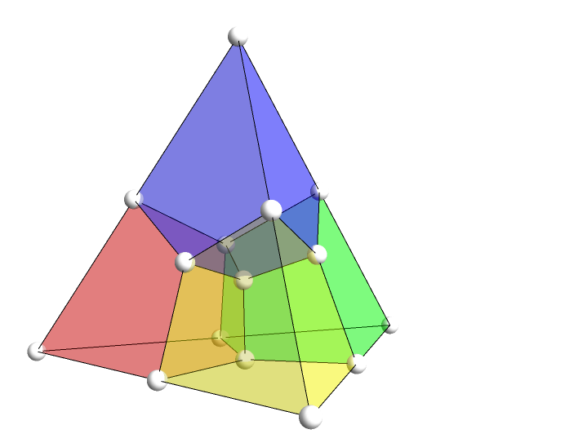

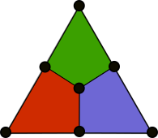
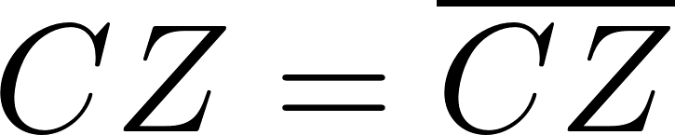
More than 1 qubit gate
Interblock and Intrablock symmetry
Interblock gates
Intrablock gates
Choi
map

Slide 18
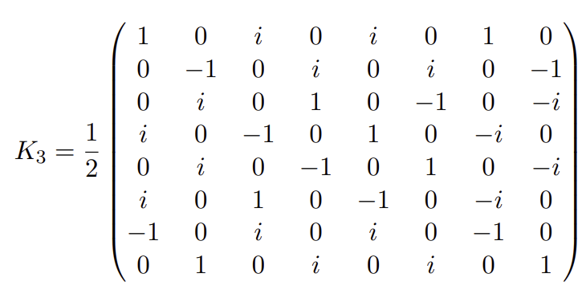
Interblock transversal
This is not so different from the single-qubit transversal gate
Stack the TN and pretend it is single qudit gate
[[12,1,2]] legos with transversal CCZ
Gives globally transversal CCZ code after conjoining
Transversal K3 gate

Slide 19

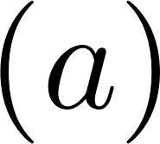
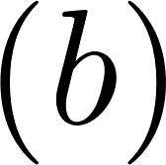

Intrablock transversal
How to conjoin legos to produce intrablock transversal gates
Z

Slide 20

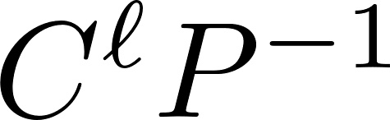
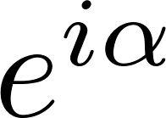
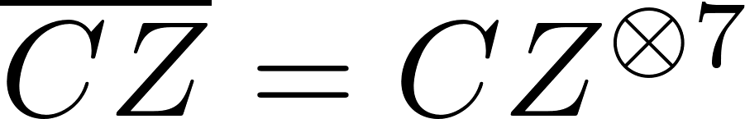
Addressable gate = localized symmetry
Can make gates addressable if symmetry is localized (act non-trivially on subset)
To do so, we find legos that have localized symmetries
P
Any multicontrolled-phase is localized symmetry of bit flip code
Notes:
Focus on two qubit gates to make things more interesting

Slide 21
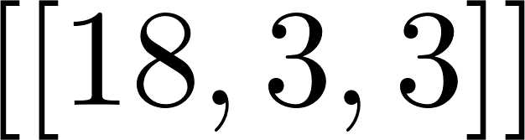

Addressable intrablock gate
Examples (CZ & CCZ)
…
…
…
Steane joined by GHZ/rep code
Addressable CZ
…
…
…
Z
…
…
…
[[12,1,2]] joined by GHZ/rep code
Addressable CCZ
…
…
…
Z
…
…
…
…
…
…
Notes:
Focus on two qubit gates to make things more interesting

Slide 22
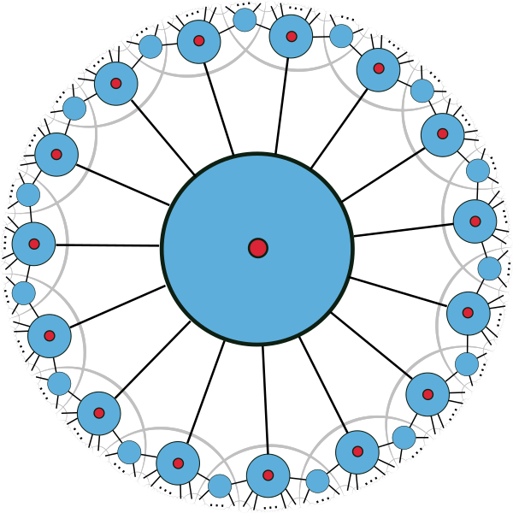
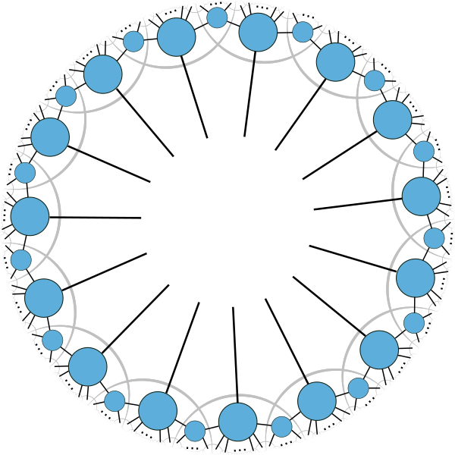

Holographic code example
Holographic QRM code (addressable CZ, global T, CCZ)
1
12
15
11
7
2
13
4
14
9
10
3
8
5
6
15
0
15
0
…
…
1-7
8-14
1-7
8-14

Slide 23
Addressable gates in Holographic codes
Theorem 1: there exist constant-rate holographic codes where transversal interblock and intrablock logical CZs can be implemented on any pair of logical qubits if their locations in the tensor network are related by a discrete rotation.
Theorem 2: Holographic black hole codes can be constructed where all local qubits localize on the horizon of the AdS black hole and intrablock/interblock logical CZs acting on any pair of the logical qubit is transversal and FT.
Two-qubit logical gates (Log(n) depth) [Steinberg et al] → depth-1
Compared to global CNOT, CZ yields 20x reduction at 3 layers already
Theorem 3: The above can be generalized to transversal C^{r}P gates if lego blocks admit transversal gates with C^{r}P operators.

Slide 24
Rule of thumb, but no theorem,yet
More cleanable a tensor is, the more addressable the code will be when they are conjoined
A tensor/state is r-cleanable wrt to O if any powers of O can be “cleaned” off of any r legs (qubits)
  c.f. local recoverability of subalgebra
O₁
Q₁
O₆
O₂
Q₂
O₅
Q₅
O₃
O₄
Q₃
Q₄

Slide 25

Iterated Fractal code
…
…

Slide 26

Iterated fractal code
We get a class of codes that support transversal interblock/mesoblock/intrablock transversal C^{r}P gates. Also FT if the base codes have d>=3.
Asymptotic code parameter
Not LDPC ☹
Efficiently decodable with TN-Max Likelihood decoder for any single qubit iid error ☺

Slide 27




f=3 Fractal code from (punctured) QRM
Use [[15,1,3]] QRM code as basic blocks
Fully addressable CZ on any two logical qubits
Partially addressable T
  Always act on even # qubits
Code parameters
Fully addressable T, CS, CCZ possible
…

Slide 28
Summary
Atoms/molecules of code → lego blocks
Conjoining → inter-atomic/inter-molecular interactions
TN has been mostly consigned to do computations
But can also helps with code design!
Addressable transversal (non-Clifford) gates: easy with lego
  Didn’t mention: come equipped with enumerator and decoder using TN
Can get all codes

Slide 29




future
Atm lego can more easily accommodate gates, but less so with sparsity and distance
  Use lego blocks with interesting symmetries (e.g. T), combine with sparsification algorithm
  Reverse engineer product construction → can we get better distance beyond concat moves
  LDPC codes with interesting gates (note lots of no gos)
  Switchable codes with nice gates
Finding atomic legos
  Quantum anti-code: search for localized Clifford/non-Clifford symmetries
  Automorphism + computational search
  Dihedral extension/XP codes
  Self-trace, untrace, stopper operation
  Graph classification of codes w/ transversal gate

