Slide 1
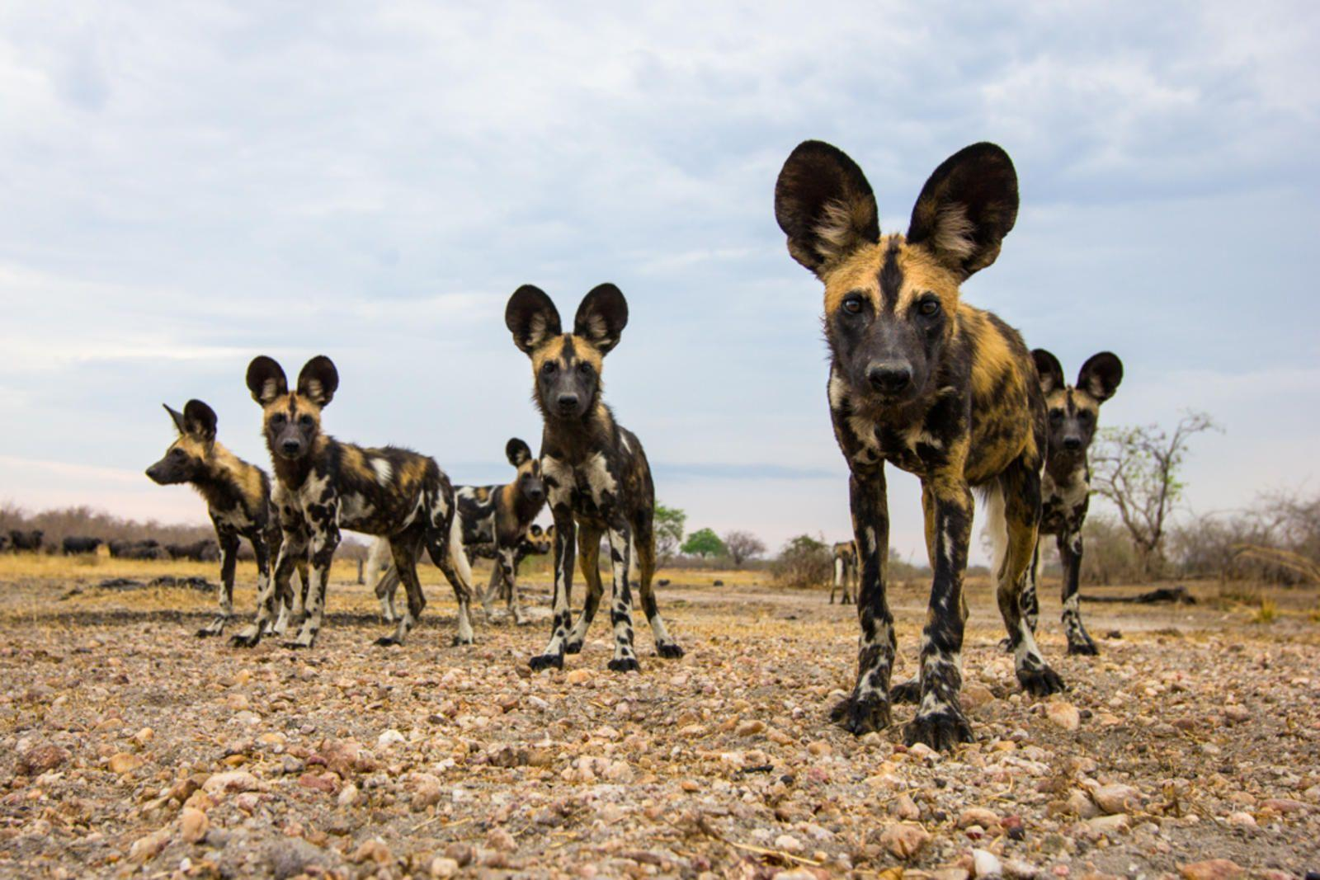
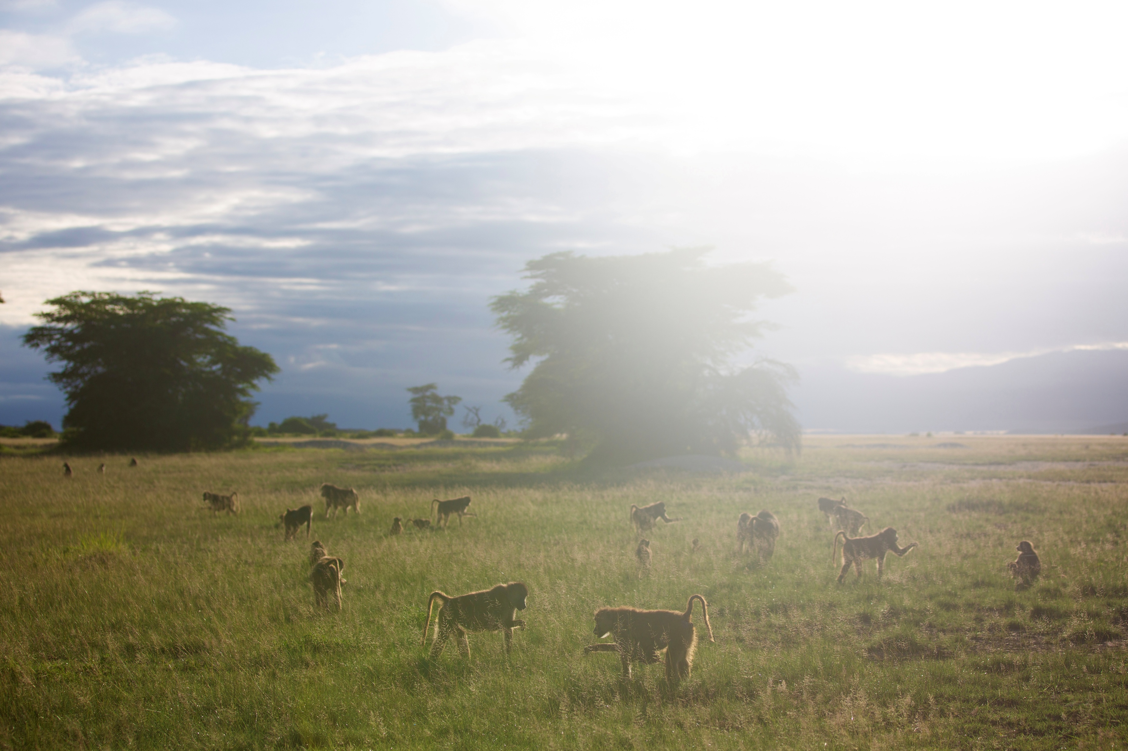
Drivers of extinction risk of social animals
Brian A. Lerch
William Burrad-Lucas
Brian Lerch

Slide 2
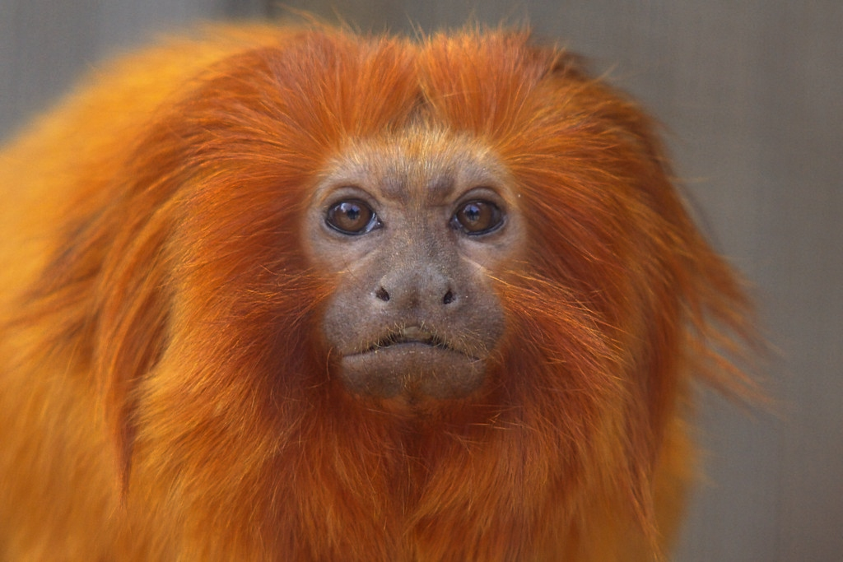
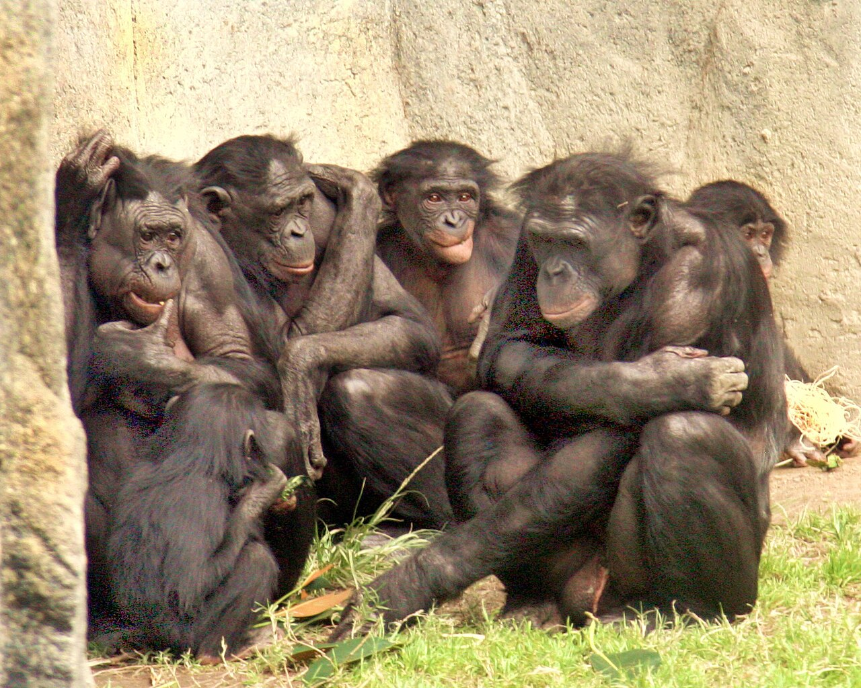
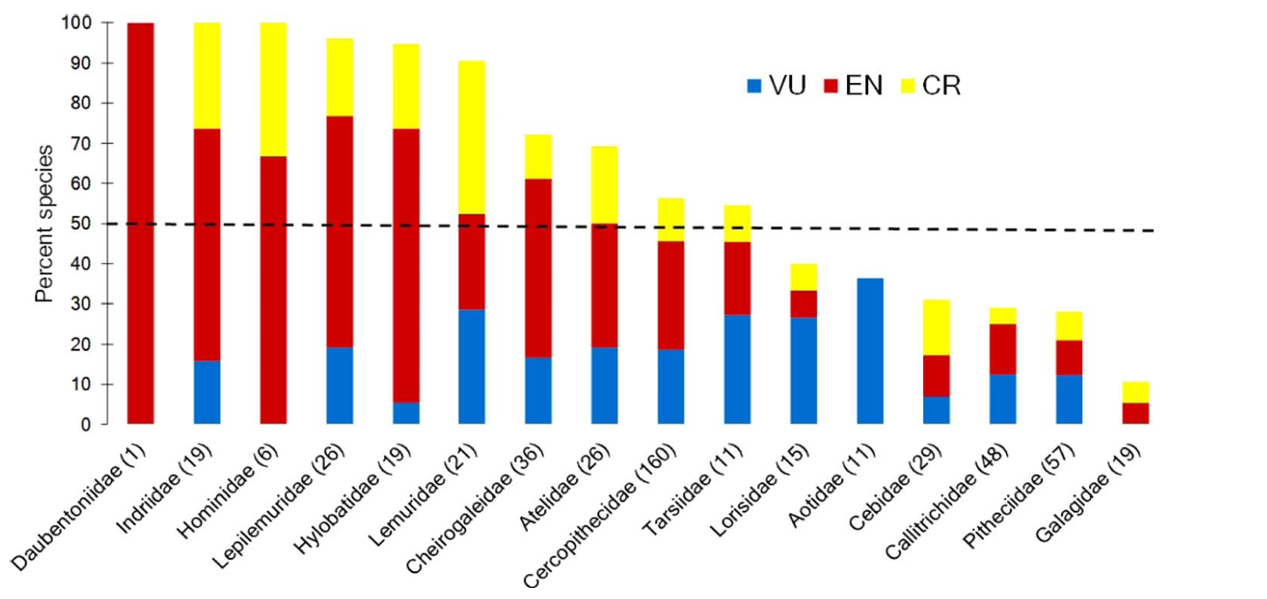
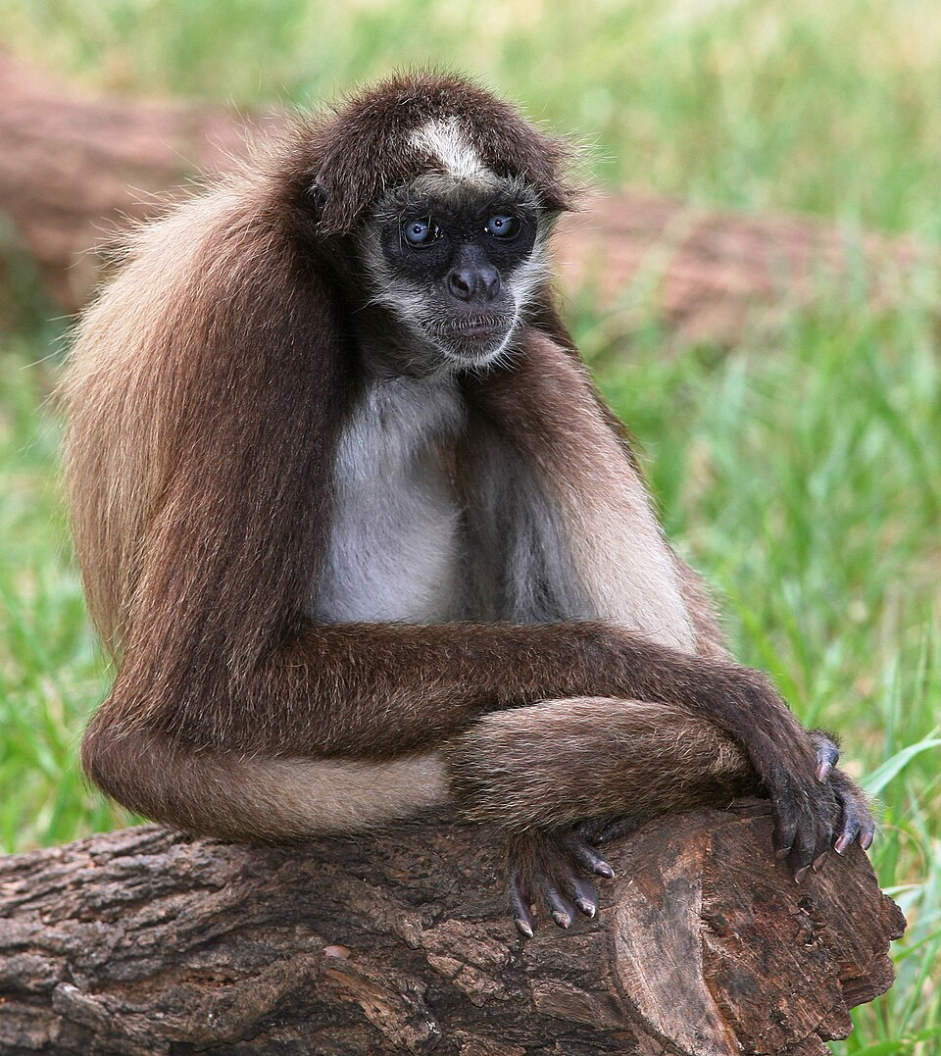
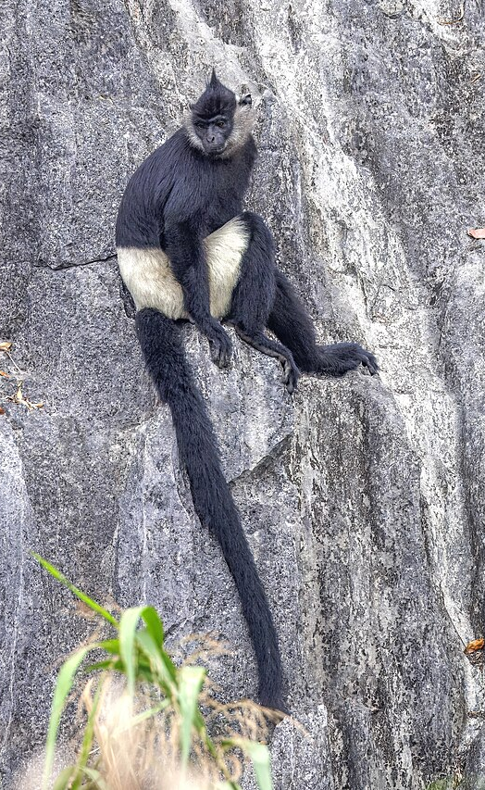
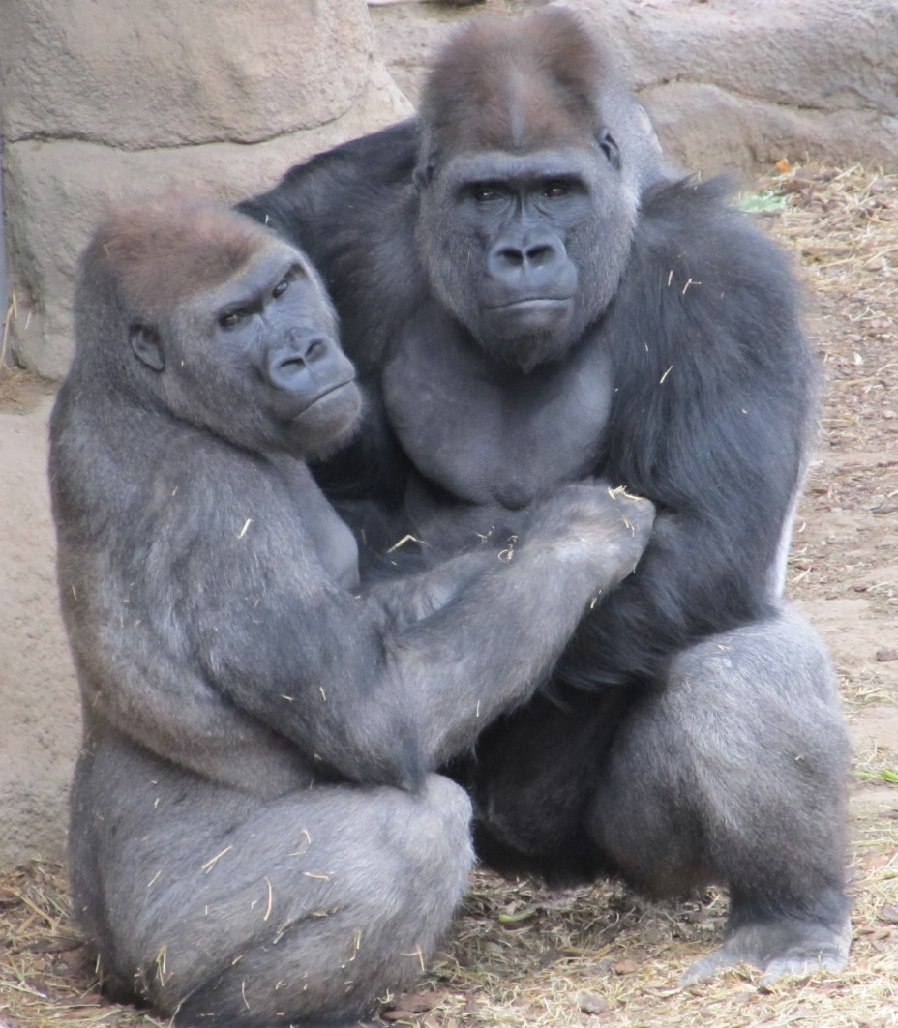
Why study extinction risk in social animals?
Many social animals are highly threatened with extinction
Su Neko
WCalvin
Primates: ~500 species
60% threatened
75% declining
Estrada et al. 2017
Tom Friedel
Charles Sharp

Slide 3
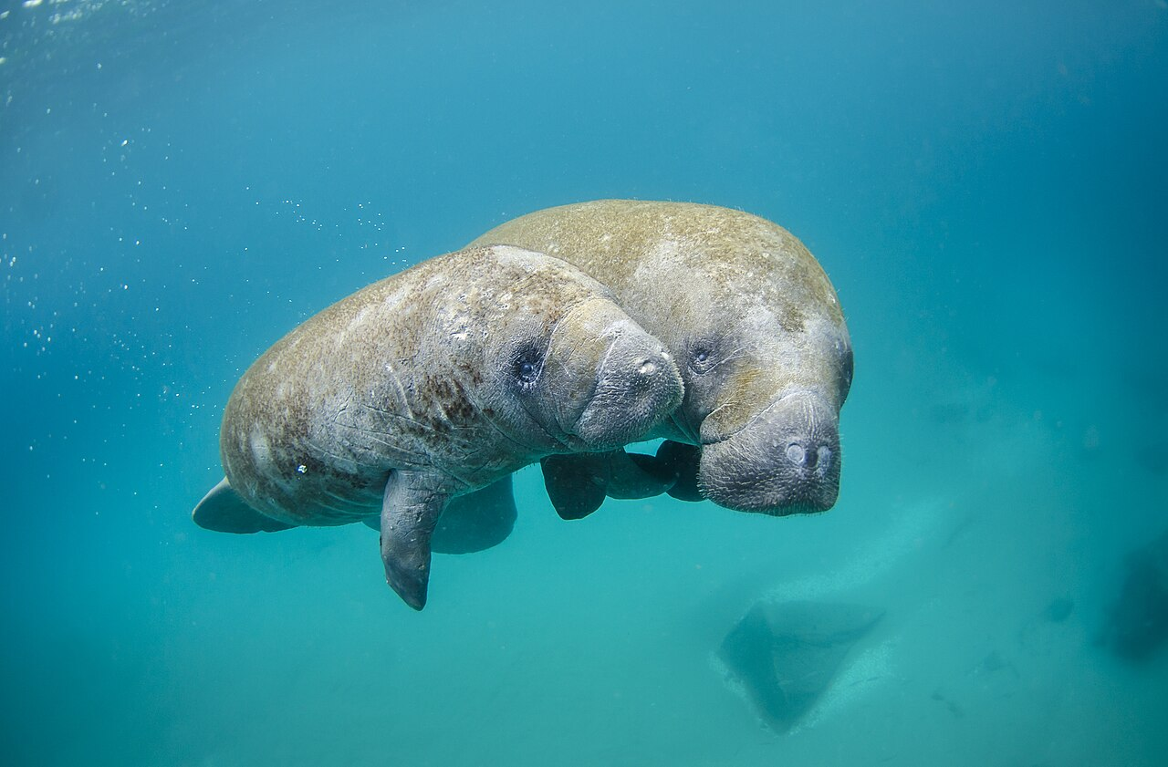
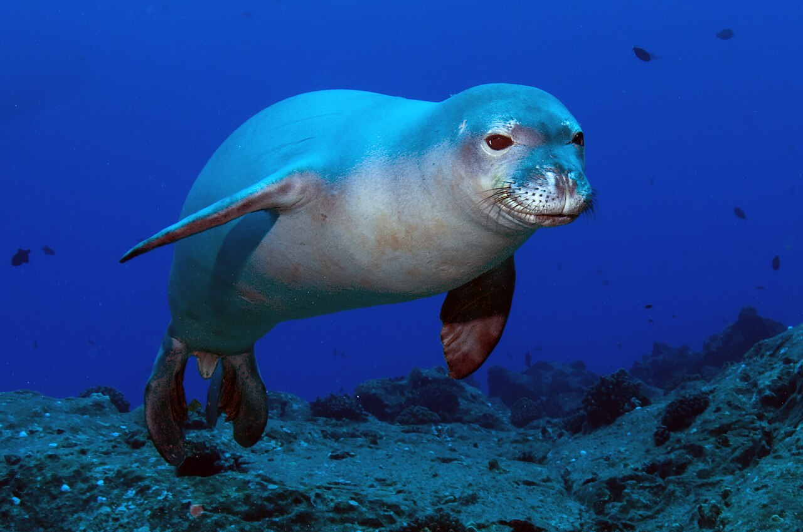
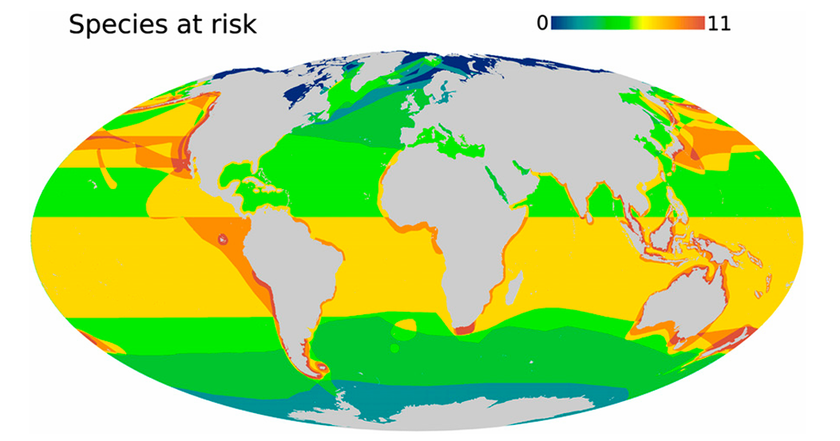
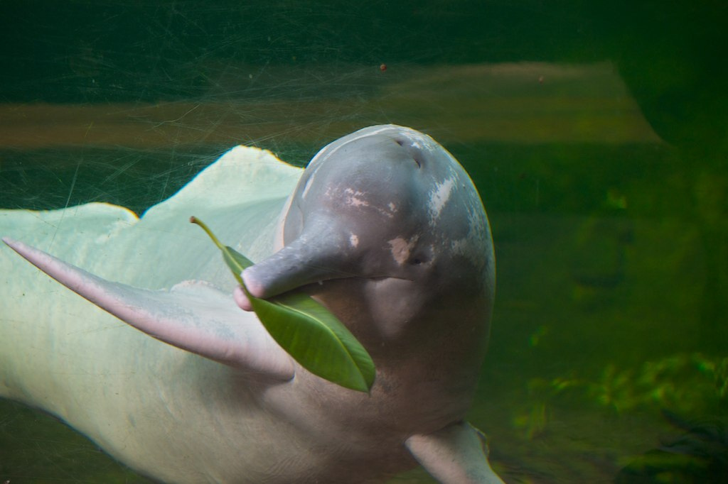
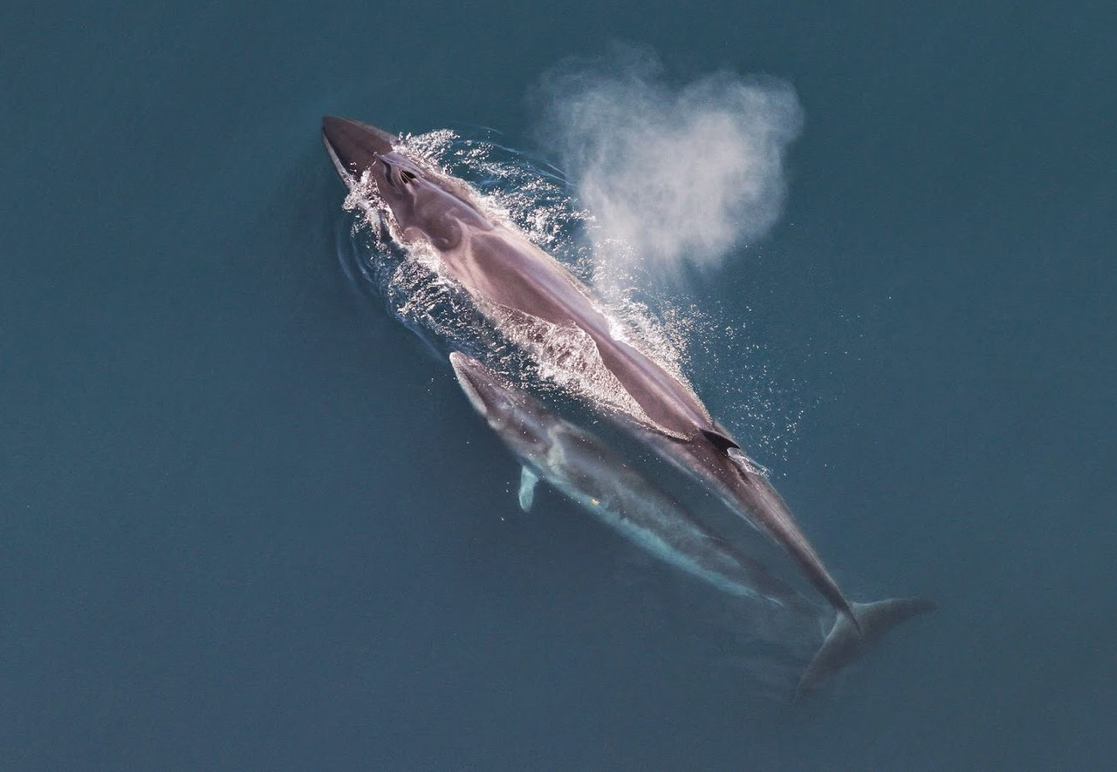
Why study extinction risk in social animals?
Many social animals are highly threatened with extinction
Sam Farkas
N3kt0n
Marine mammals: ~120 species
Cetaceans, pinnipeds, and sirenians
33% threatened
Davidson et al. 2012
Michelle Bender
Christin Khan

Slide 4
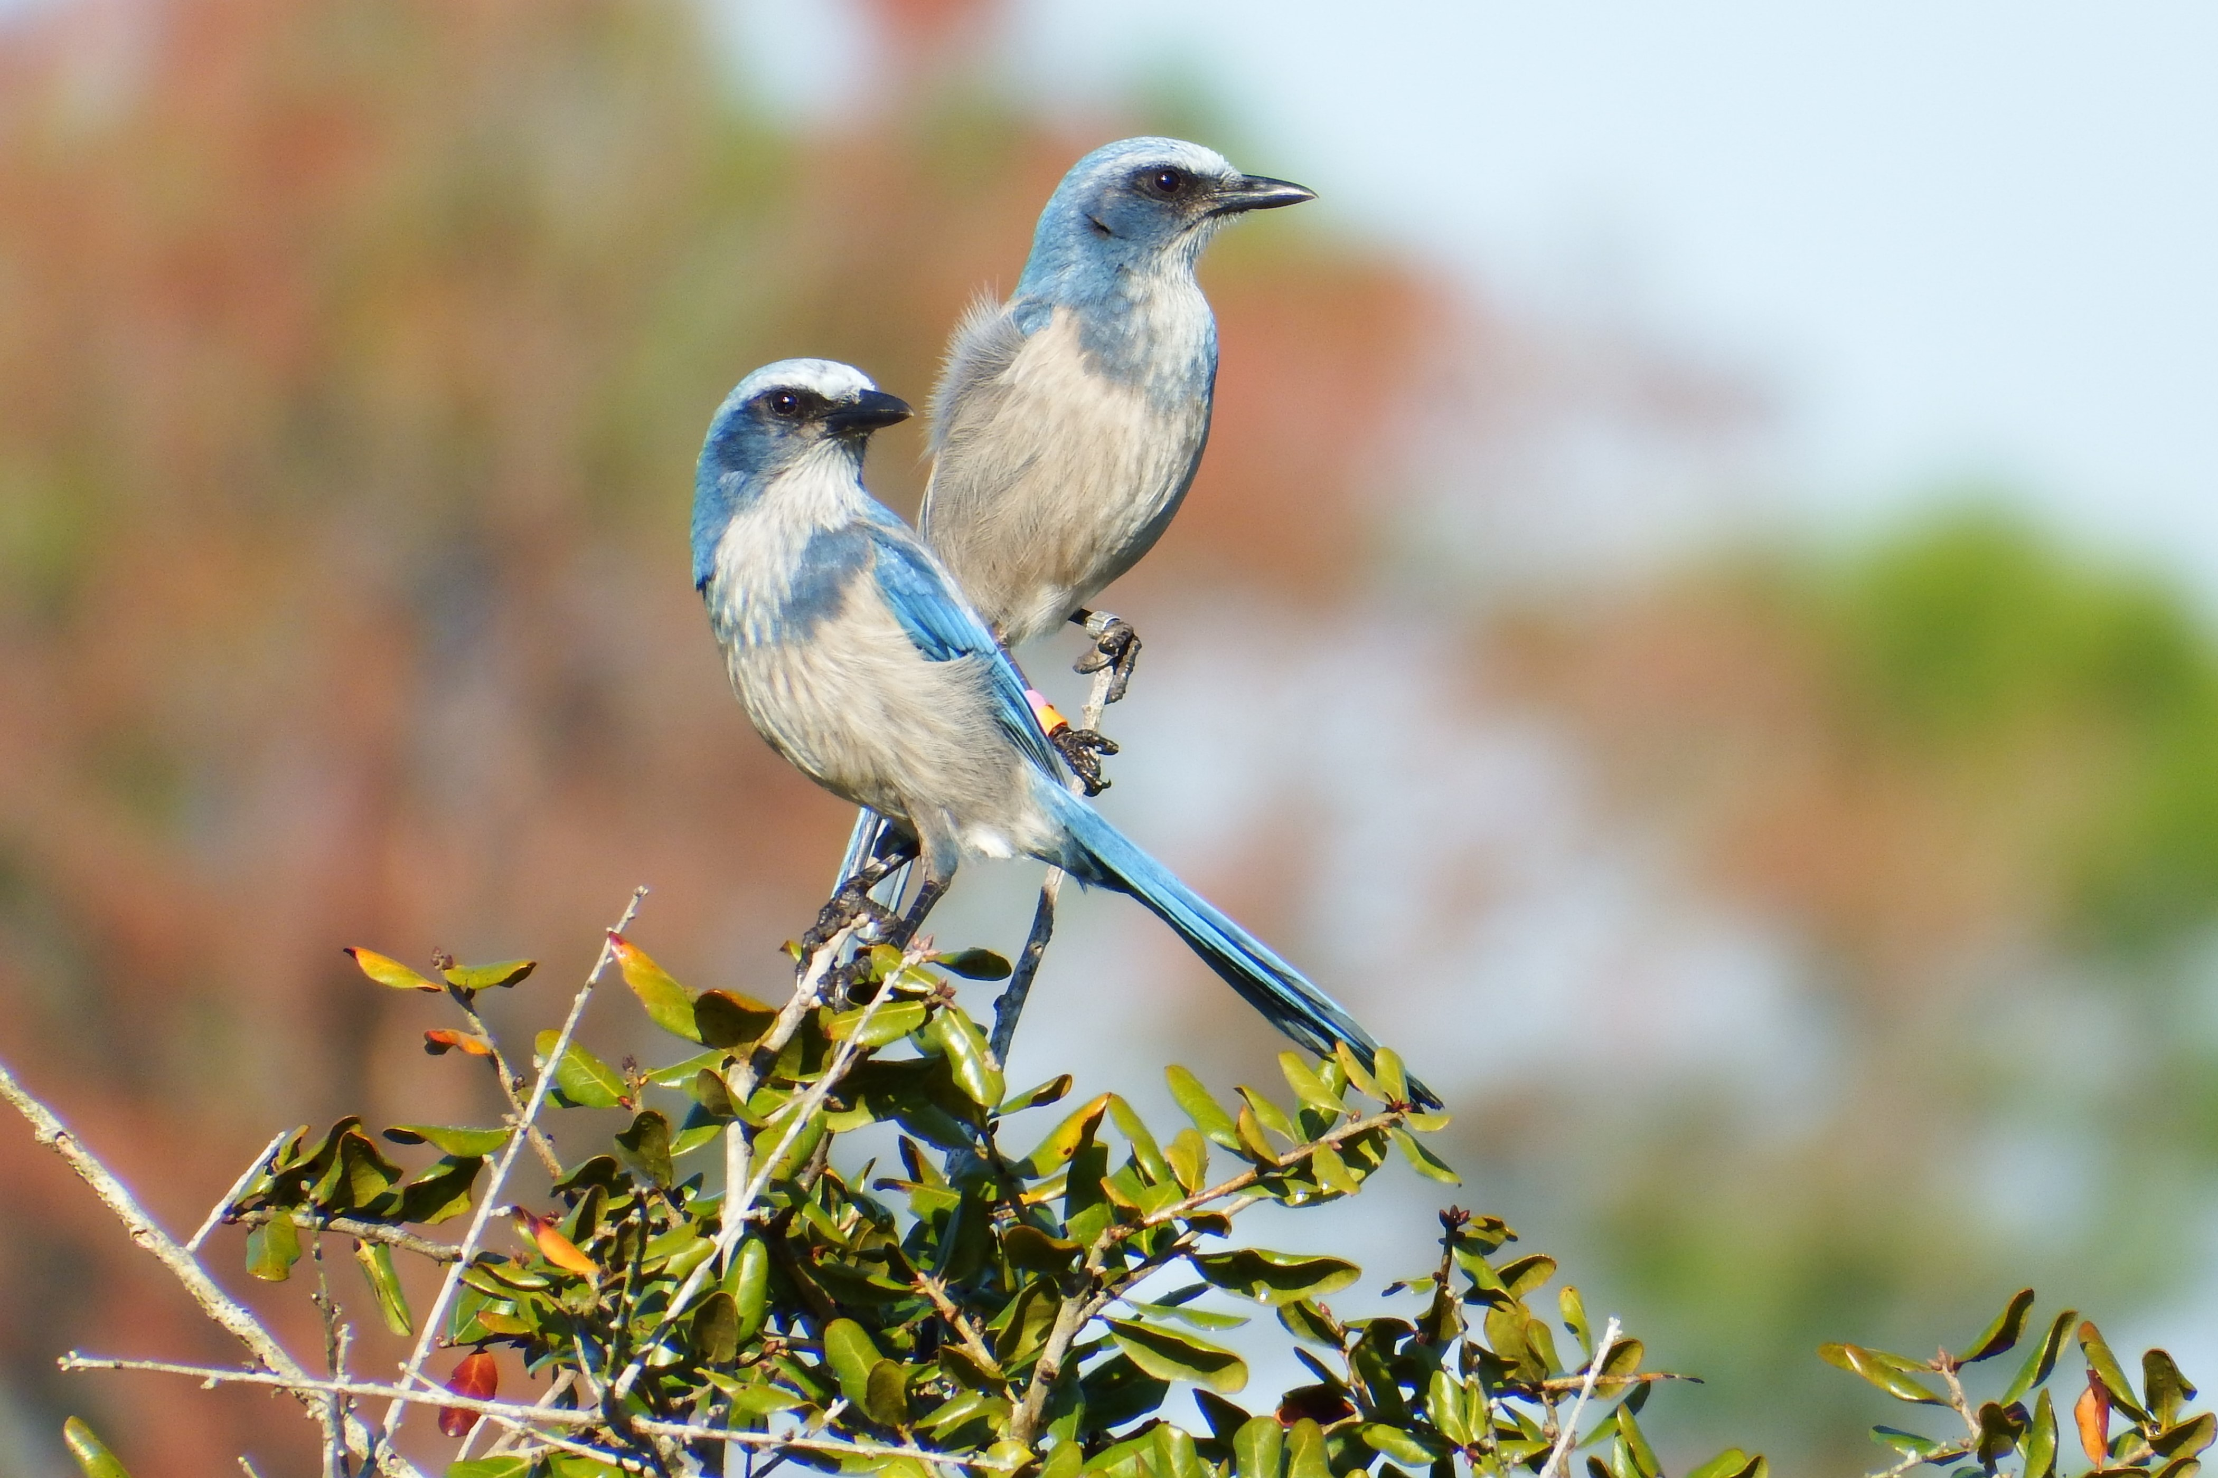
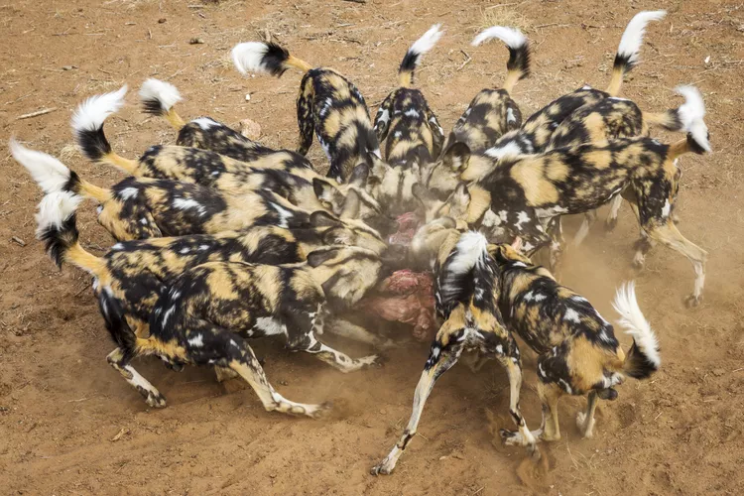
Why study extinction risk in social animals?
Many social animals are highly threatened with extinction
Social structure specifically linked to extinction risk
Lacy et al. 2024
Angulo et al. 2013
Young Ha Suh
Catherina Unger

Slide 5
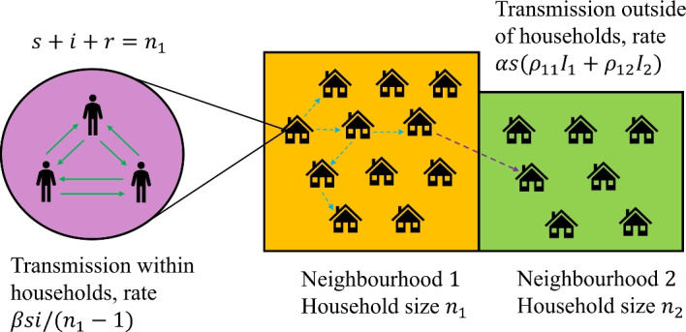
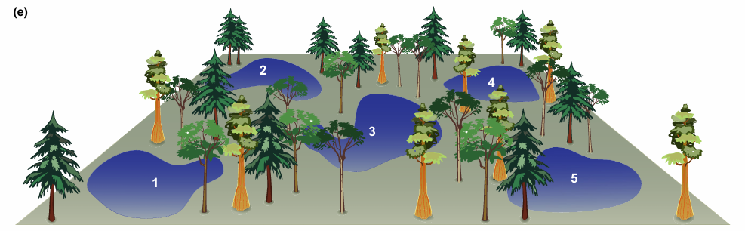
Why study extinction risk in social animals?
Many social animals are highly threatened with extinction
Social structure specifically linked to extinction risk
Population structures critically affect ecological dynamics
Metacommunity structure
Household structure
Thompson et al. 2020
Barlow et al. 2025

Slide 6
Why study extinction risk in social animals?
Many social animals are highly threatened
Social structure specifically linked to extinction risk
Population structures critically affect ecological dynamics
Social structure particularly unique
  Between-group processes
    Fission
    Fusion
    Between-group competition

Slide 7
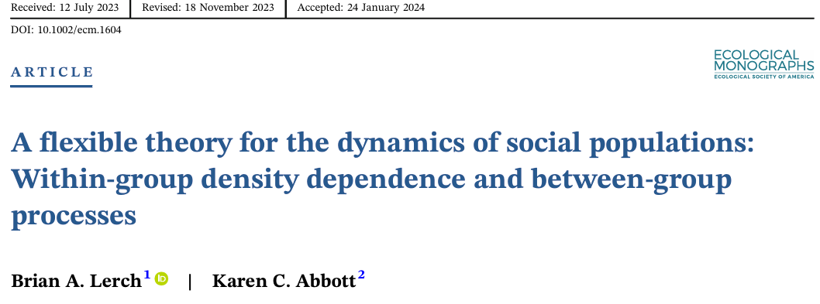
Modeling the dynamics of socially structured populations

Slide 8
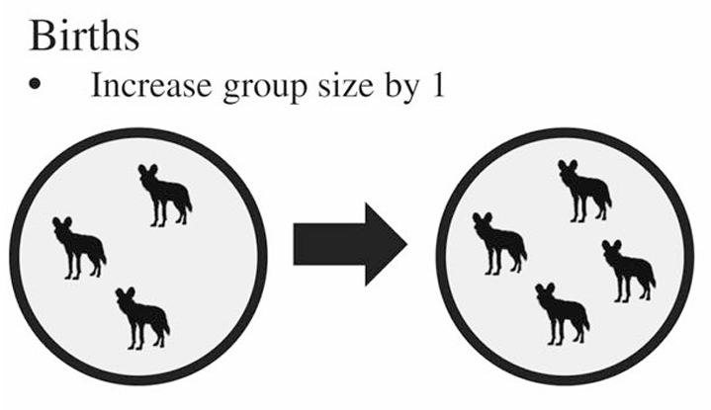
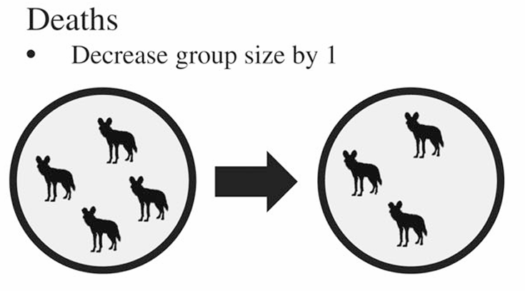
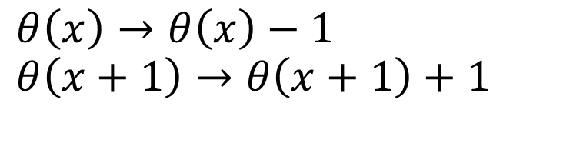
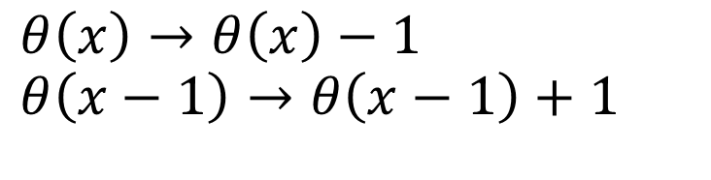
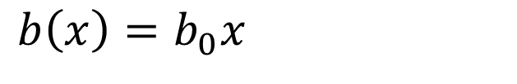
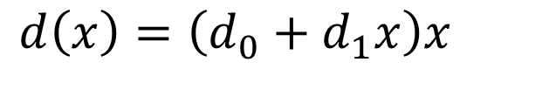
Within-group processes
Let x be the size of a given group and $θ\left(x\right)$ the number of groups of size x
$$b\left(x\right)=b_{0}x$$
$$d\left(x\right)=\left(d_{0}+d_{1}x\right)x$$
$$θ\left(x\right)→θ\left(x\right)−1$$
$$θ\left(x+1\right)→θ\left(x+1\right)+1$$
$$θ\left(x\right)→θ\left(x\right)−1$$
$$θ\left(x−1\right)→θ\left(x−1\right)+1$$
Lerch and Abbott 2024

Slide 9
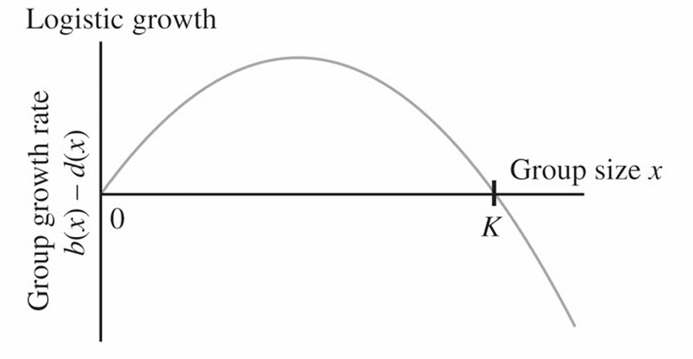
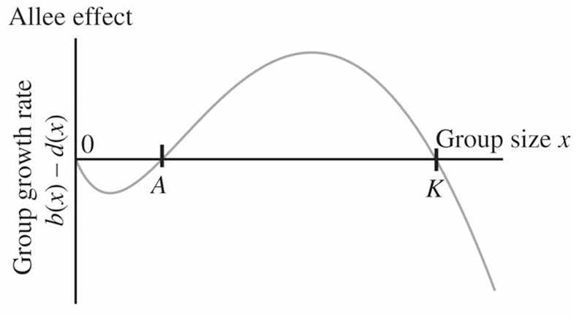
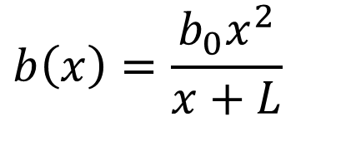
Within-group processes
$$b\left(x\right)=\frac{b_{0}x^{2}}{x+L}$$
Lerch and Abbott 2024

Slide 10
Intuition building:
Simulation results
Only within-group processes

Slide 11
Groups fluctuate around carrying capacity and go extinct due to demographic stochasticity

Slide 12
Since there is no process to return lost groups, the result at the population level is exponential decay
Lerch and Abbott 2024

Slide 13
Extinction risk: Role of initial population size
Lerch and Abbott 2024

Slide 14
Extinction risk: Role of initial population size
Lerch and Abbott 2024

Slide 15
Small populations with large groups less extinction prone than large populations with small groups
Lerch and Abbott 2024

Slide 16
Branching process theory provides an efficient method for studying extinction in this model

Slide 17

Using branching process theory
Probability population has gone extinct by time t starting with single group of size x (Kolmogorov Backwards Equations)
$$\frac{{ds}_{x}}{dt}=λ\left(x\right)\left[G_{x}\left(s_{1},s_{2},…,s_{x_{max}}\right)−s_{x}\right]$$
Rate of any event
Probability generating function

Slide 18
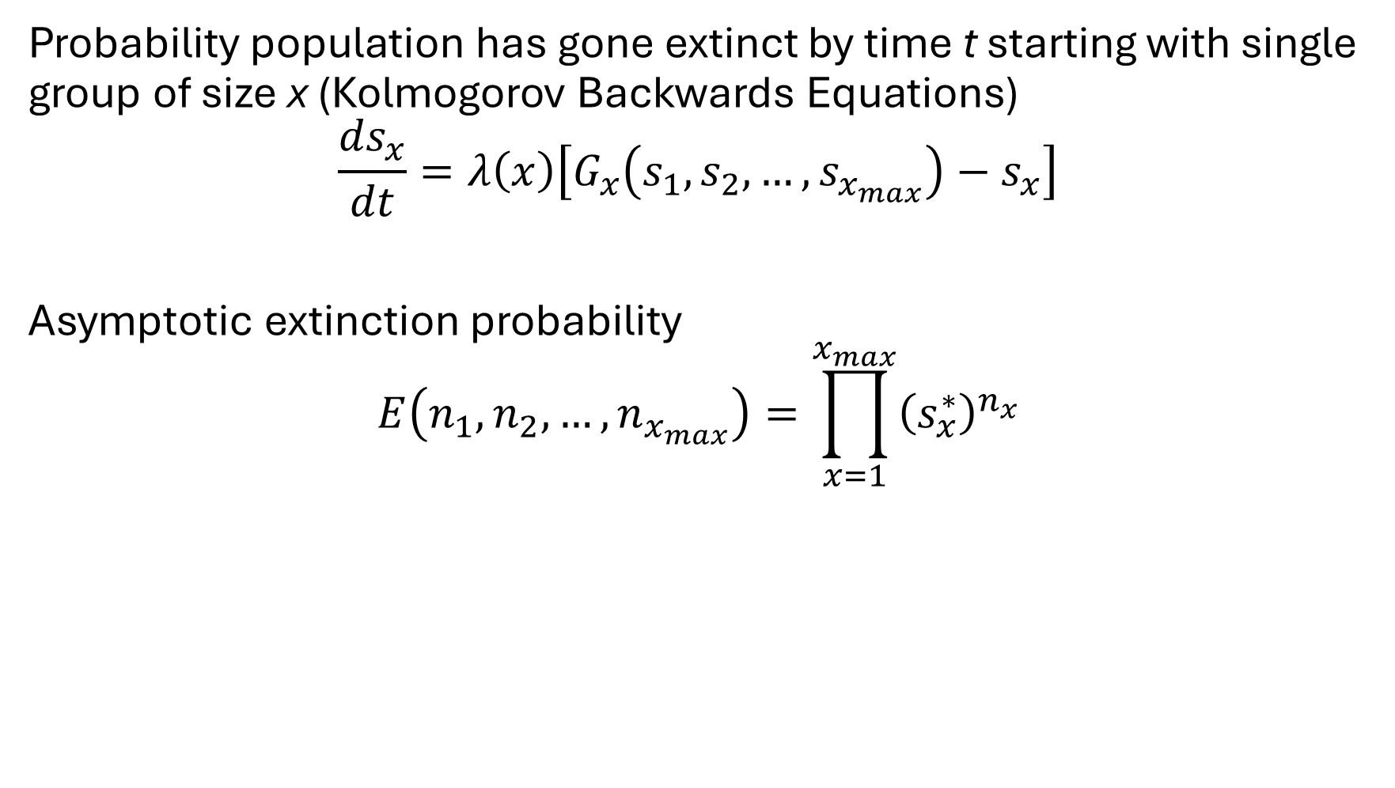
Using branching process theory
Probability population has gone extinct by time t starting with single group of size x (Kolmogorov Backwards Equations)
$$\frac{{ds}_{x}}{dt}=λ\left(x\right)\left[G_{x}\left(s_{1},s_{2},…,s_{x_{max}}\right)−s_{x}\right]$$
Asymptotic extinction probability
$$E\left(n_{1},n_{2},…,n_{x_{max}}\right)=\prod_{x=1}^{x_{max}}{{\left(s_{x}^{∗}\right)}^{n_{x}}}$$
Initial # size x groups

Slide 19
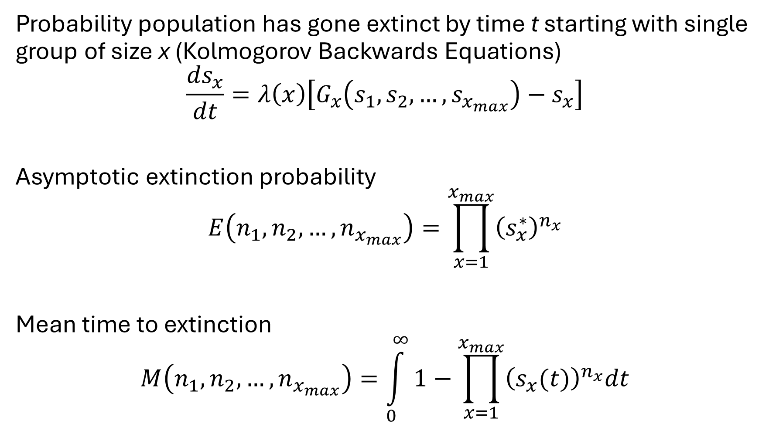
Using branching process theory
Probability population has gone extinct by time t starting with single group of size x (Kolmogorov Backwards Equations)
$$\frac{{ds}_{x}}{dt}=λ\left(x\right)\left[G_{x}\left(s_{1},s_{2},…,s_{x_{max}}\right)−s_{x}\right]$$
Asymptotic extinction probability
$$E\left(n_{1},n_{2},…,n_{x_{max}}\right)=\prod_{x=1}^{x_{max}}{{\left(s_{x}^{∗}\right)}^{n_{x}}}$$
Mean time to extinction
$$M\left(n_{1},n_{2},…,n_{x_{max}}\right)=\int_{0}^{∞}{1−\prod_{x=1}^{x_{max}}{{\left(s_{x}(t)\right)}^{n_{x}}dt}}$$

Slide 20
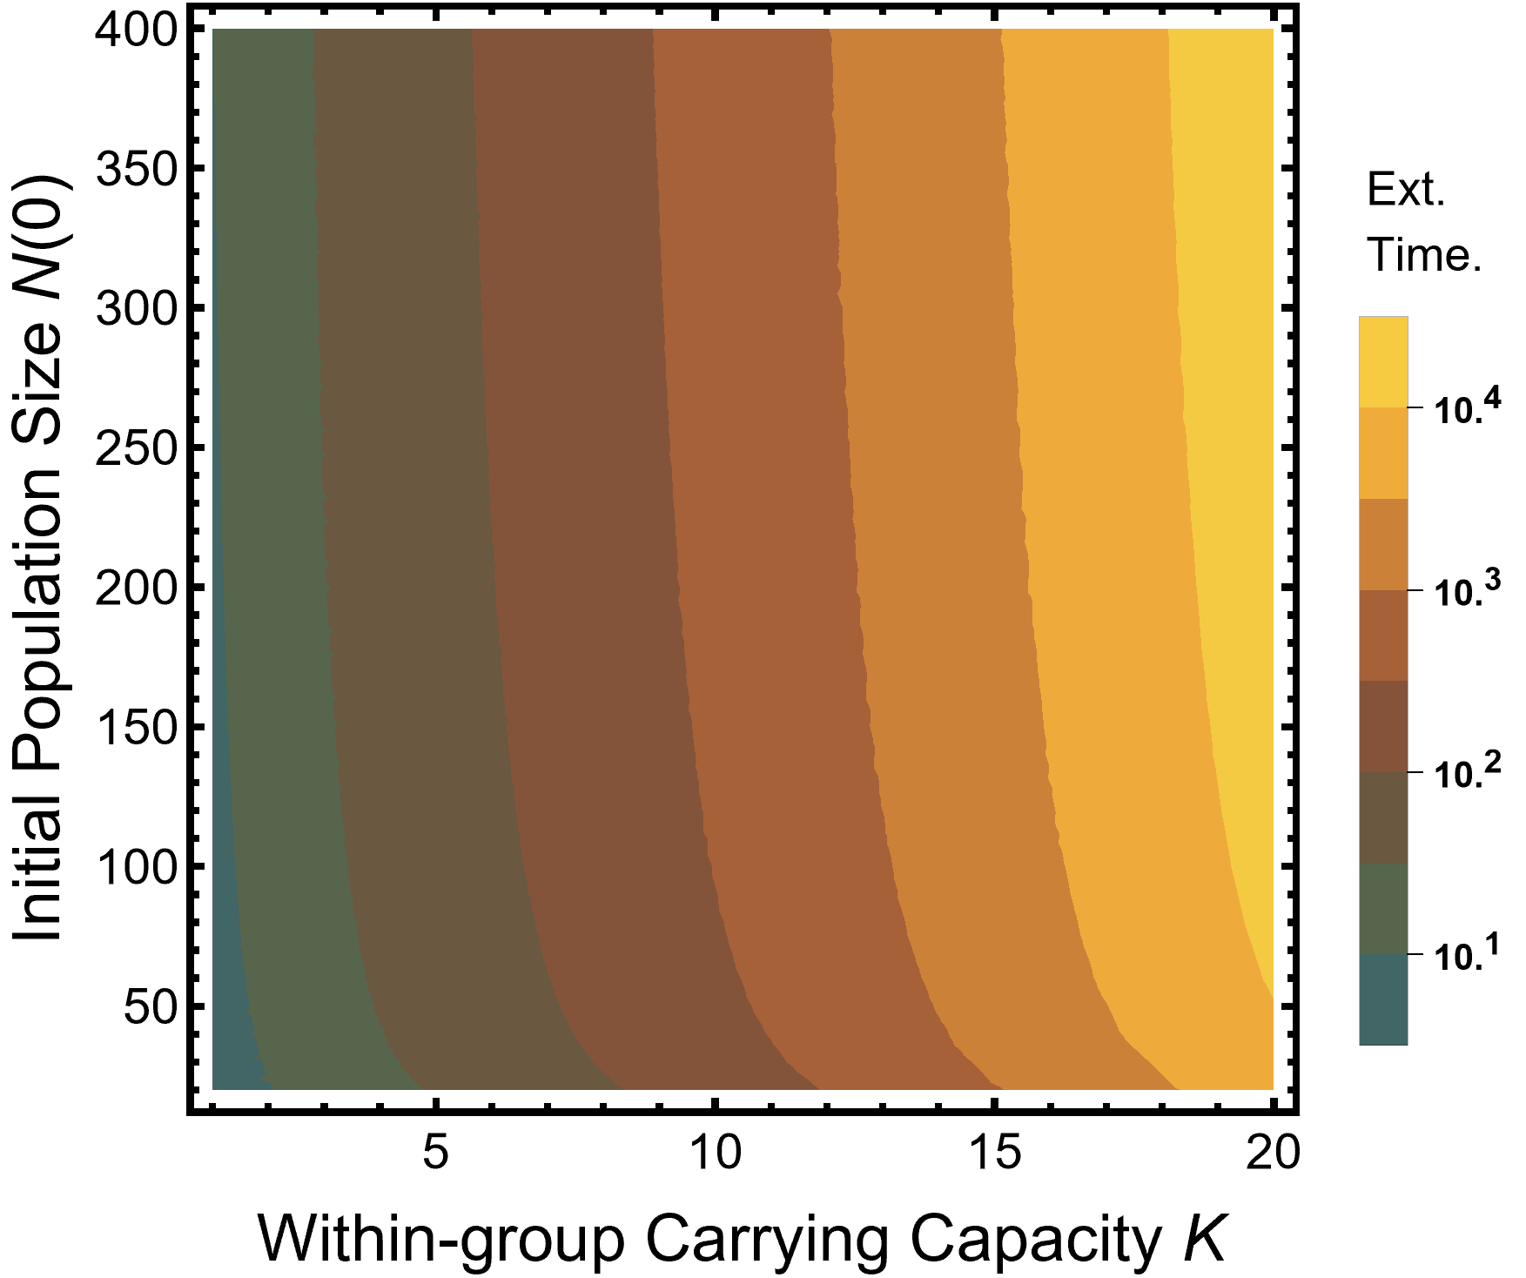
Lerch and Schreiber in prep

Slide 21
Group size more important than population size for extinction risk
Lerch and Schreiber in prep

Slide 22
But we’ve ignored the features of social populations that make them unique…
Extinction appears to be a considerable issue for social populations

Slide 23
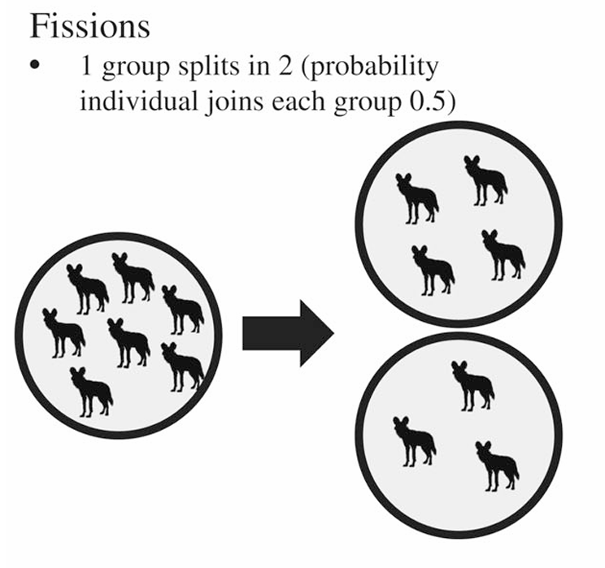
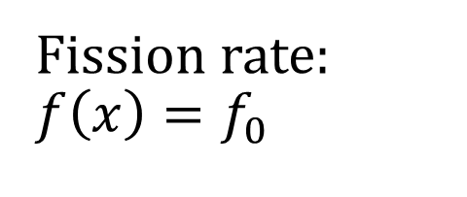

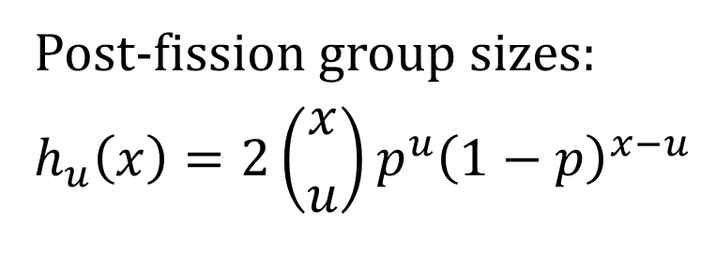
Between-group process
Fission rate:
$$f\left(x\right)=f_{0}$$
Post-fission group sizes:
$$h_{u}\left(x\right)=2\left({x \atop u}\right)p^{u}{\left(1−p\right)}^{x−u}$$
Rate fission creates group of size u:
$$φ\left(u\right)=\sum_{x=u}^{x_{max}}{h_{u}\left(x\right)f\left(x\right)θ(x)}$$
Simon 2010; Simon et al 2012
Lerch and Abbott 2024

Slide 24
Fissions uniquely provide means of population growth: small groups
Lerch and Abbott 2024

Slide 25
Fissions uniquely provide means of population growth: small groups
Lerch and Abbott 2024

Slide 26
Fissions uniquely provide means of population growth: small groups
Lerch and Abbott 2024

Slide 27
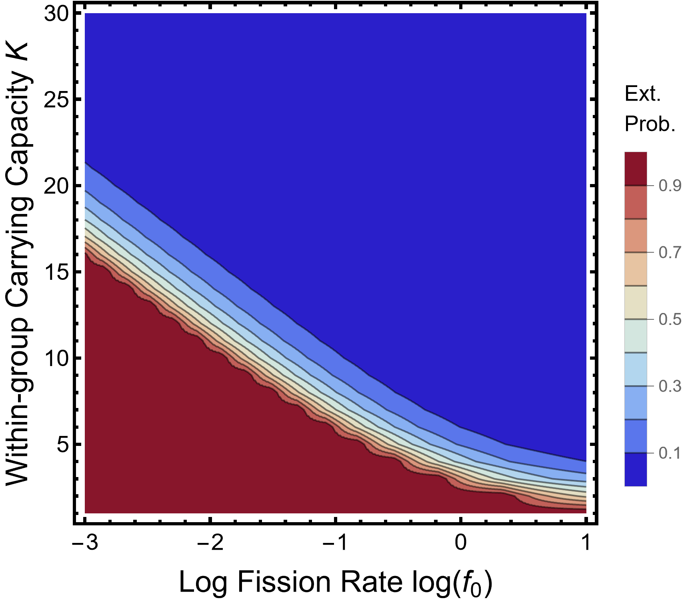
Large groups and frequent fissions lead to low extinction risk
Lerch and Schreiber in prep

Slide 28
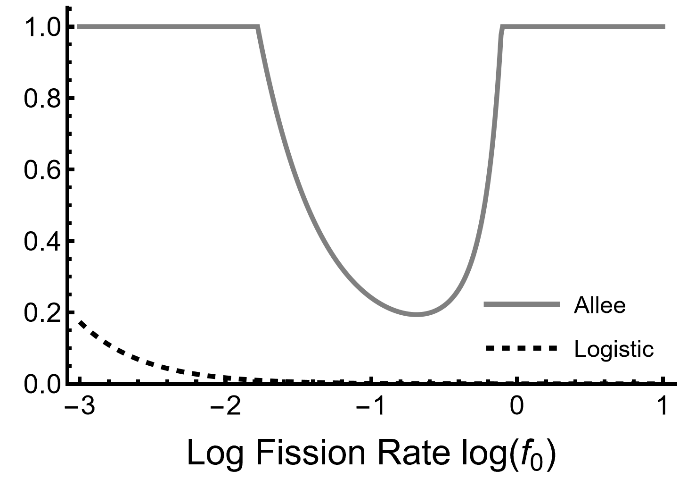
Fissions reduce extinction risk with logistic growth
Group fissions and population extinction
But have a non-monotonic effect with an Allee effect
Extinction Probability
The Allee case has much higher extinction risk
Lerch and Schreiber in prep

Slide 29
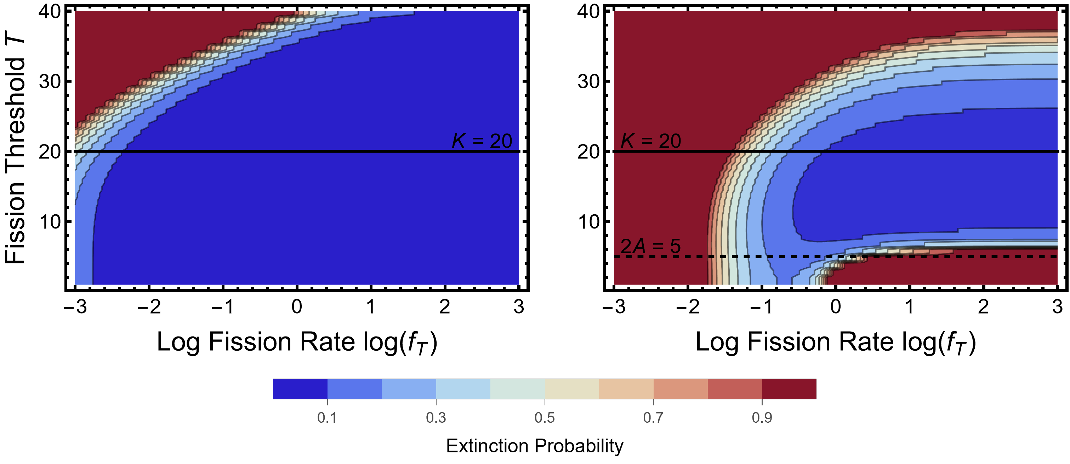
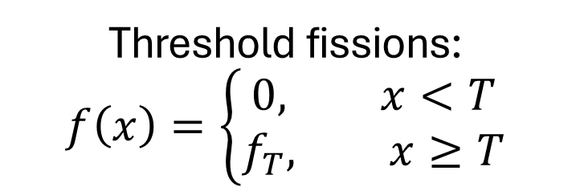
Threshold fissions:
$$f\left(x\right)=\left\{\begin{aligned}0, x<T \\ f_{T}, x≥T\end{aligned}\right.$$
Specific strategies for how and when to fission have large ecological implications
Logistic
Allee
Lerch and Schreiber in prep

Slide 30
Specific strategies for how and when to fission have large ecological implications
Logistic
Allee
Lerch and Schreiber in prep

Slide 31
Considering group fissions/ new group formation important step for conservation
Group size has been addressed in the literature

Slide 32
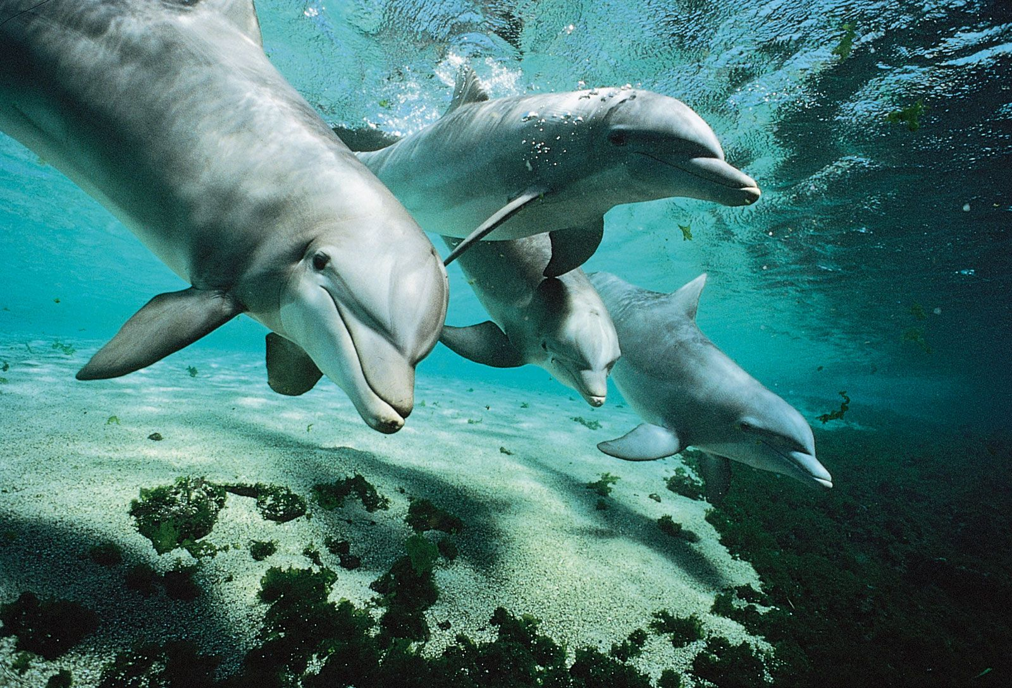
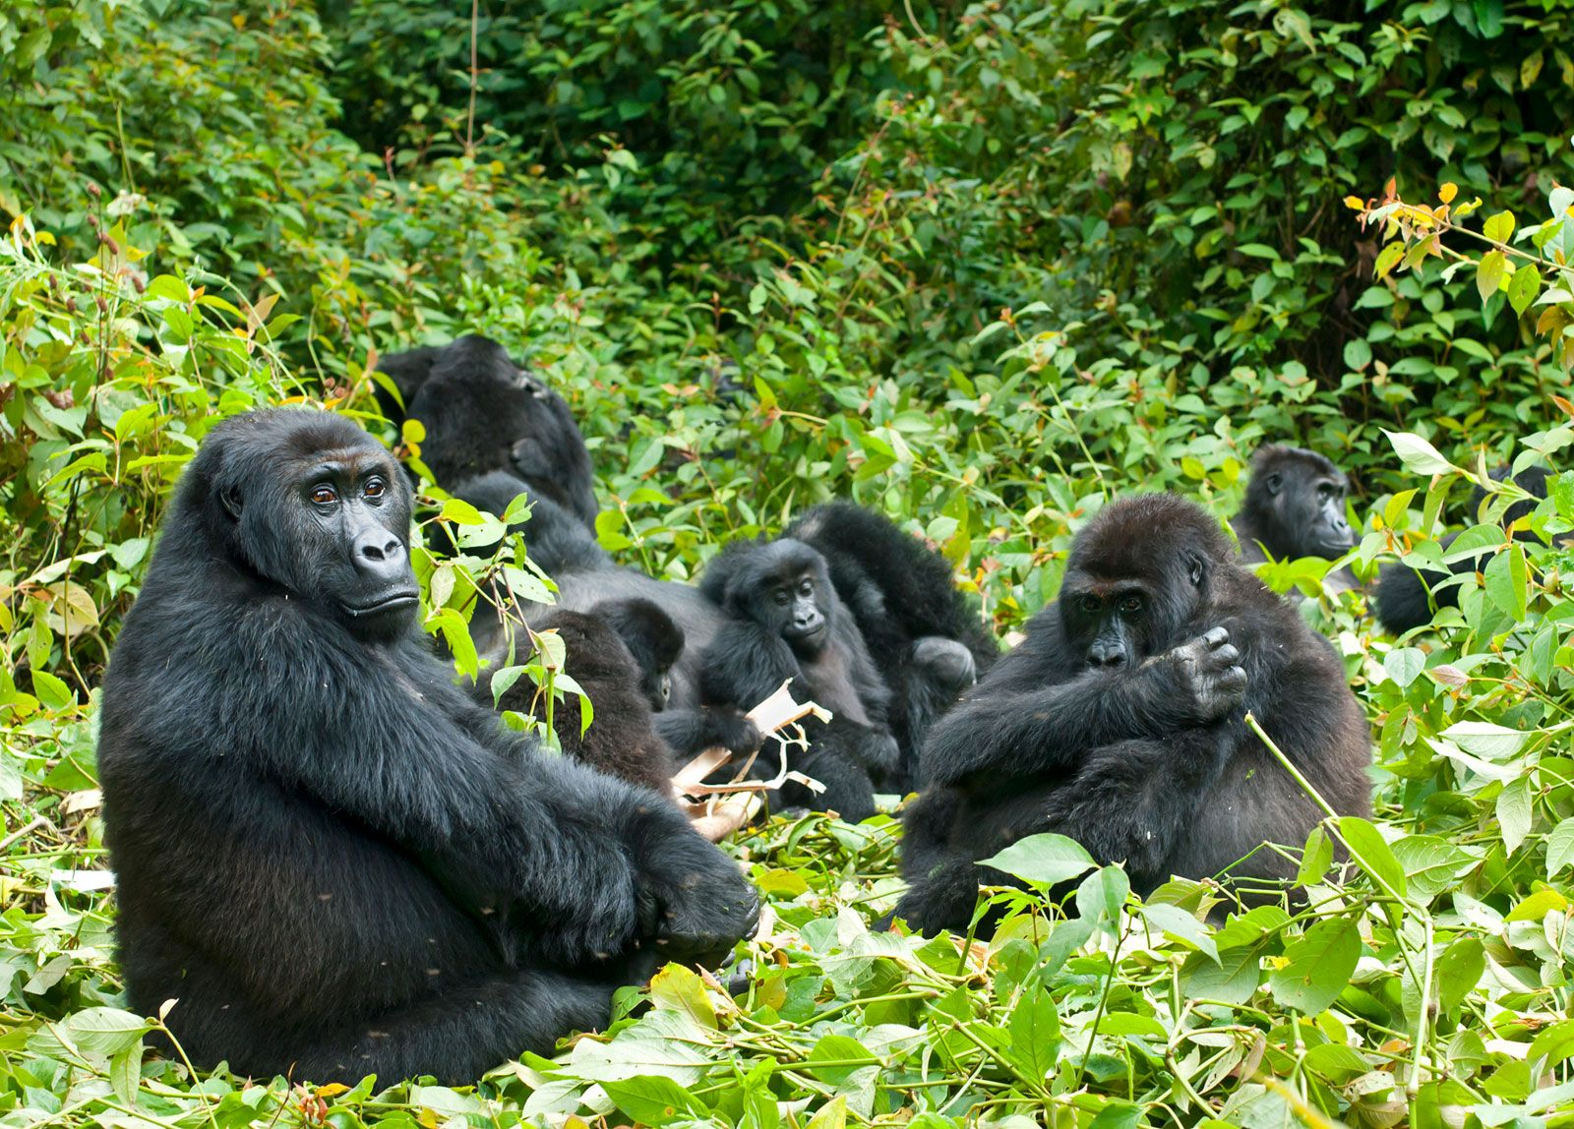
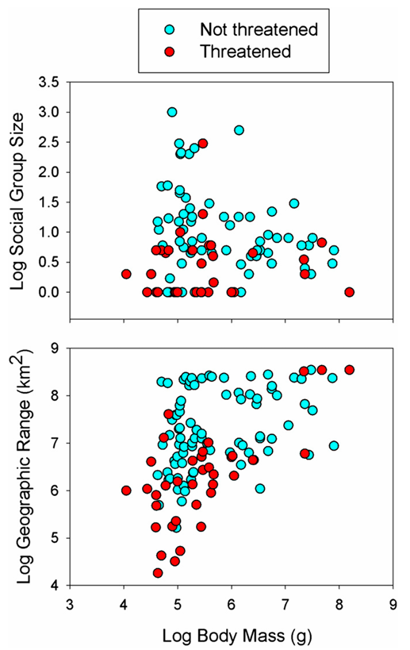
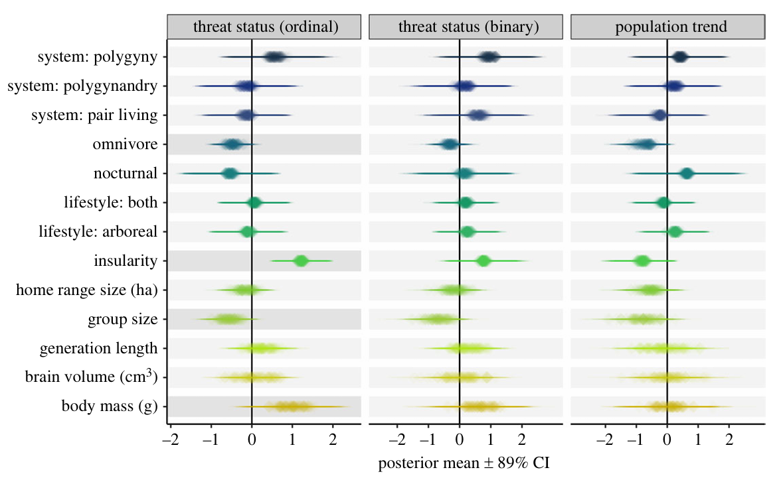
Empirical studies find that species with small group size are more extinction prone
Guenter Guni
Flip Nicklin
Creighton & Nunn 2023
Davidson et al. 2012

Slide 33
Reminiscent of the SLOSS debate
Is it better to have a single large or several small reserves?
Our results suggest SL > SS
SL > SS unless (Fahrig et al. 2022)
  Environmental/ species heterogeneity
  Frequent recolonization
Extinct groups cannot be recolonized

Slide 34




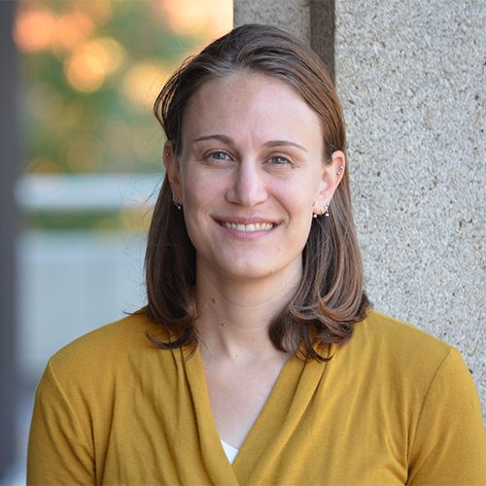
Thank you! Questions?
Co-authors:
Email: blerch25@gmail.com
Socials: @LerchEcoEvo
Webpage: https://lerchta.wixsite.com/lerch-eco-evo
Sebastian Schreiber
Karen Abbott

