Slide 1
Distributed Asynchronous Optimization Methods in Skywing
ICERM workshop on Asynchronous Methods for Numerical Linear Algebra
May 7, 2026
Wayne Mitchell
Center for Applied Scientific Computing (CASC)

Slide 2
Edge computing applications demand robust, decentralized, asynchronous algorithms
Decentralized, asynchronous control of distributed systems
Avoids a centralized single point of failure
Robust to individual agent failure
Robust to disruptions in communication
Algorithmic needs
Decentralized with direct access to only local information
Limited communication patterns (avoid all-to-one and all-to-all)
Robust to communication delays/information loss

Slide 3
Decompose global objective into a sum of local objectives for each distributed agent
Many distributed optimization algorithms require splitting the global objective of the optimization problem into local objectives
Local objectives can be calculated by individual agents without communicating
Curious about approaches when the objective is non-separable!

Slide 4
Linear least squares is naturally separable in row-partitioned form
Linear least squares: build a linear model given data matrix, A, and response vector, b
Distribute by partitioning the matrix by rows/equations/data points
Objective is now separable, coupled through a consensus constraint

Slide 5
Column-partitioned least squares does not immediately admit a separable objective
Distribute by partitioning the matrix by columns/features
All agents have a copy of the response vector, b

Slide 6
Use the normal equations to reformulate and change variables
First, regularize to avoid issues with rank of A
Reformulate via the normal equations
Solve for v = M⁻¹b and recover x=A^{T}v

Slide 7
Reformulated problem may now be cast as an optimization problem with separable objective
Obtain v = M⁻¹b by casting as an optimization problem
Note that the matrix, M, can be decomposed
This yields a separable objective
Distributed Ridge Regression with Feature Partitioning
Cristiano Gratton, Naveen K. D. Venkategowda, Reza Arablouei, Stefan Werner (2018)

Slide 8
There are many existing algorithms for solving distributed optimization problems
Some families of methods for distributed optimization
Gradient descent
Newton
Primal-dual (e.g. ADMM)

Slide 9
Gradient descent methods are popular, simple, and naturally robust to asynchrony
Gradient descent (GD) is simple: just follow the (partial) gradient!
Stochastic gradient descent (SGD):
Select random subsets of the data to calculate the gradient
Trivially parallelizable (in the shared-memory context)
Naturally robust to asynchrony: SGD uses noisy, inexact gradients anyway… so stale gradients are fine

Slide 10
Decentralized, asynchronous gradient descent requires some extra care
Typical distributed strategies for gradient descent involve either synchronous allreduces or centralized parameter server
We want an asynchronous and decentralized implementation
…

Slide 11
Averaging solution values in agent neighborhoods yields decentralized convergence
Decentralized and asynchronous GD can be achieved via:
Fixed point may be away from the exact optimum if local gradients don’t vanish
Would like to somehow capture global gradient information
(update with local gradient)
(send/recv updates to/from neighbors)
(average over agent neighborhood)
Asynchronous Decentralized Parallel Stochastic Gradient Descent
Xiangru Lian, Wei Zhang, Ce Zhang, and Ji Liu (2018)

Slide 12
Push-sum gossip algorithms can provide decentralized, asynchronous averaging
Auxiliary cumulative variables ensure conservation of mass
Achieving Linear Convergence in Distributed Asynchronous Multiagent Optimization
Ye Tian, Ying Sun, Gesualdo Scutari (2020)

Slide 13
ASY-SONATA uses asynchronous push-sum to track the average gradient across agents
All agents converge to the global optimum
Convergence is linear for strongly convex objectives
Achieving Linear Convergence in Distributed Asynchronous Multiagent Optimization
Ye Tian, Ying Sun, Gesualdo Scutari (2020)

Slide 14
Alternating Direction Method of Multipliers (ADMM) is a different approach utilizing the dual
Split the primal variables into x and y
Introduce dual variables, z, and form the augmented Lagrangian
Alternately solve for the primal and dual variables

Slide 15
Formulate decentralized optimization in terms of equality constraints and apply ADMM
Introduce bridge variables, y_{ij}, as equality constraints
Introduce dual variables, z_{ij}, for each constraint
Can simplify and eliminate primal y_{ij} variables

Slide 16
An alternate derivation of ADMM via operator theory shows that it is robust to asynchrony
Krasnoselskii-Mann (KM) iteration to find a fixed point of non-expansive operator, T
Randomized, asynchronous coordinate updates for the above produce a convergent iteration
ARock: An Algorithmic Framework for Asynchronous Parallel Coordinate Updates
Zhimin Peng, Yangyang Xu, Ming Yan, Wotao Yin (2016)

Slide 17
An alternate derivation of ADMM via operator theory shows that it is robust to asynchrony
Can solve optimization problems via Peaceman-Rachford splitting (PRS): a KM iteration with the Peaceman-Rachford operator
T_{PR} is non-expansive, so PRS is robust to asynchrony
ADMM is equivalent to PRS applied to the dual
Linear convergence for strongly convex objectives
Asynchronous Distributed Optimization Over Lossy Networks via Relaxed ADMM: Stability
and Linear Convergence. Nicola Bastianello, Ruggero Carli, Luca Schenato, Marco Todescato (2021)

Slide 18
Test and compare SONATA and ADMM with different parameters and problem settings
Test the effect of parameter choices for each algorithm
Compare SONATA vs. ADMM modifying:
Number of agents
Matrix condition number
Communication topology
Asynchronous setting
Default problem setup:
Random 32x32 matrix (no regularization) with condition number 2.0
8 agents
Fully connected communication topology

Slide 19
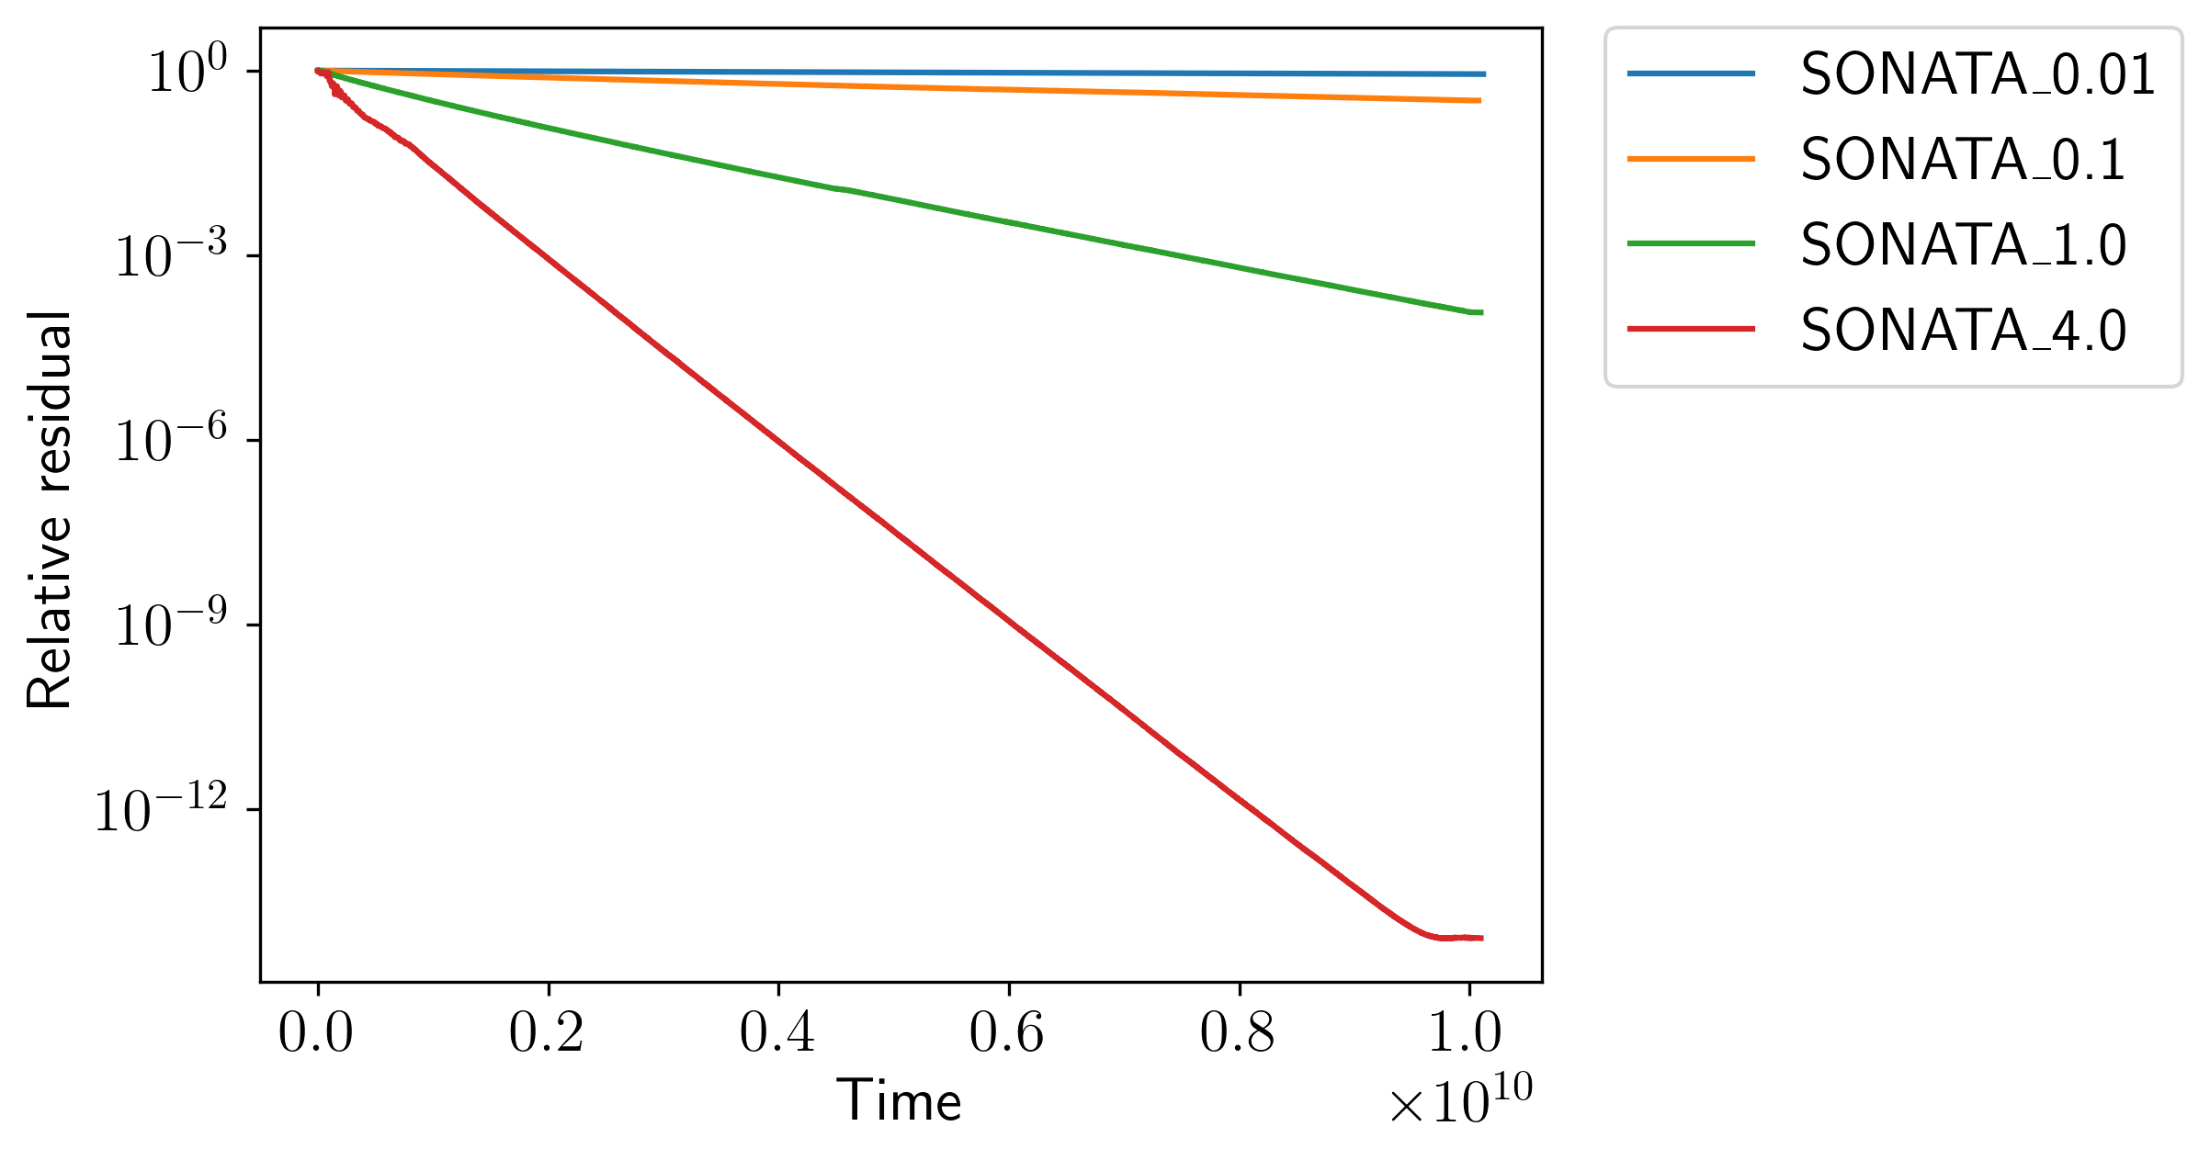
Choosing an appropriate step size, 𝛾, is crucial for achieving fast SONATA convergence
Want to choose the highest learning rate without diverging
Choice depends on problem, condition, number of agents, etc.
Modify 𝛾

Slide 20
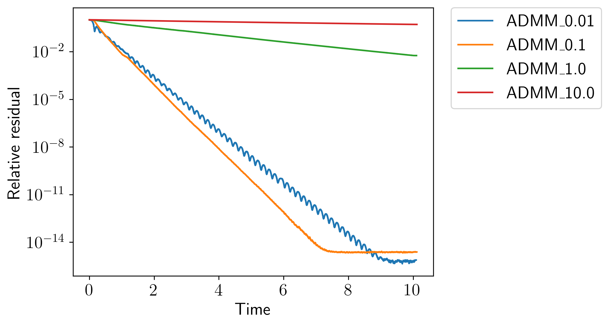
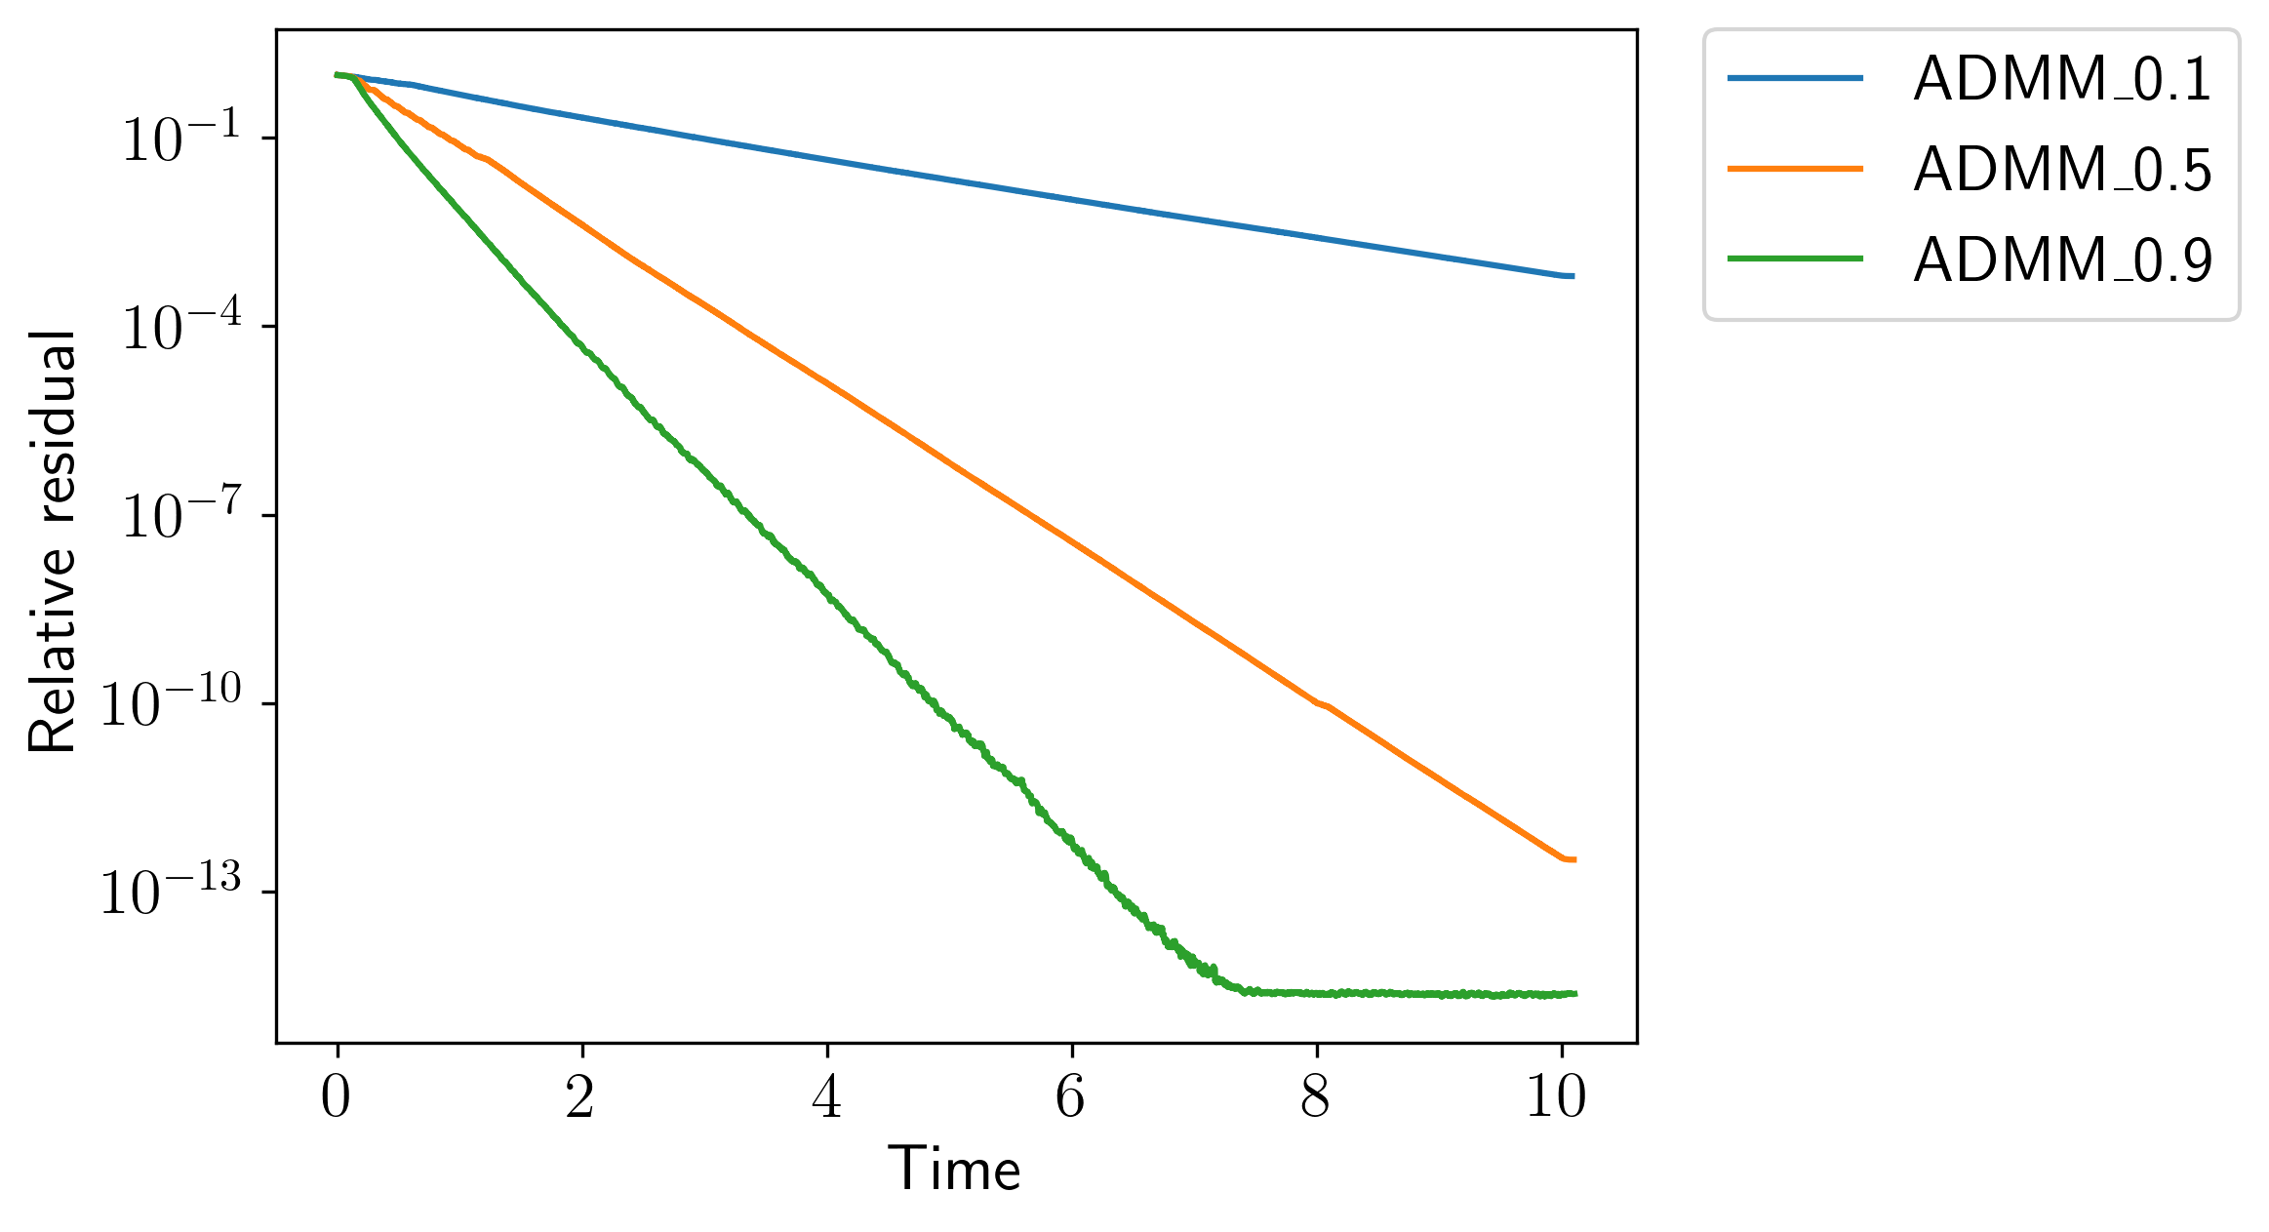
Choosing an appropriate penalty, 𝜌, and over-relaxation, ⍺, is crucial for ADMM convergence
Penalty, 𝜌, balances primal and dual terms in augmented Lagrangian
Over-relaxation, ⍺, is similar to a step-size (usually larger is better)
Modify 𝜌
Modify ⍺
Notes:
Alpha = 0.9

Slide 21
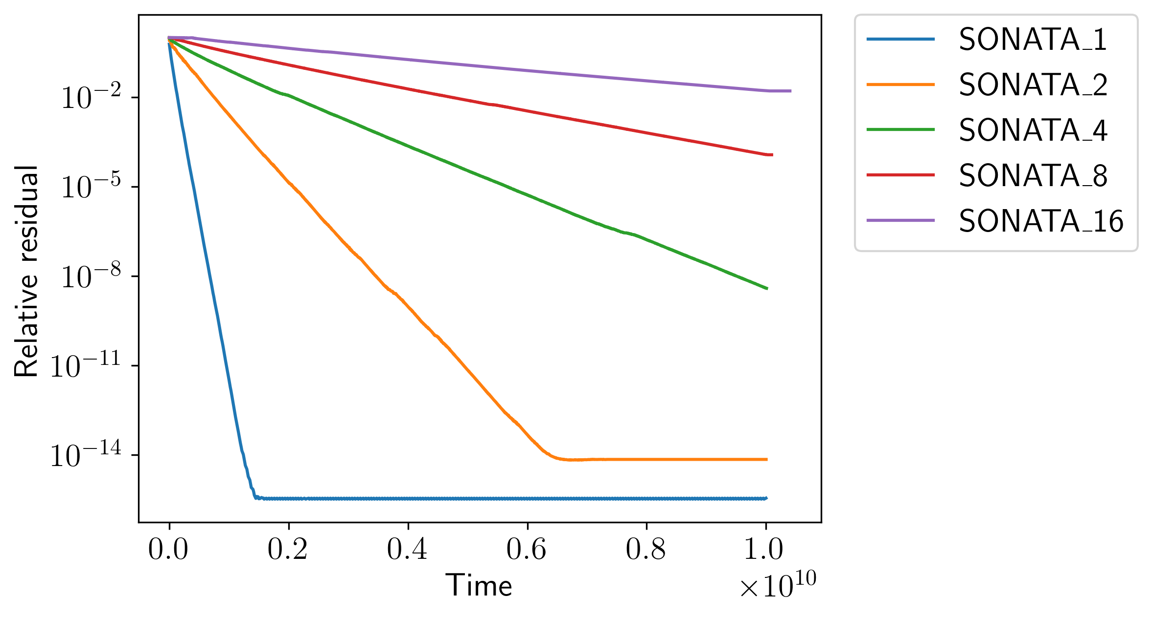
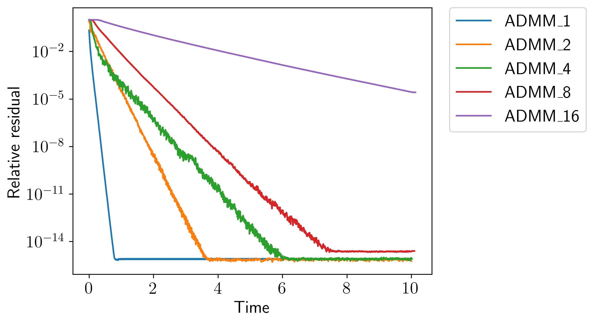
SONATA and ADMM convergence both degrade with increasing number of agents
ADMM is generally better as we scale the number of agents
Can improve ADMM 16 agent run somewhat by adjusting penalty
SONATA
ADMM

Slide 22
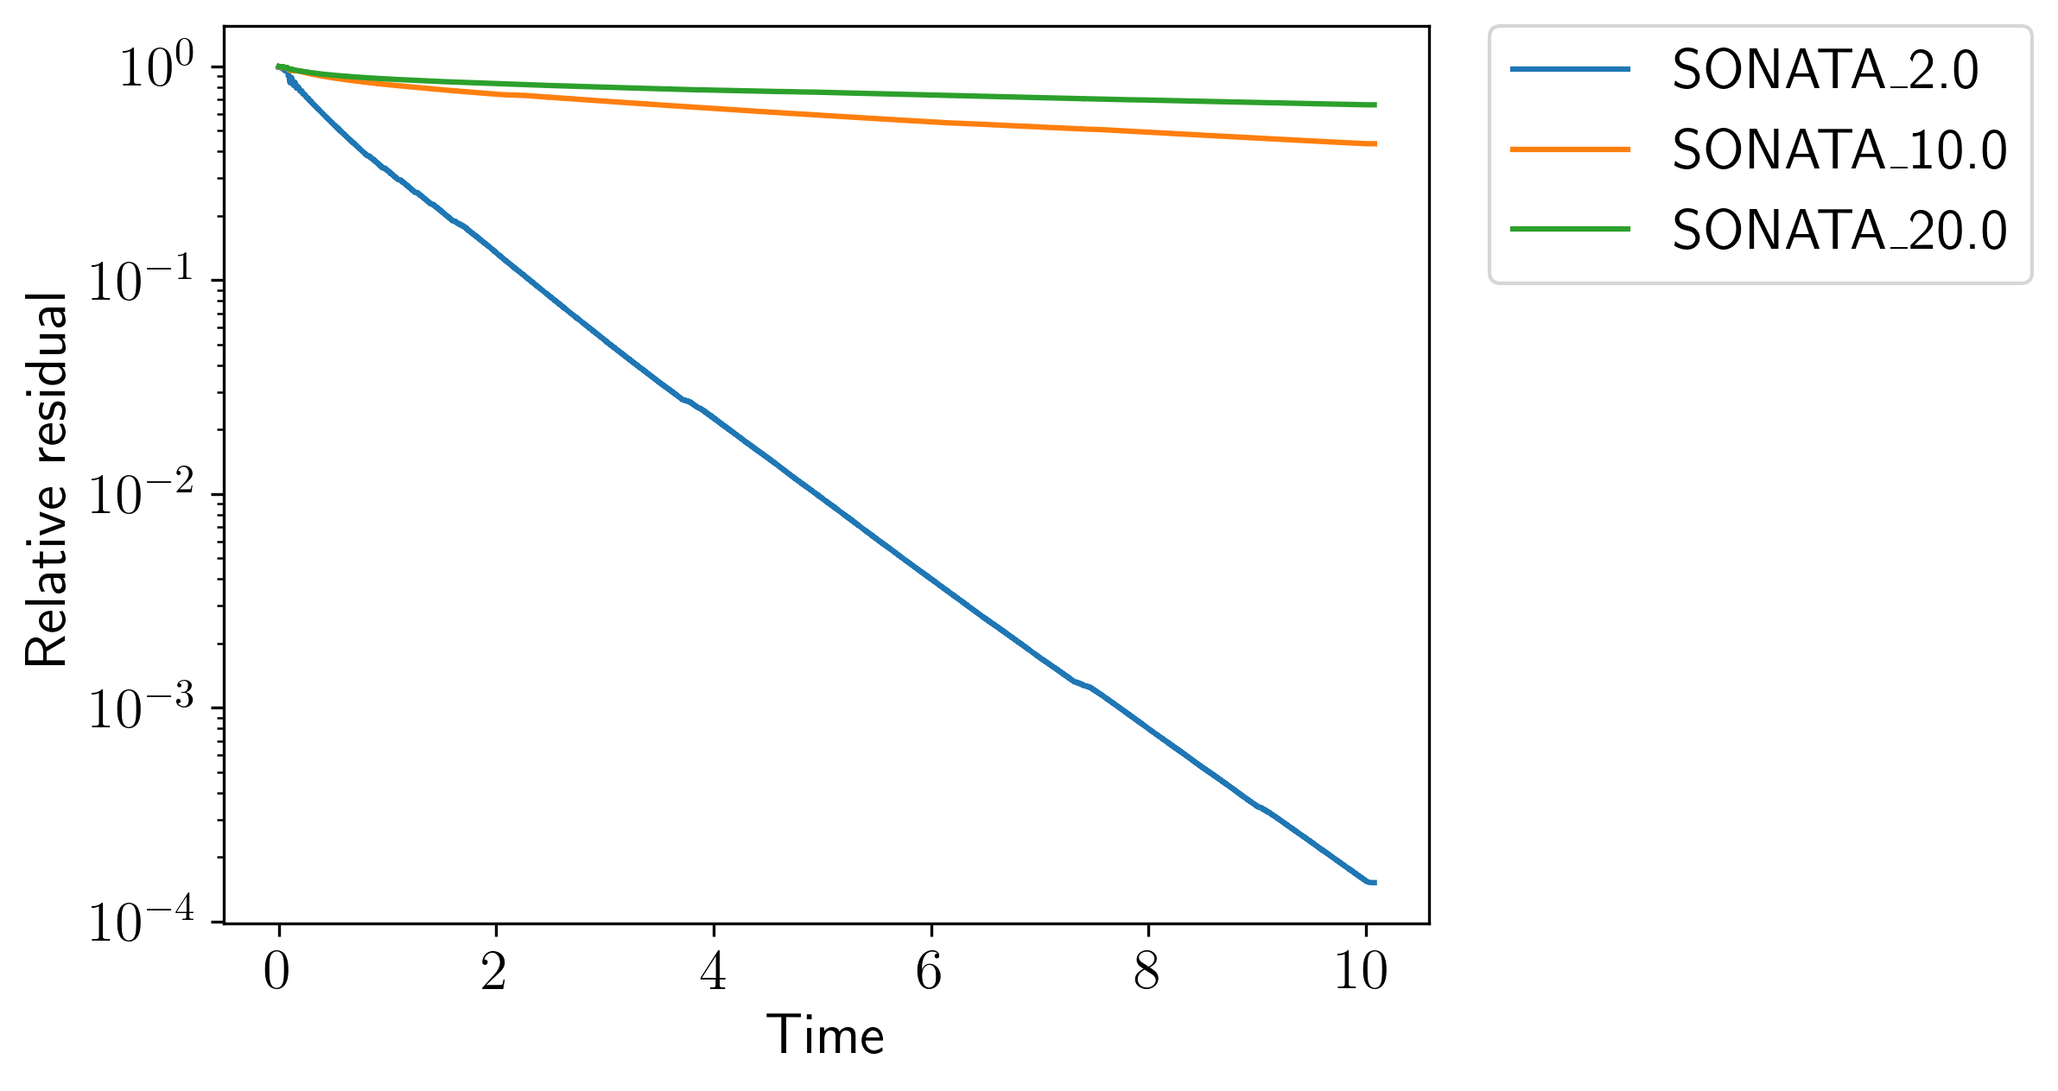
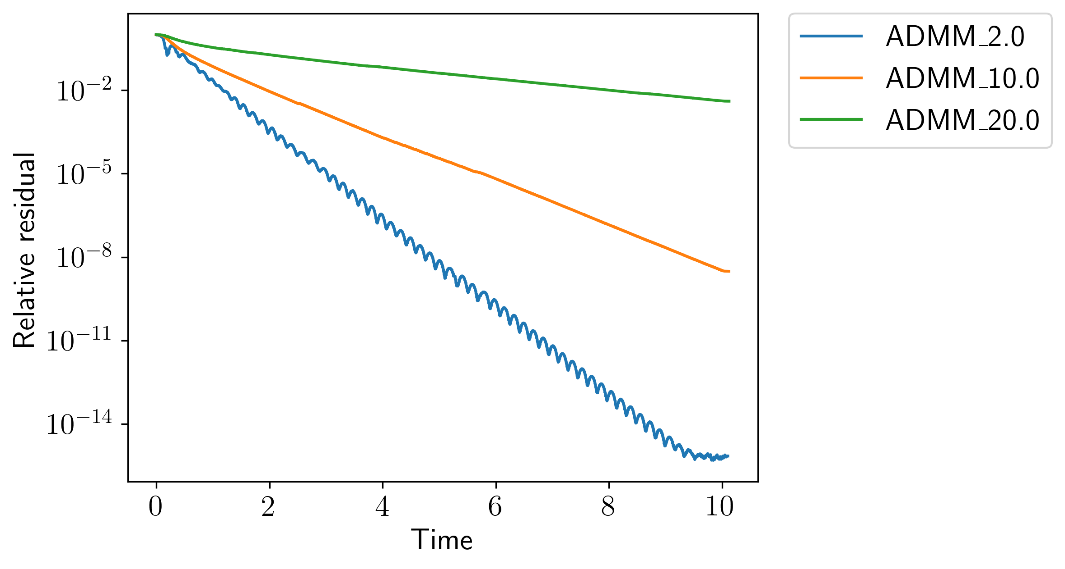
Convergence suffers for both SONATA and ADMM as condition number increases
Adjusting learning rate for SONATA has very limited benefit
Need to adjust penalty for ADMM as conditioning changes
SONATA
ADMM
Notes:
Gamma = 1, alpha = 0.9, rho = 0.01, 8 agents

Slide 23
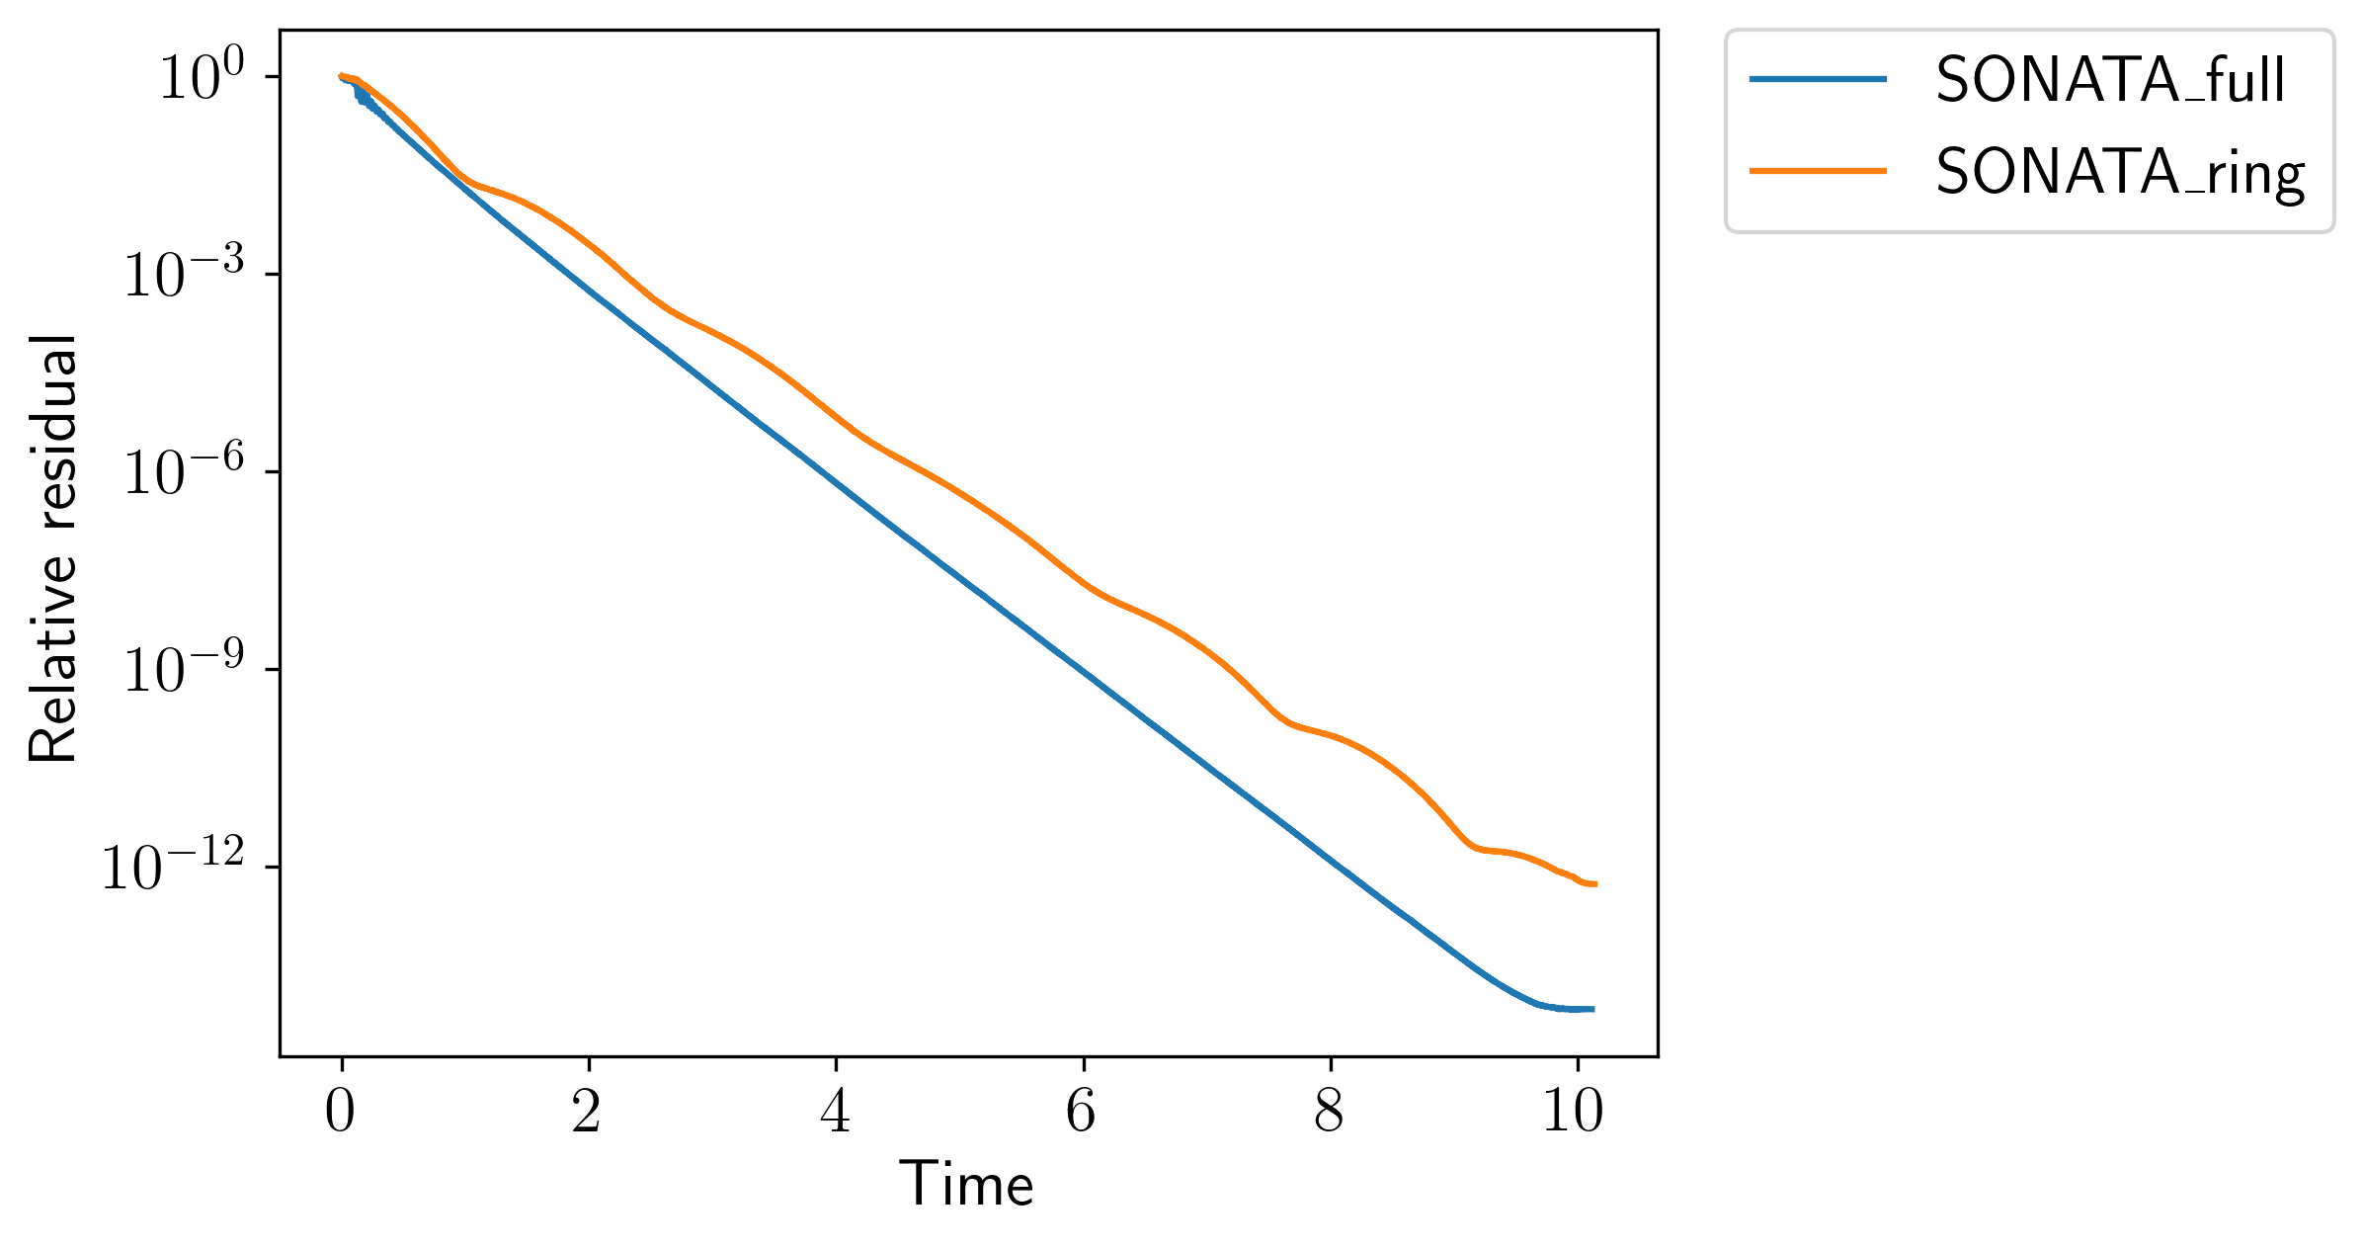
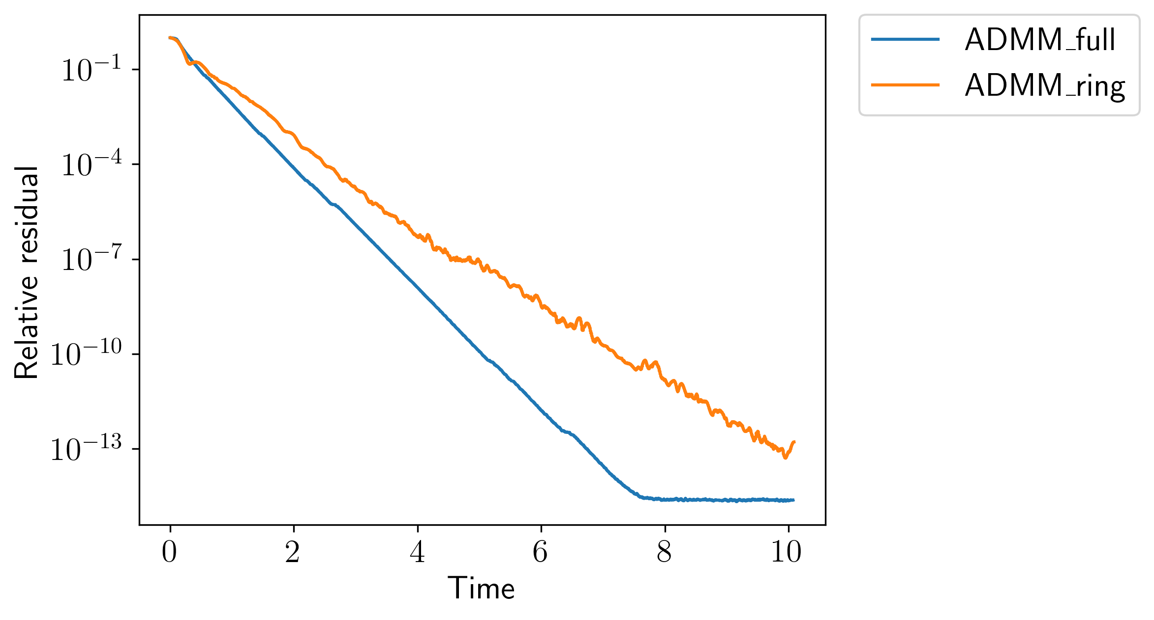
Both ADMM and SONATA can handle limited communication topologies
Had to tweak parameters for ring topology compared to full
Ring topology yields slightly slower convergence
SONATA
ADMM
Notes:
ADMM: alpha = 0.9 (full), 0.5 (ring), rho = 0.1
SONATA: gamma = 4 (full), 1 (ring)

Slide 24
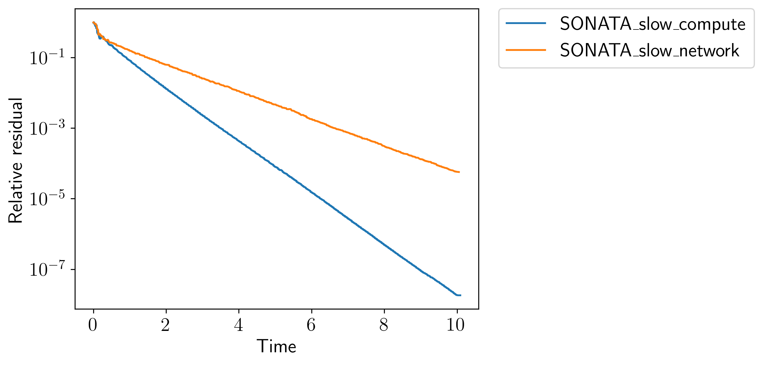
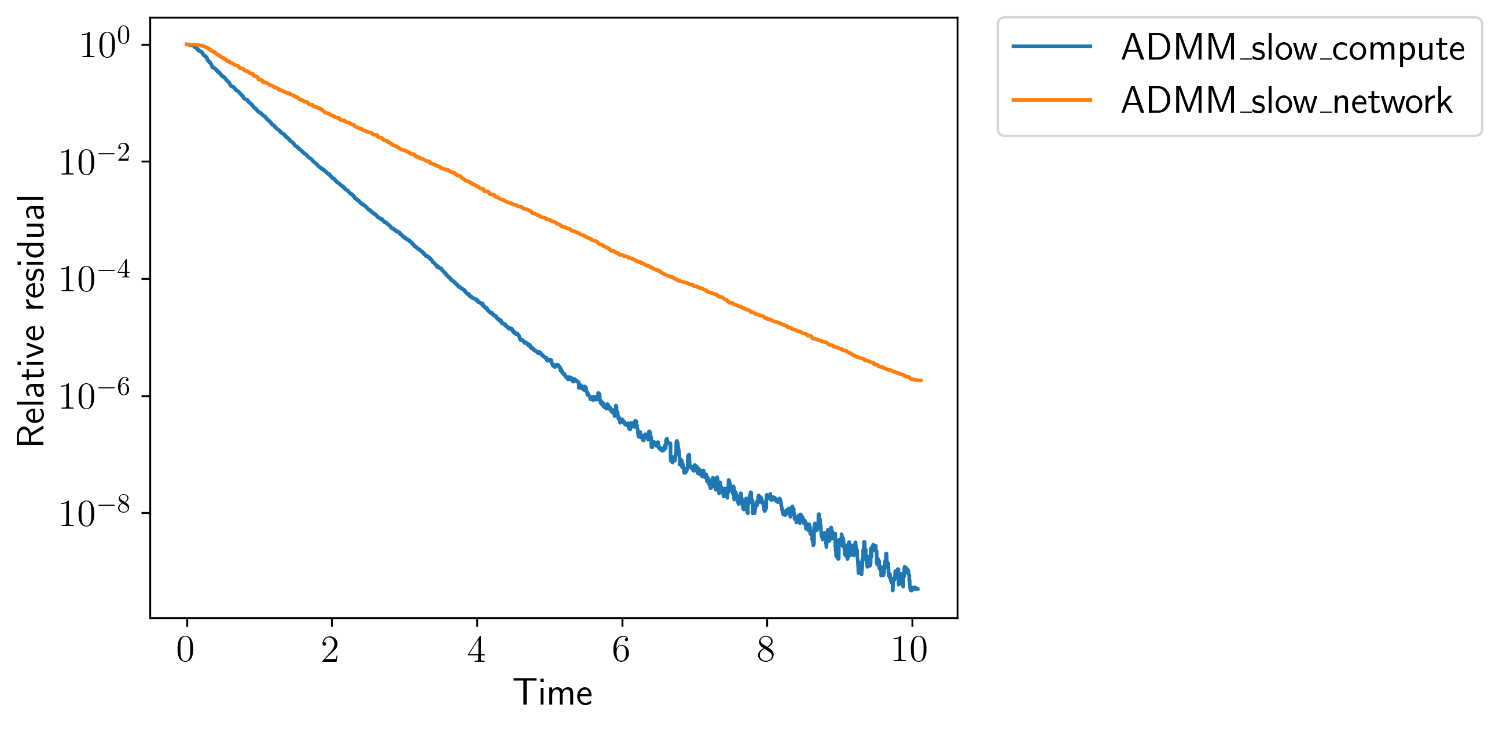
Both ADMM and SONATA are robust to asynchrony
Two methods for injecting asynchrony
Slow compute: 2 of the 8 agents are significantly slowed down
Slow/inconsistent network: all agents may be slowed with 50% probability
SONATA
ADMM

Slide 25
Skywing provides multiple decentralized optimization methods that are robust to asynchrony
There are distributed formulations of both row- and column-partitioned least squares
SONATA and ADMM provide two different optimization approaches that are decentralized and asynchronous
Both SONATA and ADMM suffer with increased condition number or number of agents, but ADMM is generally better
Curious about potential further enhancements or other viable classes of methods!
Funding: LLNL – LDRD 24ERD030

