Slide 1



Modelling wave-ice interactions and sea-ice dynamics in the marginal ice zone
Brown University
29/01/2025
Guillaume Boutin
With contributions from: Christopher Horvat, Timothy Williams, Karoline Holland, Pierre Rampal, Einar Ólason, Véronique Dansereau, Nicolas Mokus, Heather Regan, Fabrice Ardhuin, Fanny Ardhuin, Camille Lique...
This project is supported by Schmidt Sciences – a philanthropic initiative that seeks to improve societal outcomes through the development of emerging science and technologies.

Slide 2
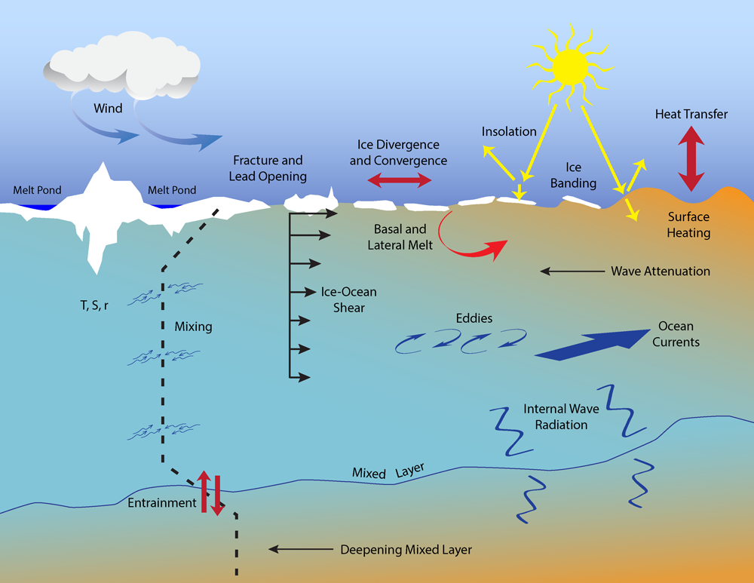
Introduction
Sea ice fragmentation by waves
Waves Radiative
Stress
Wave Radiation
Stress
Waves play a large role in shaping the MIZ by breaking the ice.
Credits : APL, Univ. of Washington

Slide 3
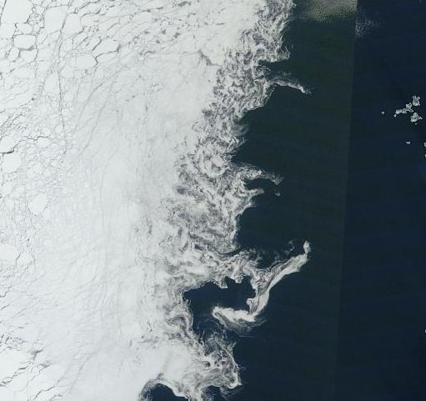
Introduction
Sea ice models do not account for the effect of fragmentation to assess ice resistance to deformation
Instead, they use the concentration → resolution dependent, not very physical
Can we estimate the impact of waves on sea ice dynamics in the MIZ in wave-ice coupled model?
Aqua/MODIS corrected reflectance images. 15/09/2015, North of Svalbard (worldview.earthdata.nasa.gov)

Slide 4
Today’s plan
Investigating wave impact on ice dynamics using neXtSIM-WW3
II) Modelled MIZ extent: evaluation and evolution
III) The road ahead: reliable wave height and floe sizes, investigating mixing and broken ice dynamics
Can we estimate the impact of waves on sea ice dynamics in the MIZ in wave-ice coupled model?

Slide 5
neXtSIM-WW3: a new coupled framework (in 2020)
(IS2)
(IS2)
(IC2)
I) Wave impact on ice dynamics with neXtSIM-WW3 II) Modelled MIZ extent III) The road ahead

Slide 6
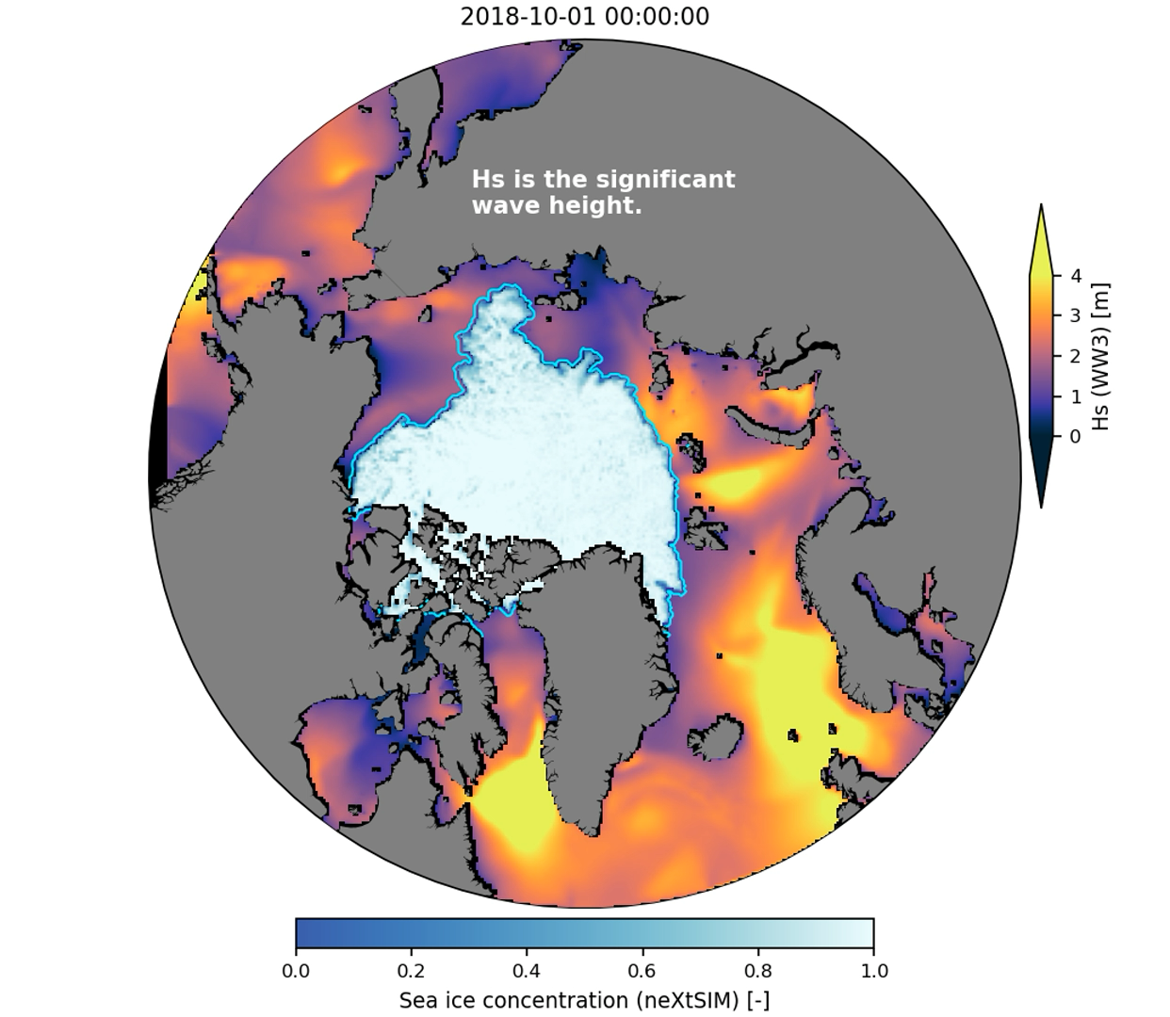
neXtSIM-WW3: illustration
Illustration with a ”recent» 25km simulation
I) Wave impact on ice dynamics with neXtSIM-WW3 II) Modelled MIZ extent III) The road ahead

Slide 7
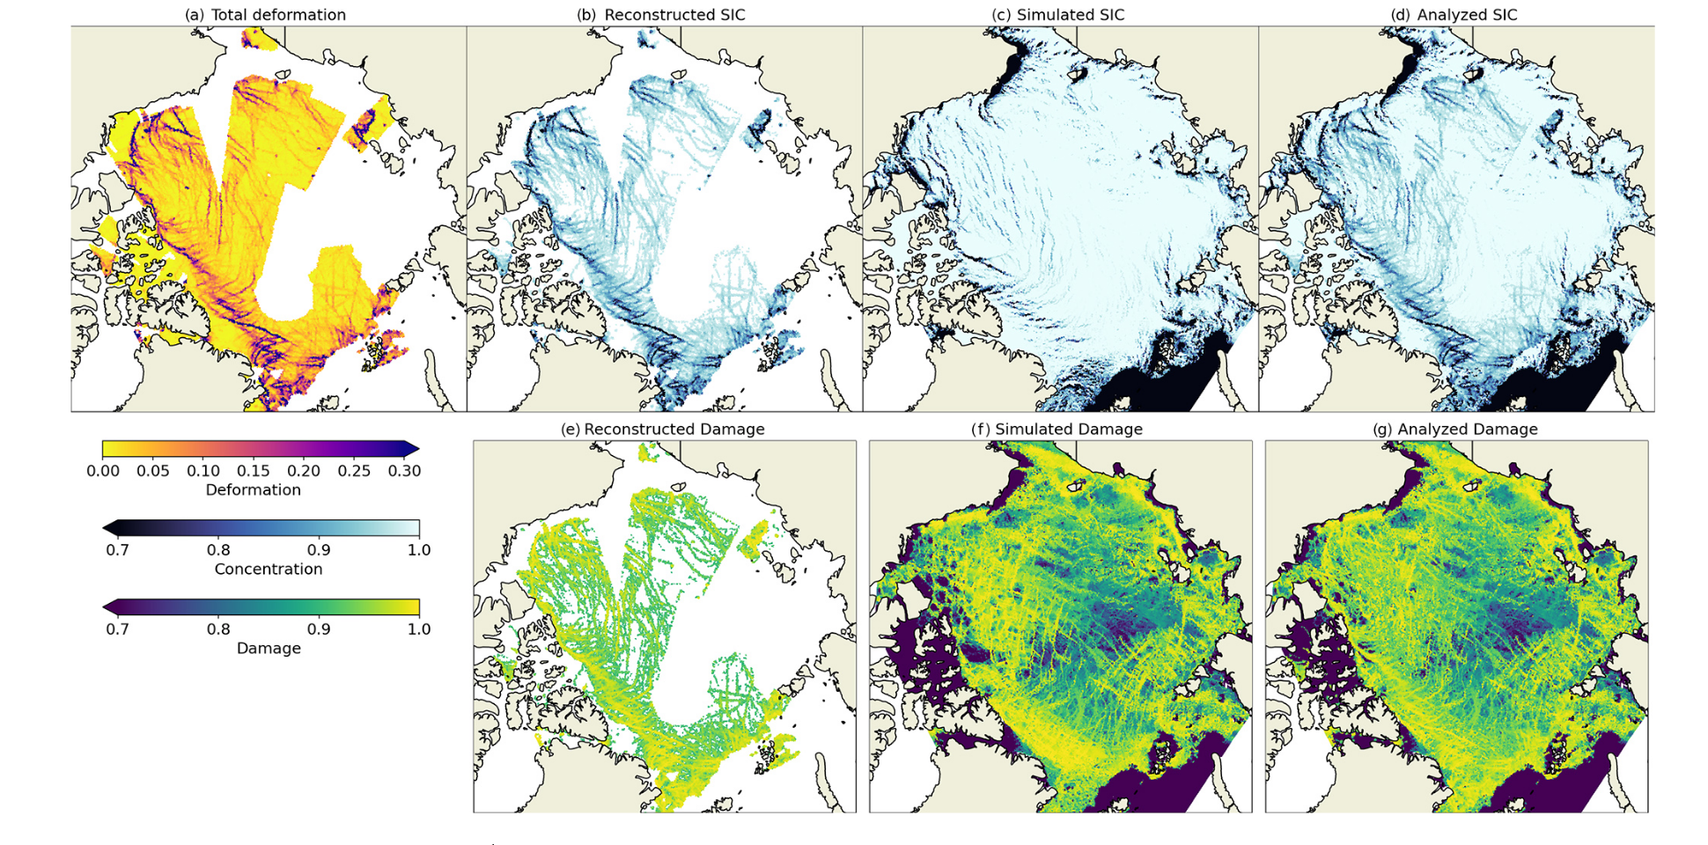
neXtSIM-WW3: The damage variable
Not today
Not today
Using a damage quantity to represent the mechanical state of the ice → Link with floe size?
Korosov et al. 2023,
https://doi.org/10.5194/tc-17-4223-2023
I) Wave impact on ice dynamics with neXtSIM-WW3 II) Modelled MIZ extent III) The road ahead

Slide 8
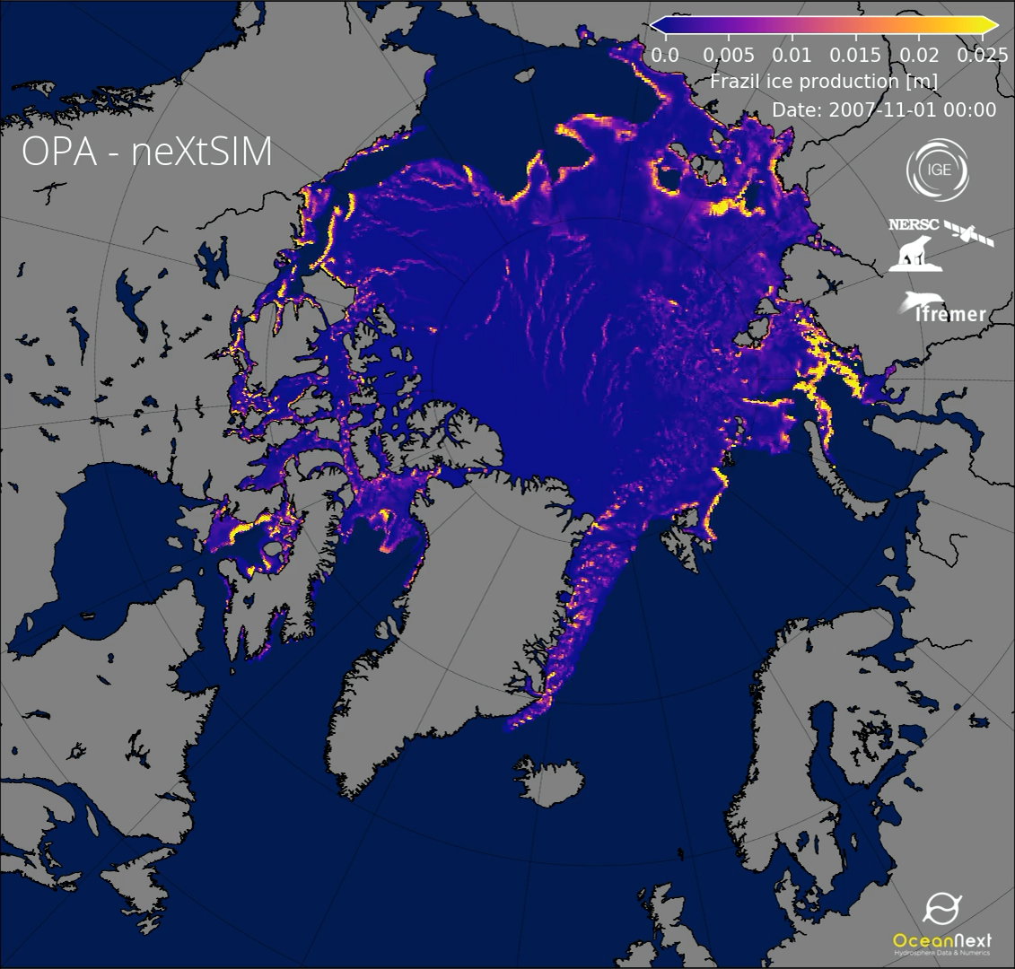
neXtSIM-WW3: The damage variable
Ice formation in open water
(lateral growth)
November 2007 to March 2008
Not really relevant for today, but just to illustrate the main motivation behind the model → pack ice
I) Wave impact on ice dynamics with neXtSIM-WW3 II) Modelled MIZ extent III) The road ahead

Slide 9
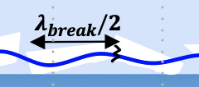
A new coupled framework
If fragmentation occurs (in the wave model WW3), we consider sea ice is fully damaged (in neXtSIM)
If $λ_{break}$< 1000m then
Damage = 1 (free drift)
I) Wave impact on ice dynamics with neXtSIM-WW3 II) Modelled MIZ extent III) The road ahead

Slide 10
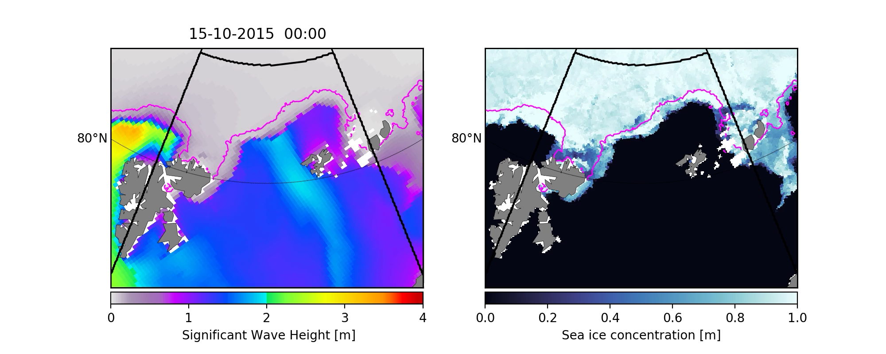
Wave impact on ice dynamics in the MIZ
Resolution: 12km (pan-Arctic)
Atm forcings: ERA5
Ocean forcings (for sea ice only ): TOPAZ4
Wave spectra at the boundary: Ifremer hindcast
A storm in October 2015 in the Barents Sea
I) Wave impact on ice dynamics with neXtSIM-WW3 II) Modelled MIZ extent III) The road ahead

Slide 11
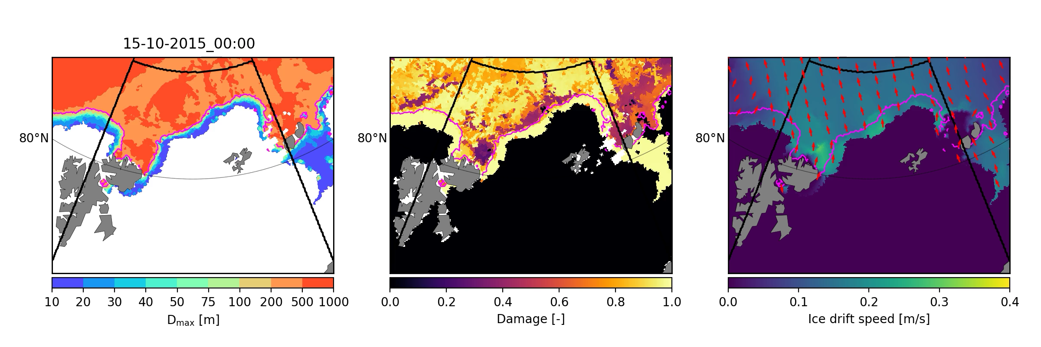
Wave impact on ice dynamics in the MIZ
Evolution of the MIZ during this storm
I) Wave impact on ice dynamics with neXtSIM-WW3 II) Modelled MIZ extent III) The road ahead

Slide 12
Wave impact on ice dynamics in the MIZ
21/10/2015 09:00 am
CPL_DMG: Coupled with link between frag. and damage
CPL_WRS: Coupled but NO LINK between frag. and damage
Broken AND thick/compact ice
I) Wave impact on ice dynamics with neXtSIM-WW3 II) Modelled MIZ extent III) The road ahead

Slide 13
Wave impact on ice dynamics in the MIZ
21/10/2015 09:00 am
CPL_DMG: Coupled with link between frag. and damage
CPL_WRS: Coupled but NO LINK between frag. and damage
Broken AND thick/compact ice
Fragmentation increases the mobility of compact and broken sea ice after extreme events → Getting the right MIZ extent matters!
I) Wave impact on ice dynamics with neXtSIM-WW3 II) Modelled MIZ extent III) The road ahead

Slide 14
Conclusion part I)
The magnitude of wave impact on sea ice mostly depends on how far they travel into the ice cover
In addition to wave radiation stress, sea ice mobility is also affected by waves through changes in sea ice mechanical properties.
Potential impact on ice edge location (forecasting...), feedback with ice thermodynamics?
A good wave-in-ice model investigating this impact should therefore ensure the MIZ extent is right.
I) Wave impact on ice dynamics with neXtSIM-WW3 II) Modelled MIZ extent III) The road ahead

Slide 15

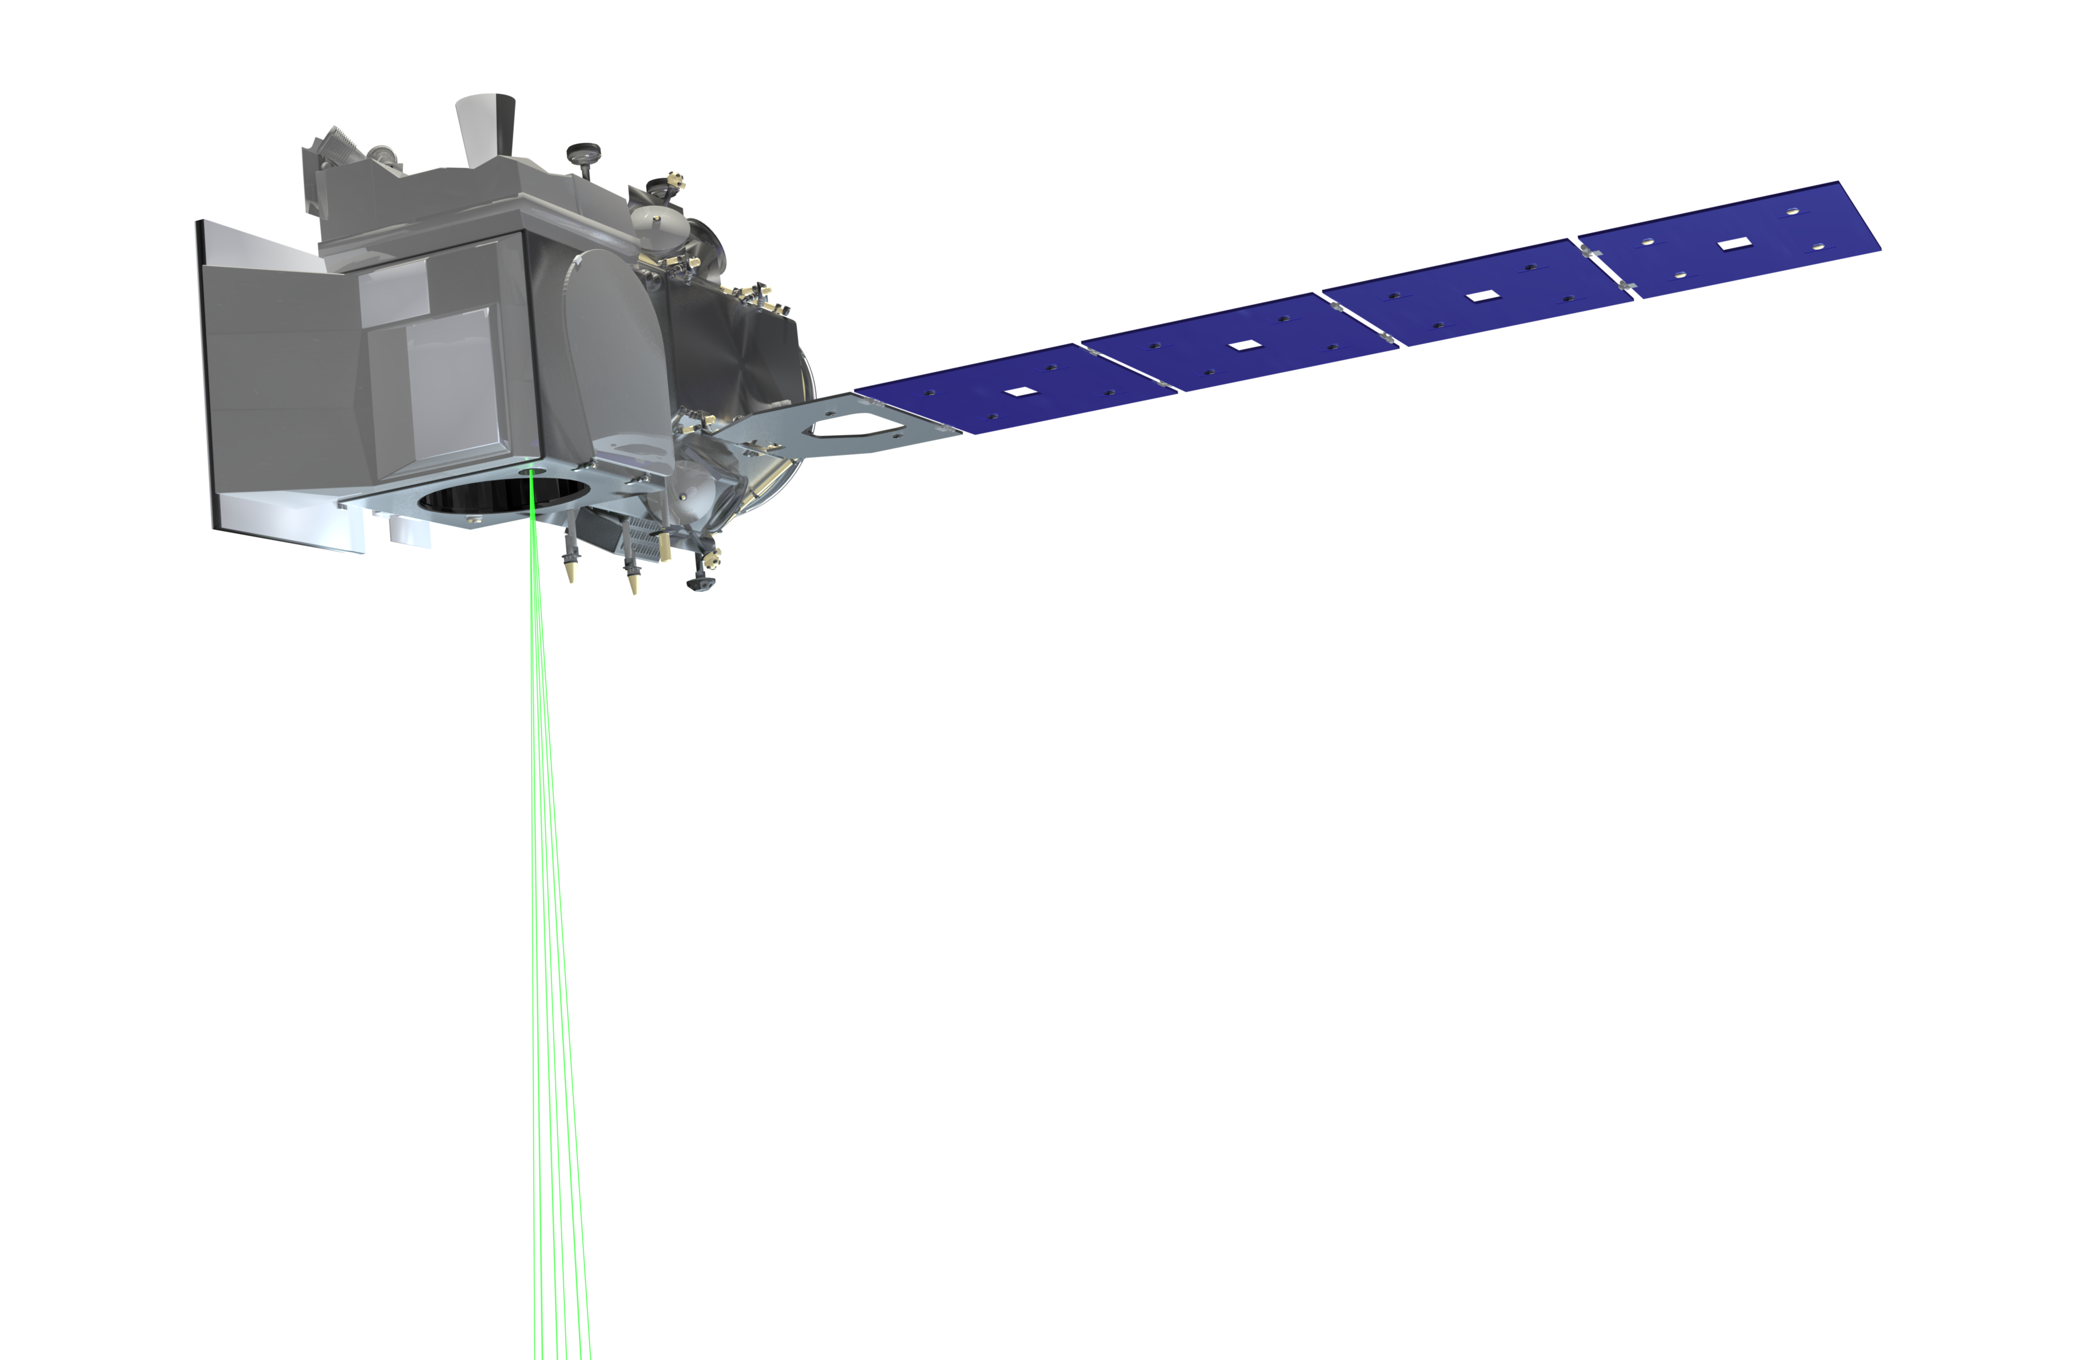

Part II: The MIZ extent: evaluation and evolution
ICESat-2 (NASA)
Picture: Elie Dumas-Lefebvre,
Dany Dumont (Phil. Trans. A cover)

Slide 16
Introduction (part II)
The magnitude of wave impact on sea ice mostly depends on how far they travel into the ice cover
A good wave-in-ice model investigating this impact should therefore ensure the MIZ extent is right, but this is highly uncertain as:
Observations of the wMIZ are rare, localized in time and space
I) Wave impact on ice dynamics with neXtSIM-WW3 II) Modelled MIZ extent III) The road ahead

Slide 17
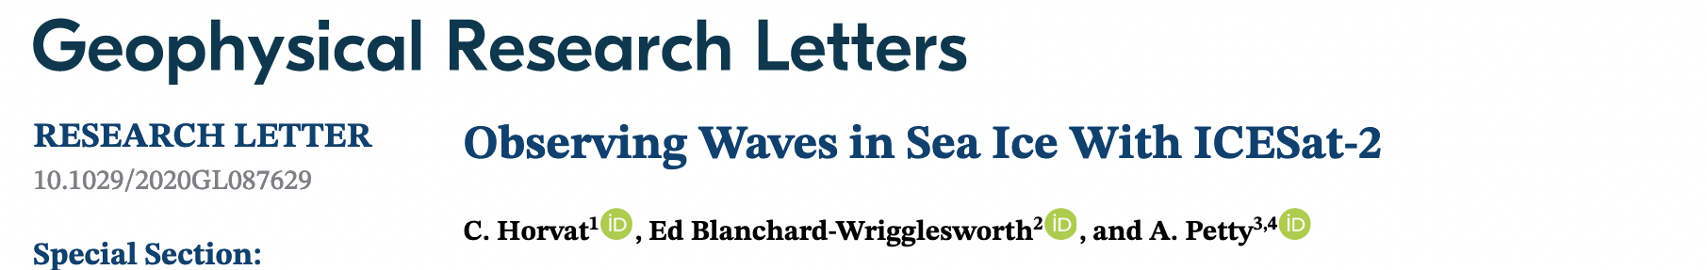
Evaluating the wMIZ extent
Here comes ICESat-2
They derive a “wave-affected fraction” (WAF) by doing the ratio of ICESat-2 tracks affected by waves over the total number of tracks for each location
Horvat et al., 2020
I) Wave impact on ice dynamics with neXtSIM-WW3 II) Modelled MIZ extent III) The road ahead

Slide 18
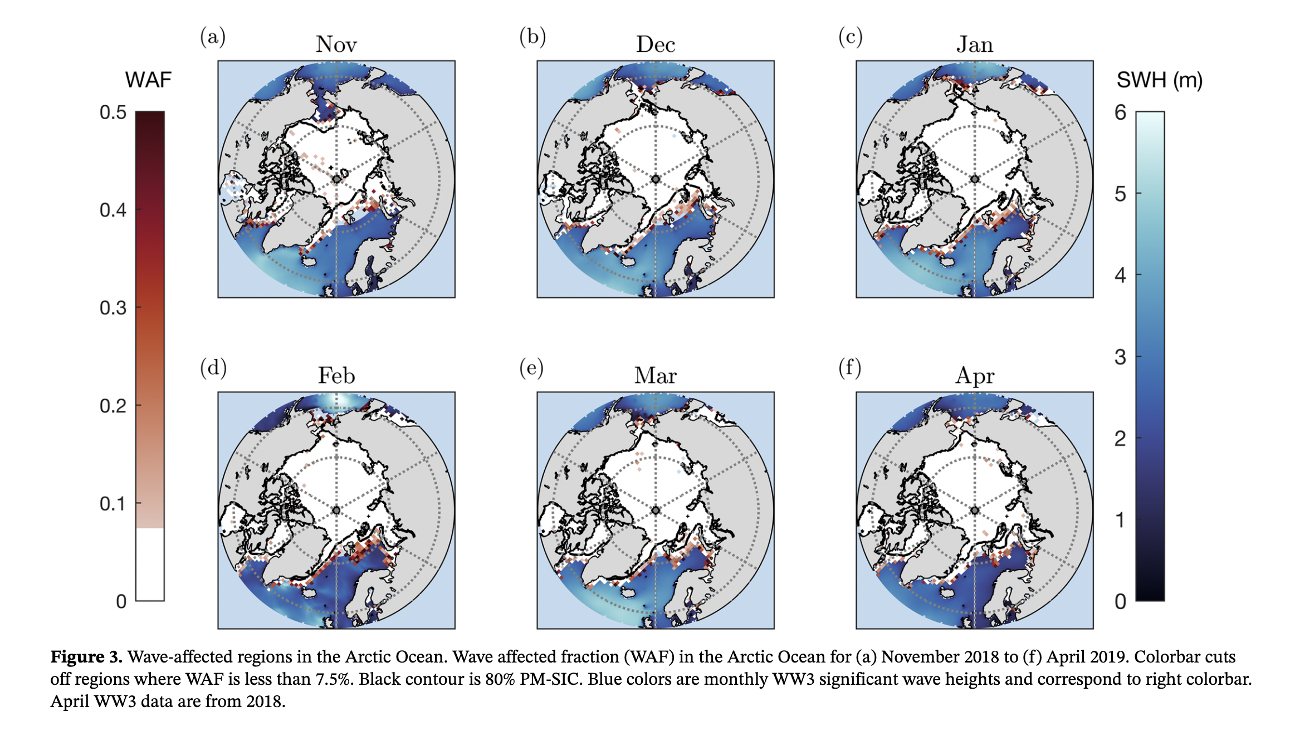
Evaluating the wMIZ extent
If (WAF > 7.5%), then the location is wave-affected
Horvat et al., 2020
The wave-affected fraction (WAF) can be used to define the wMIZ extent
I) Wave impact on ice dynamics with neXtSIM-WW3 II) Modelled MIZ extent III) The road ahead

Slide 19
Evaluating the wMIZ extent
Here comes ICESat-2
Horvat et al., 2020
Can we use that information to evaluate our model over large spatial and long temporal scales?
I) Wave impact on ice dynamics with neXtSIM-WW3 II) Modelled MIZ extent III) The road ahead

Slide 20
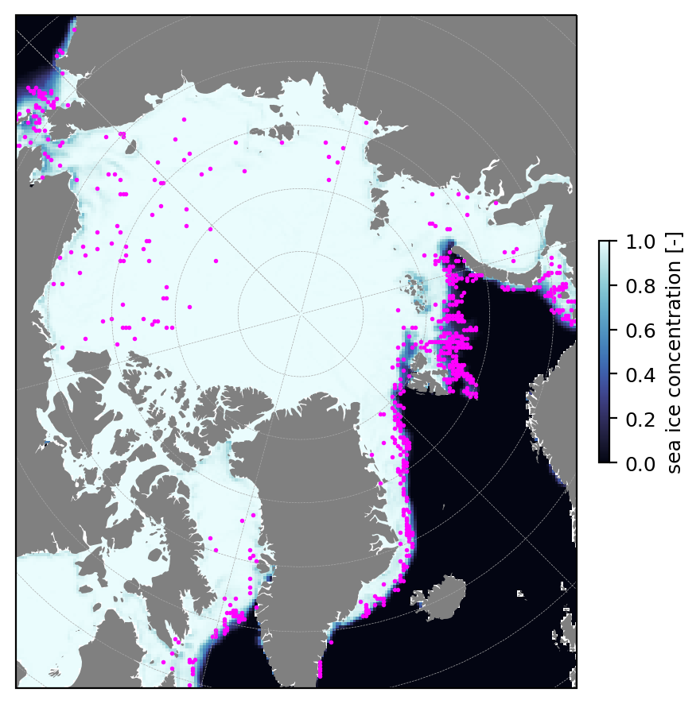
Evaluating the wMIZ extent
Wave affected locations (IS2)
Challenge: Need to define what the WAF is in the model!
Example: Feb. 2019
I) Wave impact on ice dynamics with neXtSIM-WW3 II) Modelled MIZ extent III) The road ahead

Slide 21
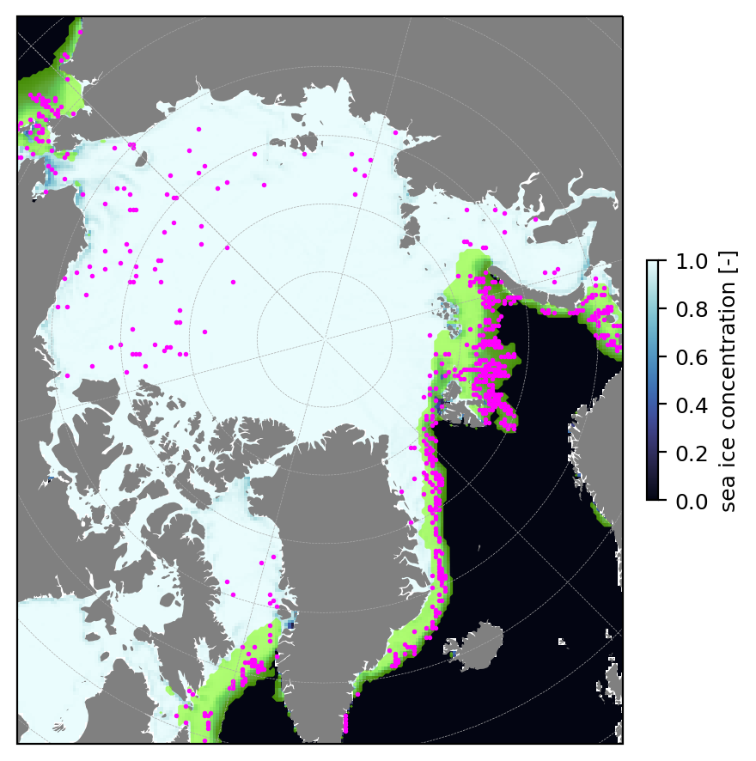
Evaluating the wMIZ extent
MIZ extent (model)
Wave affected locations (IS2)
Challenge: Need to define what the WAF is in the model!
→ Where the model results suggest waves would be large enough to affect ICESat-2 tracks for at least one event
Model do well for MIZ affected by swells (Atlantic sector), less well in the Beaufort/ Chukchi area, but observations seem noisier in these areas.
Example: Feb. 2019
Boutin et al., 2022
I) Wave impact on ice dynamics with neXtSIM-WW3 II) Modelled MIZ extent III) The road ahead

Slide 22
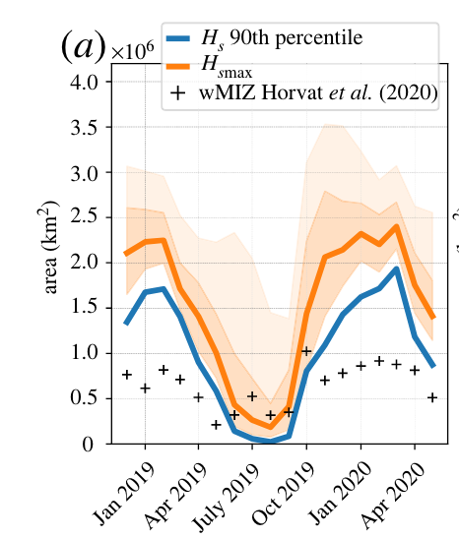
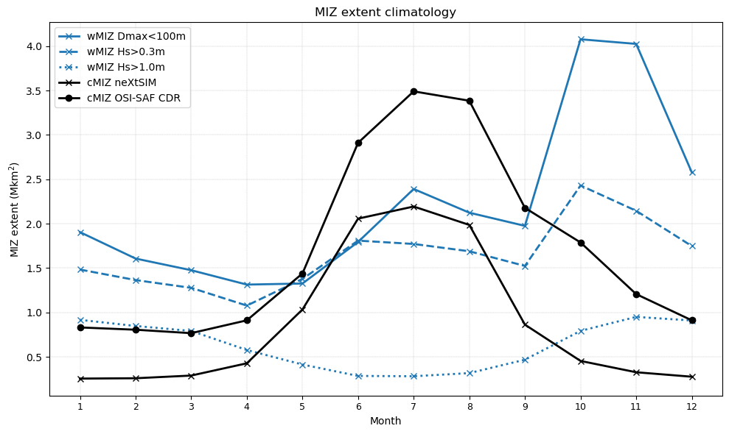
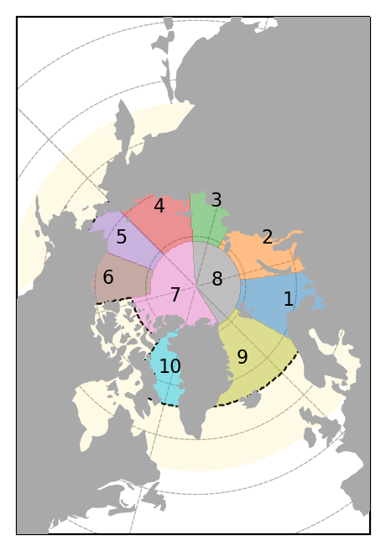
Evolution of the MIZ extent
Gives us some trust to investigate MIZ extent over longer time scales
Resolution: 25km
Period: 1993—2023
Atm forcings: ERA5
Ocean forcings (for sea ice only ): GLORYS12v1
Wave spectra at theboundary: Ifremer hindcast
Boutin et al., 2022
Boutin et al., in prep
I) Wave impact on ice dynamics with neXtSIM-WW3 II) Modelled MIZ extent III) The road ahead

Slide 23
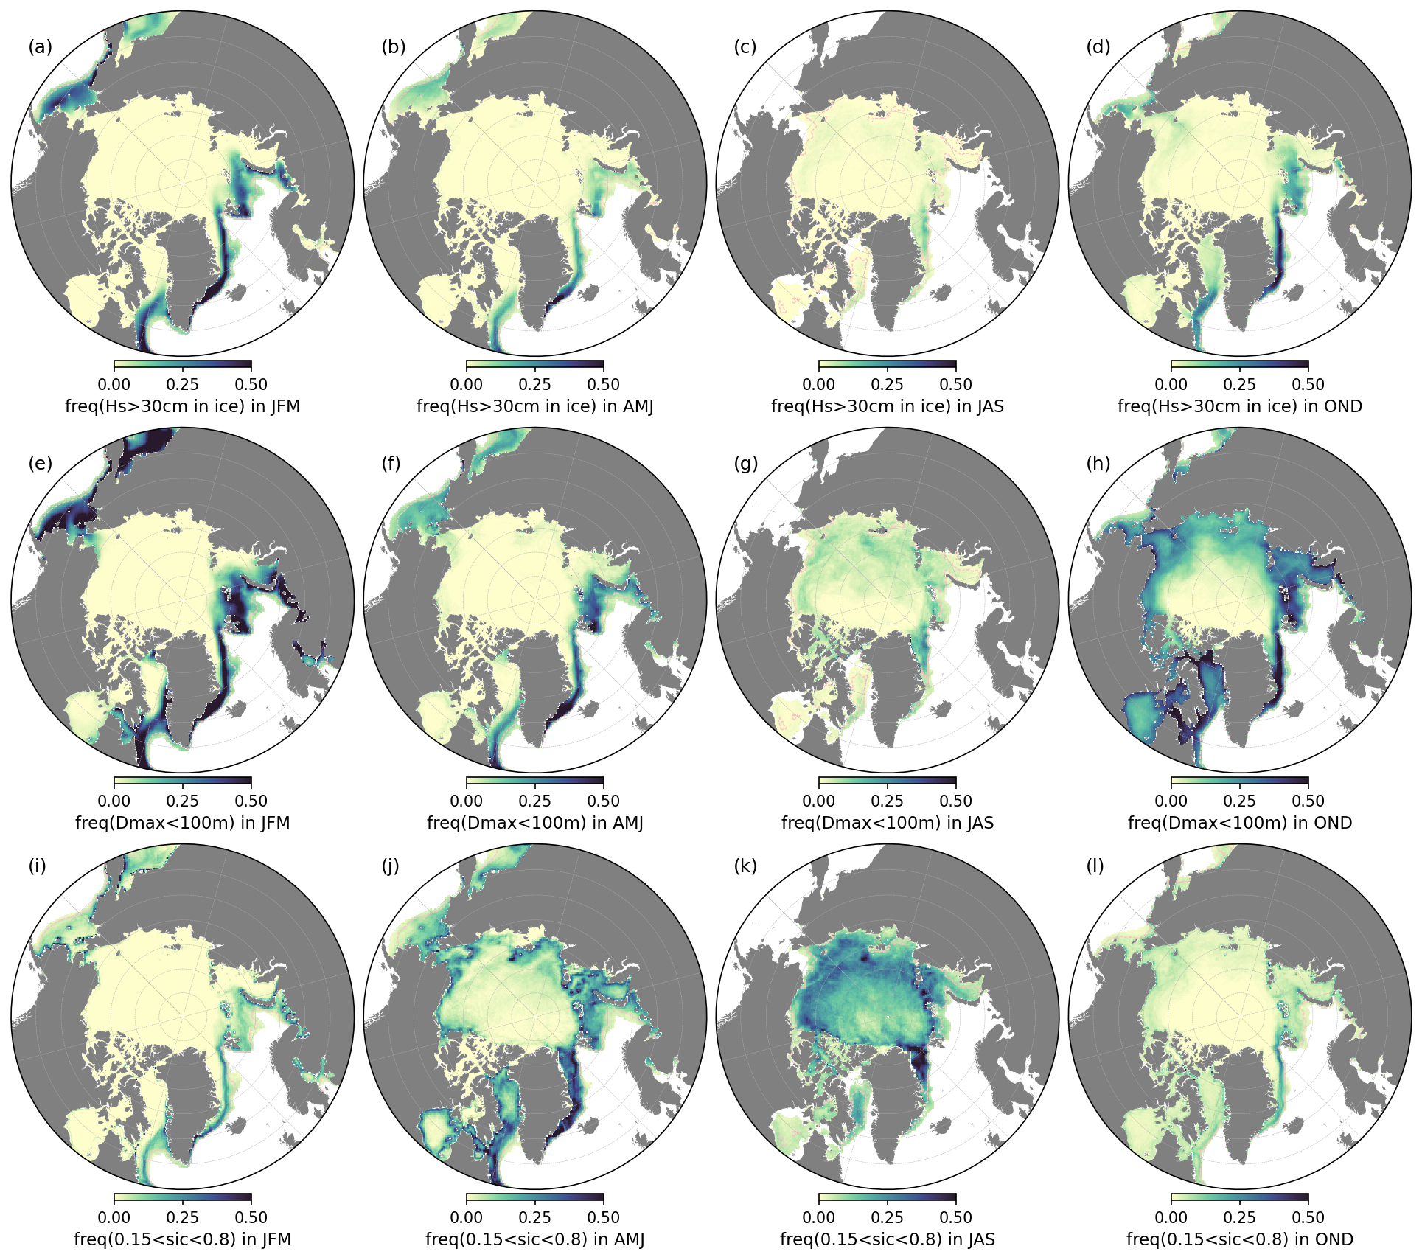
Evolution of the MIZ extent
Seasonal climatology of the
wMIZ (Hs)
wMIZ (Floe size)
cMIZ
Looks reasonable?
I) Wave impact on ice dynamics with neXtSIM-WW3 II) Modelled MIZ extent III) The road ahead
Notes:
Discussion on MIZ sensitivity

Slide 24
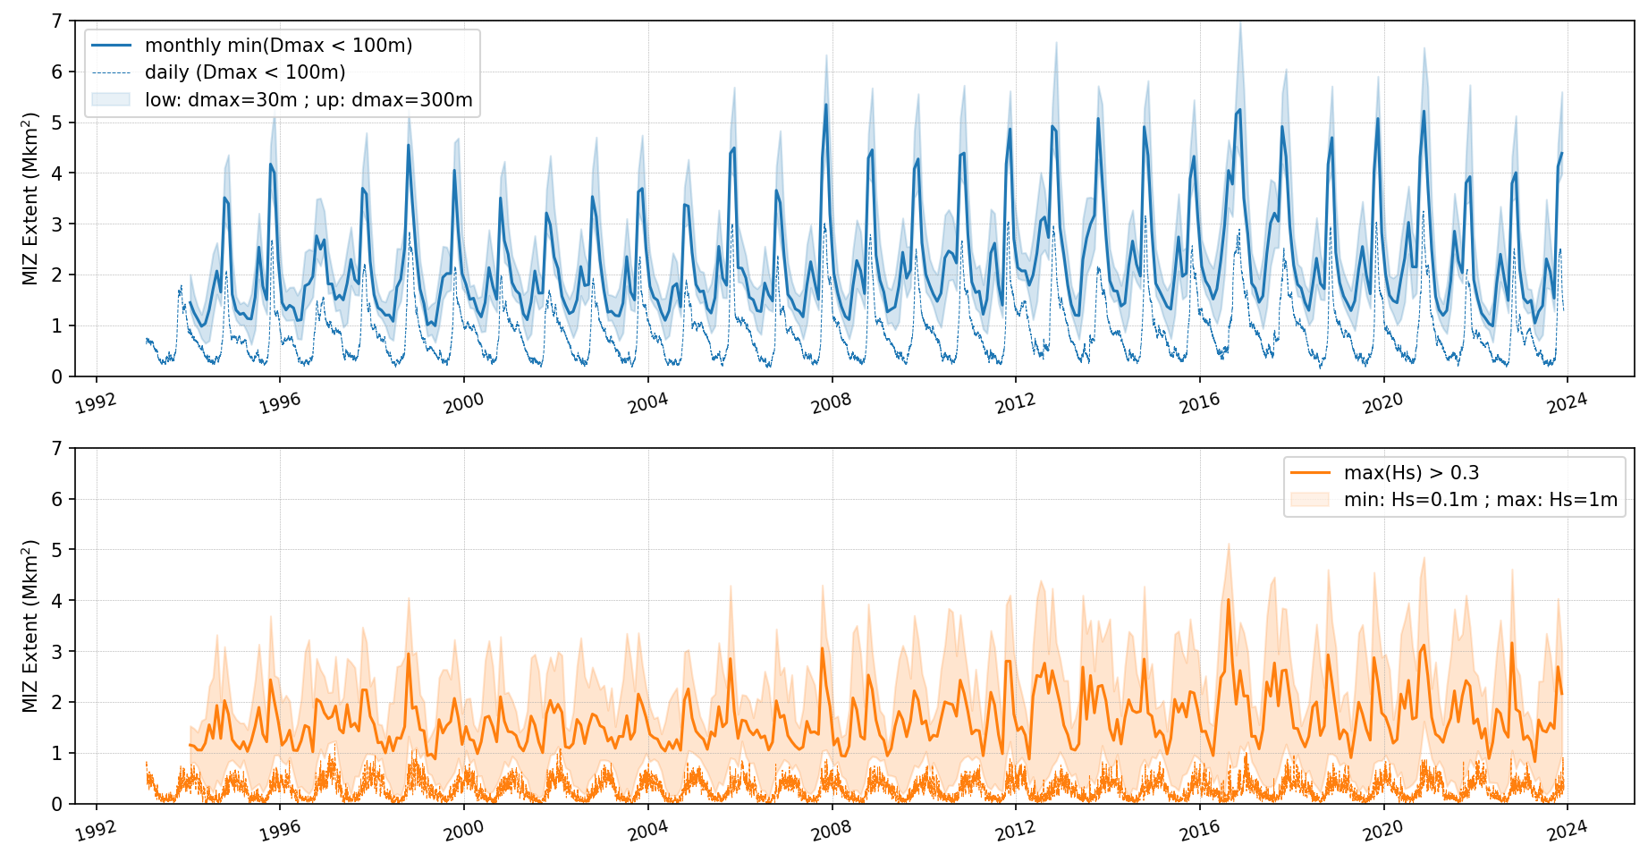
Evolution of the MIZ extent
wMIZ (Floe size)
Magnitude depends on threshold and temporal window, but variability doesn’t
wMIZ (Hs)
Magnitude and variability depend highly on threshold and temporal window
I) Wave impact on ice dynamics with neXtSIM-WW3 II) Modelled MIZ extent III) The road ahead
Notes:
Discussion on MIZ sensitivity

Slide 25
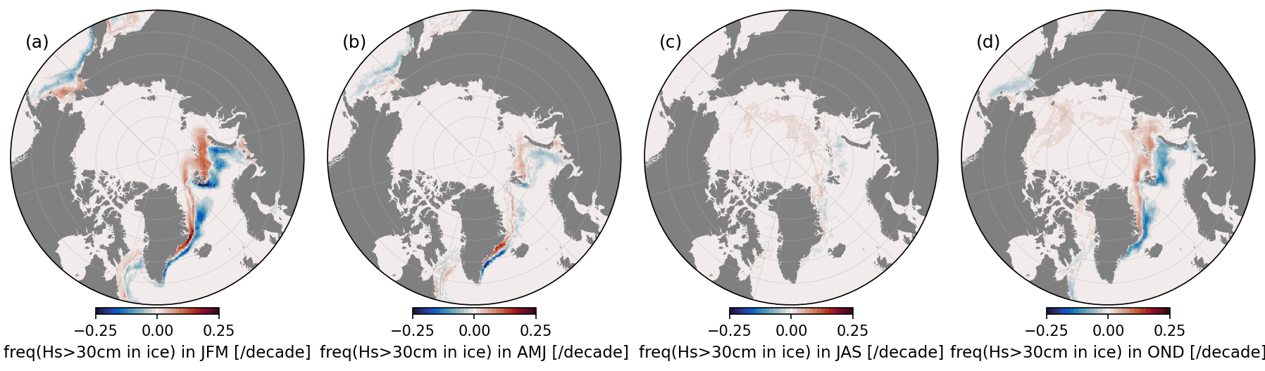
The wMIZ extent evolution
JFM
AMJ
JAS
OND
JFM
AMJ
JAS
OND
1994-2023 Trends
The wMIZ is moving north
I) Wave impact on ice dynamics with neXtSIM-WW3 II) Modelled MIZ extent III) The road ahead

Slide 26
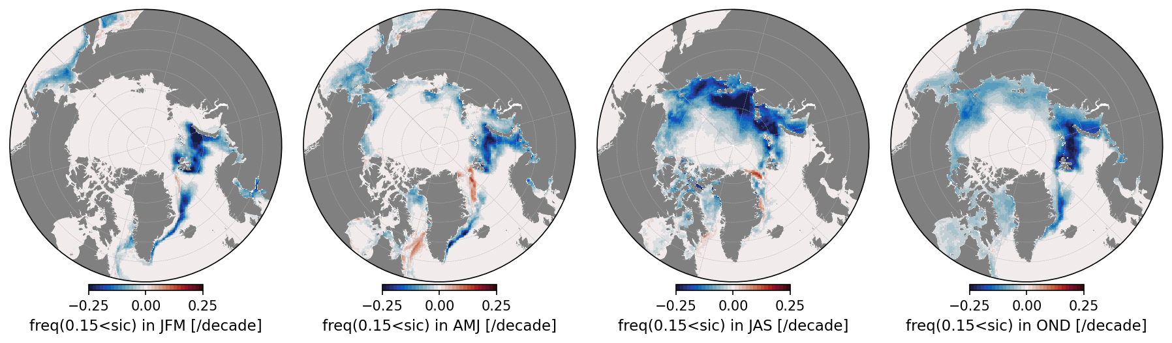
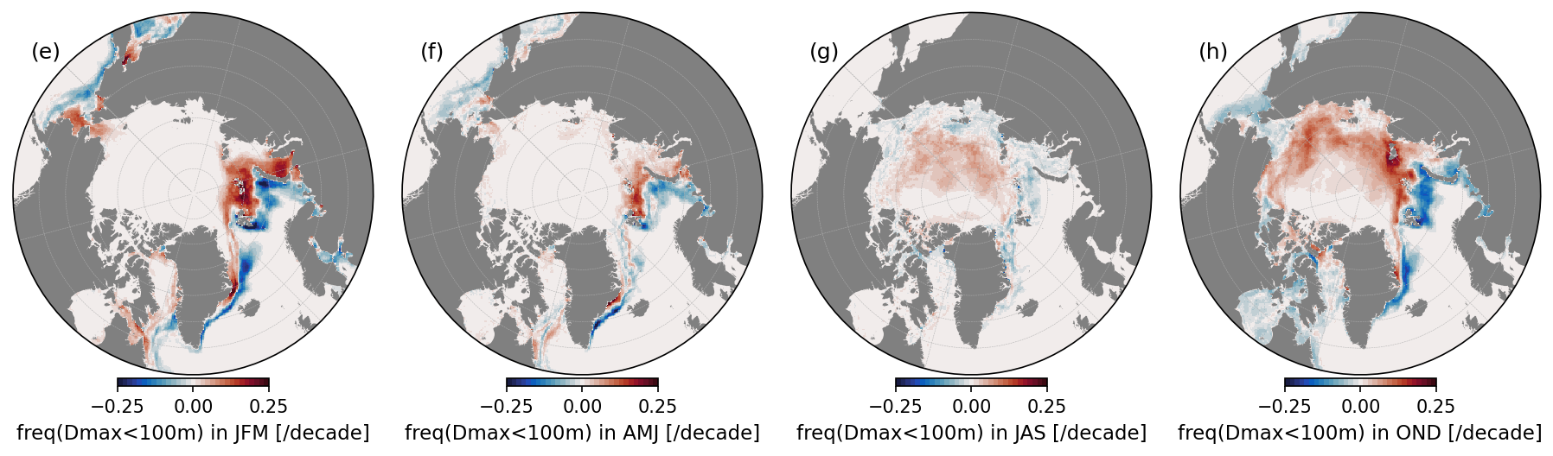
The wMIZ extent evolution
JFM
AMJ
JAS
OND
JFM
AMJ
JAS
OND
1994-2023 Trends
The wMIZ is moving north following the ice edge
I) Wave impact on ice dynamics with neXtSIM-WW3 II) Modelled MIZ extent III) The road ahead

Slide 27
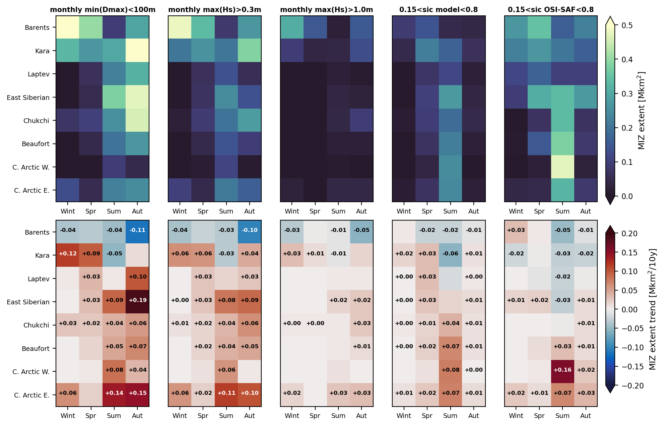
The wMIZ extent evolution
In interior regions, wMIZ is evolving much faster than cMIZ
I) Wave impact on ice dynamics with neXtSIM-WW3 II) Modelled MIZ extent III) The road ahead

Slide 28
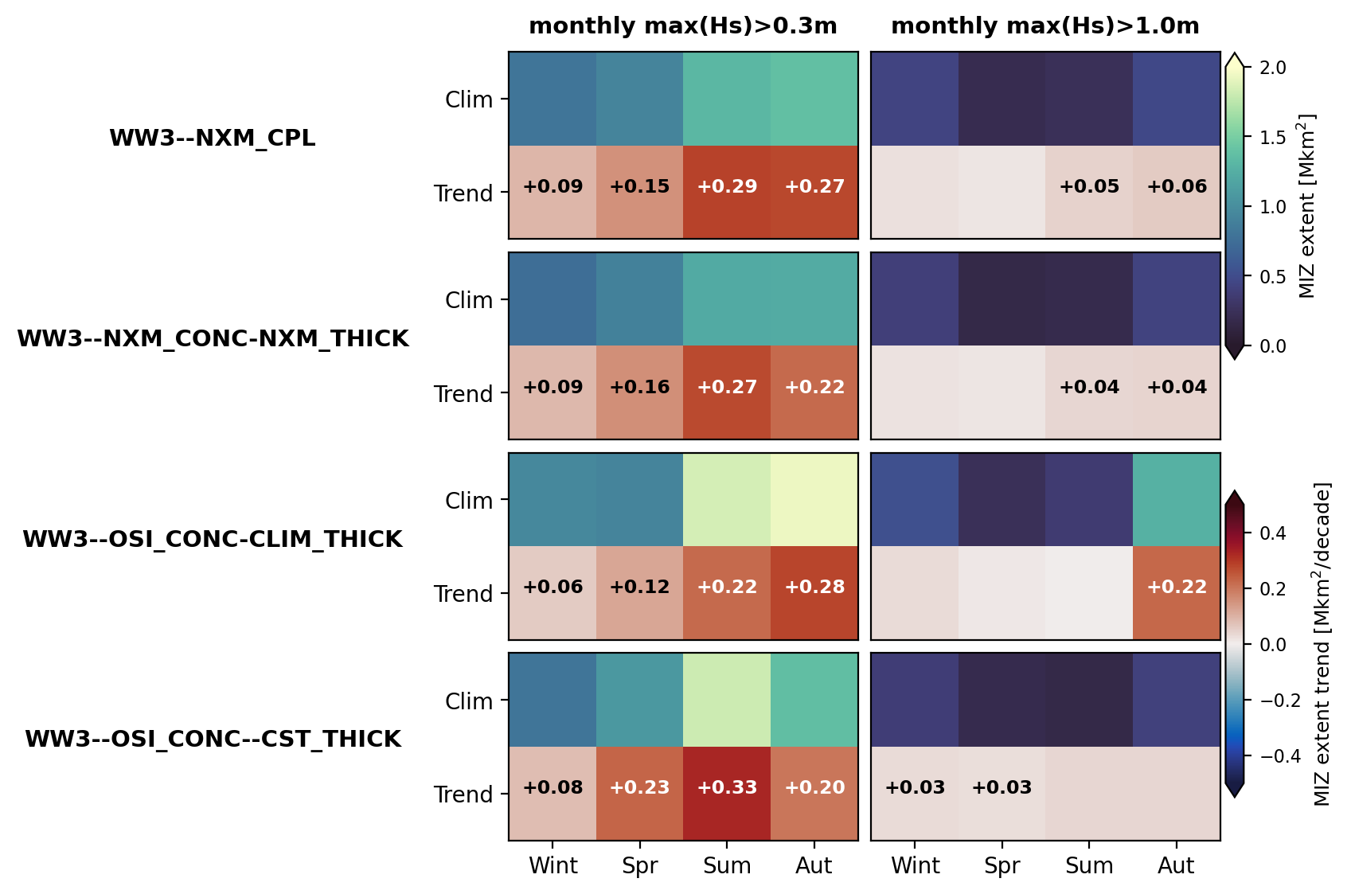
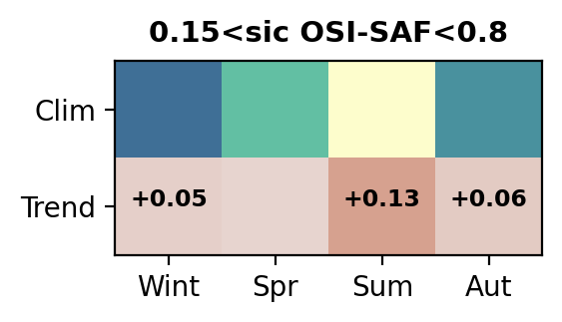
The wMIZ extent evolution
Our reference simulation, 2-way coupled with exchange every 30min.
We remove memory/advection of broken ice by forcing WW3 with conc. and thick. from WW3—NXM_CPL
Waves only see observed conc., but interannual thick. variability is removed by using a climatology for ice thickness [4]
Waves only see observed concentration changes, thickness is taken constant (1m)
By elimination (floe size, thickness), wMIZ (Hs) evolution is largely driven by change in fetch
Boutin et al., in prep
I) Wave impact on ice dynamics with neXtSIM-WW3 II) Modelled MIZ extent III) The road ahead

Slide 29
Conclusion part II)
MIZ in the coupled model looks reasonable
Floe-size definition is more consistent than Hs-based definitions for the wMIZ (sensitive to threshold and time-window considered).
wMIZ is moving north, like the cMIZ.
wMIZ is increasing in the coupled model
→ What drives this increase? → Mostly fetch
I) Wave impact on ice dynamics with neXtSIM-WW3 II) Modelled MIZ extent III) The road ahead

Slide 30
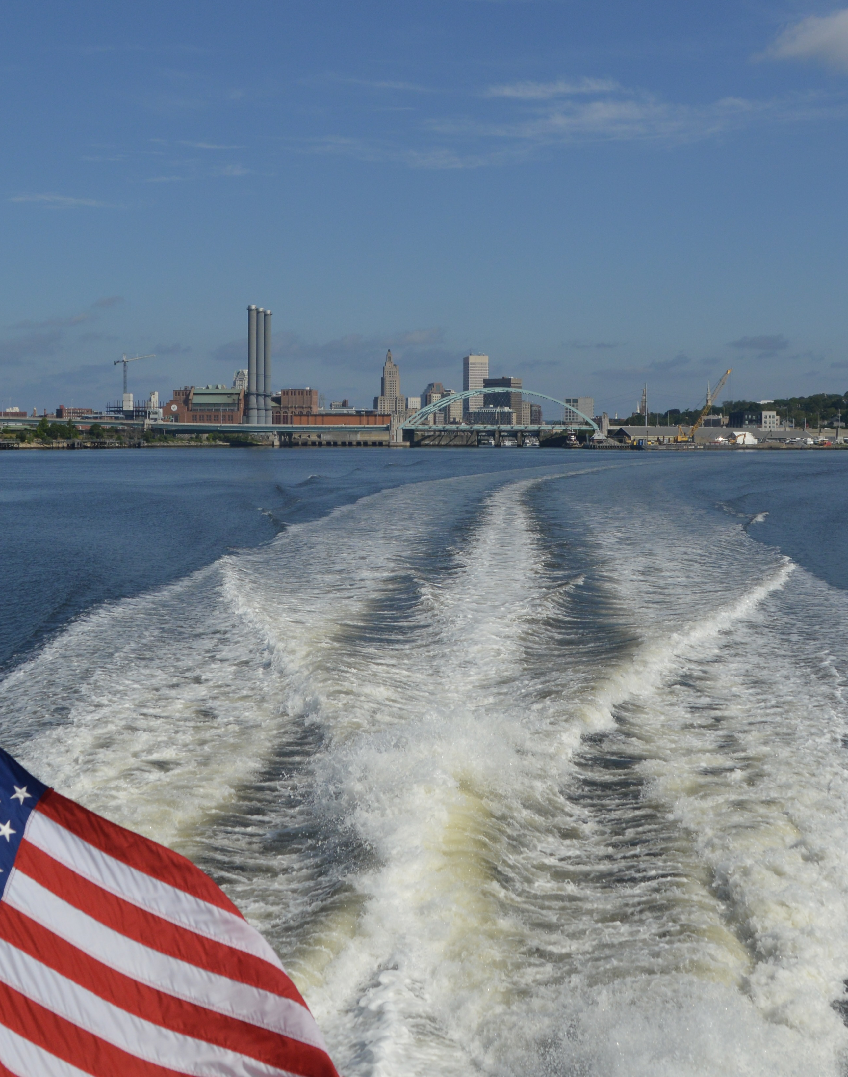
Part III: The road ahead

Slide 31
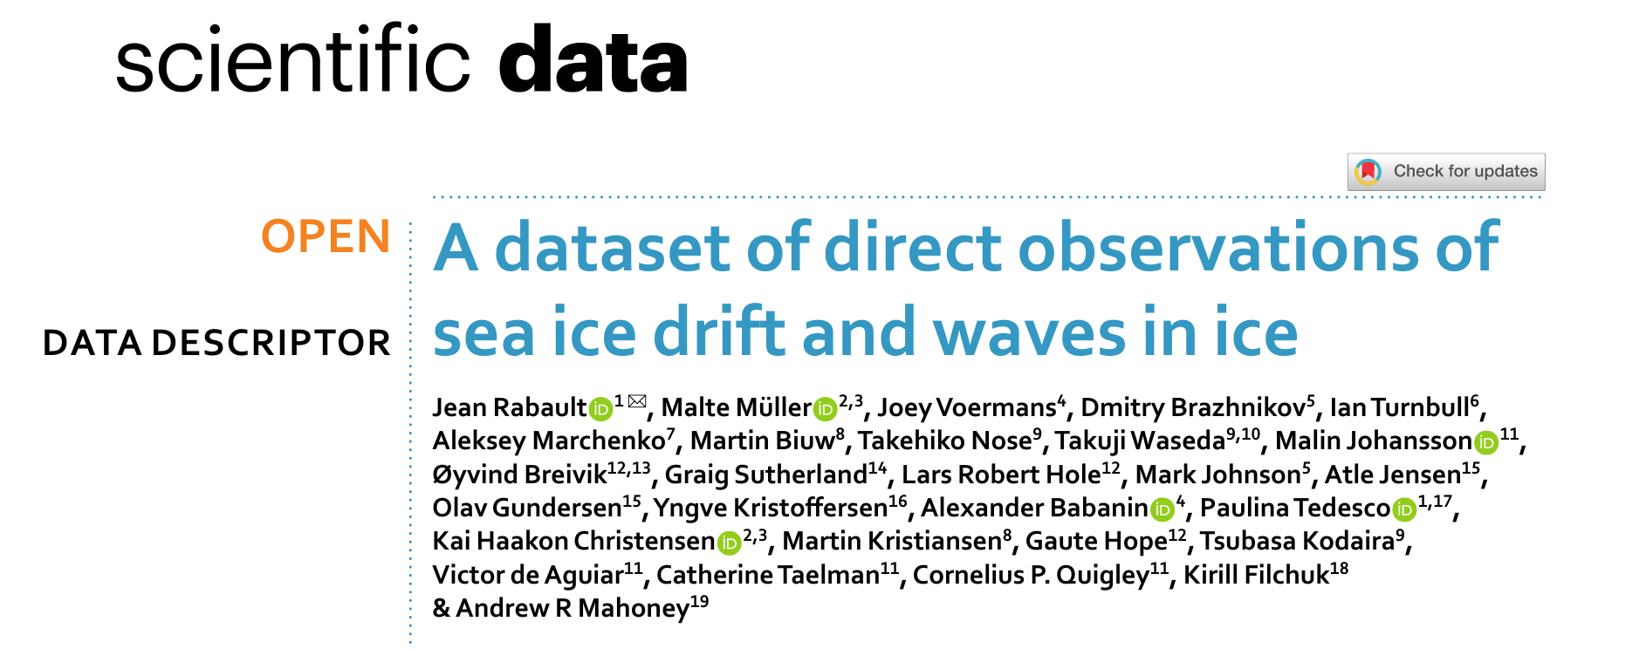
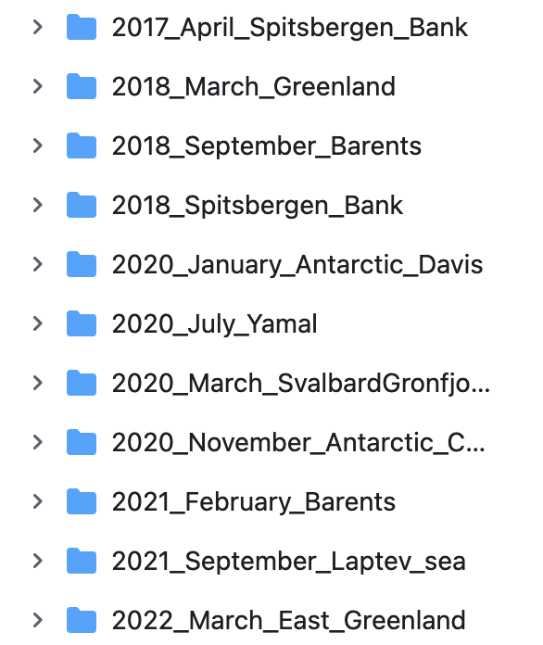
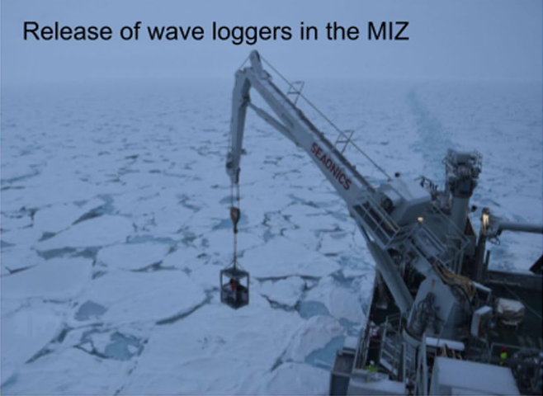
The road ahead
The distance over which waves propagate in ice is crucial → New altimetry products (IS-2, CryoSat-2) and in-situ measurement (OpenMetBuoys, Moorings, Swift buoys...) offer new avenues for model evaluation.
A lot of these buoys include a wave sensor
(I was not involved in any of that work, all credit goes to these people)
Rabault et al. 2022,
https://www.nature.com/articles/s41597-023-02160-9
It spans different times, places, ice conditions
I) Wave impact on ice dynamics with neXtSIM-WW3 II) Modelled MIZ extent III) The road ahead

Slide 32
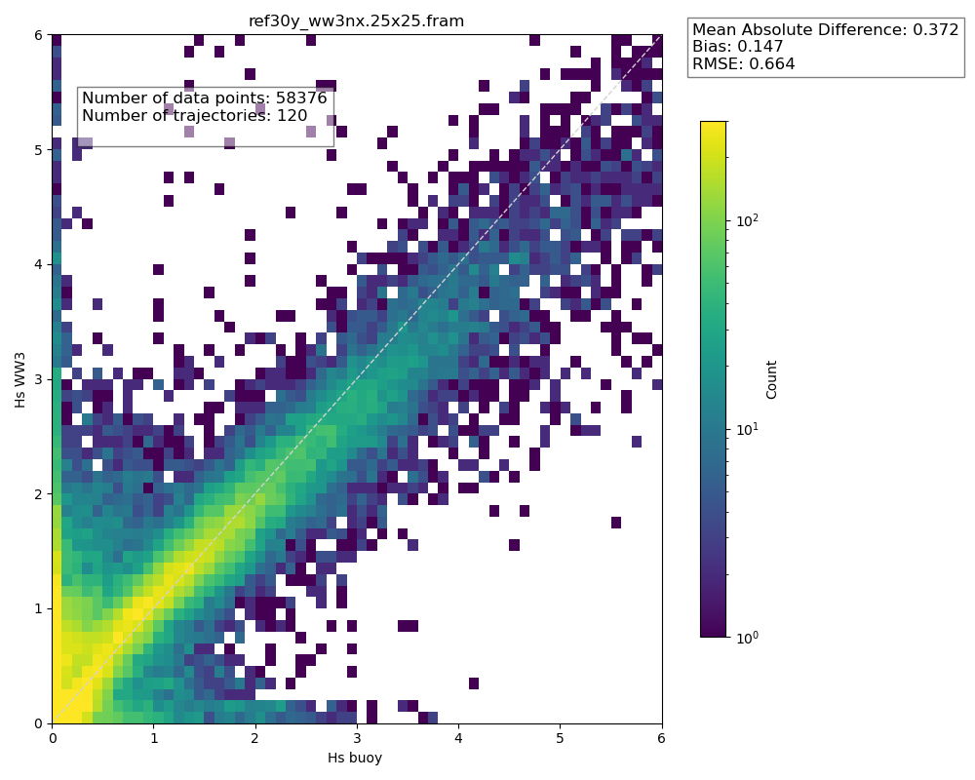
The road ahead: model vs a lot of in-situ observations
Not uncommon to have high modelled waves when none are observed
Now taking all relevant* OMB trajectories for 2018—2023
Smaller wave heights are generally overestimated
Higher wave height are generally underestimated
The model shows some skill, but where, when, and how do we explain outliers?
*With wave measurements, within the domain, that do not make my script crash
K. Holland
I) Wave impact on ice dynamics with neXtSIM-WW3 II) Modelled MIZ extent III) The road ahead

Slide 33
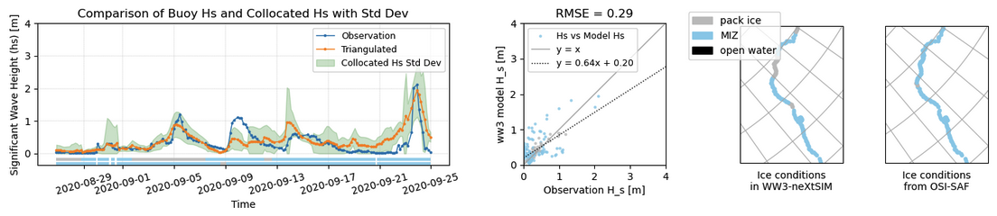
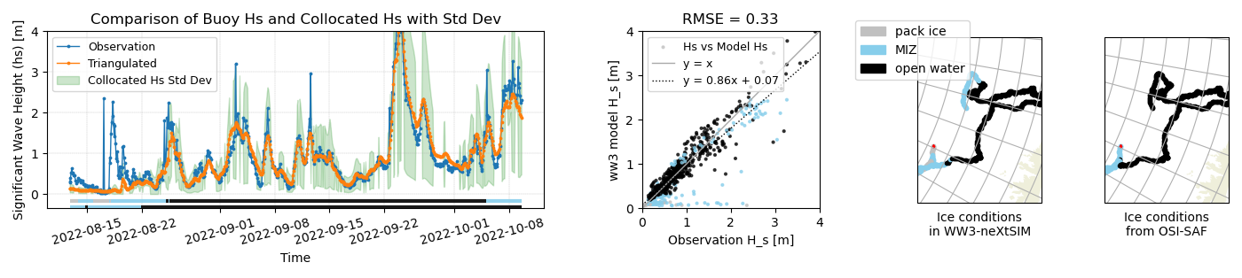
The road ahead: model vs a lot of in-situ observations
Color code: Each point’s color corresponds to its location in OW, MIZ, or pack ice, according to ice concentration criterion (0.15<MIZ<0.8) either in the model or in OSI-SAF observation dataset
Example with a buoy in the Kara Sea in July 2020
Another one North of Svalbard in August/September 2022 (MetNo/CIRFA)
I) Wave impact on ice dynamics with neXtSIM-WW3 II) Modelled MIZ extent III) The road ahead

Slide 34
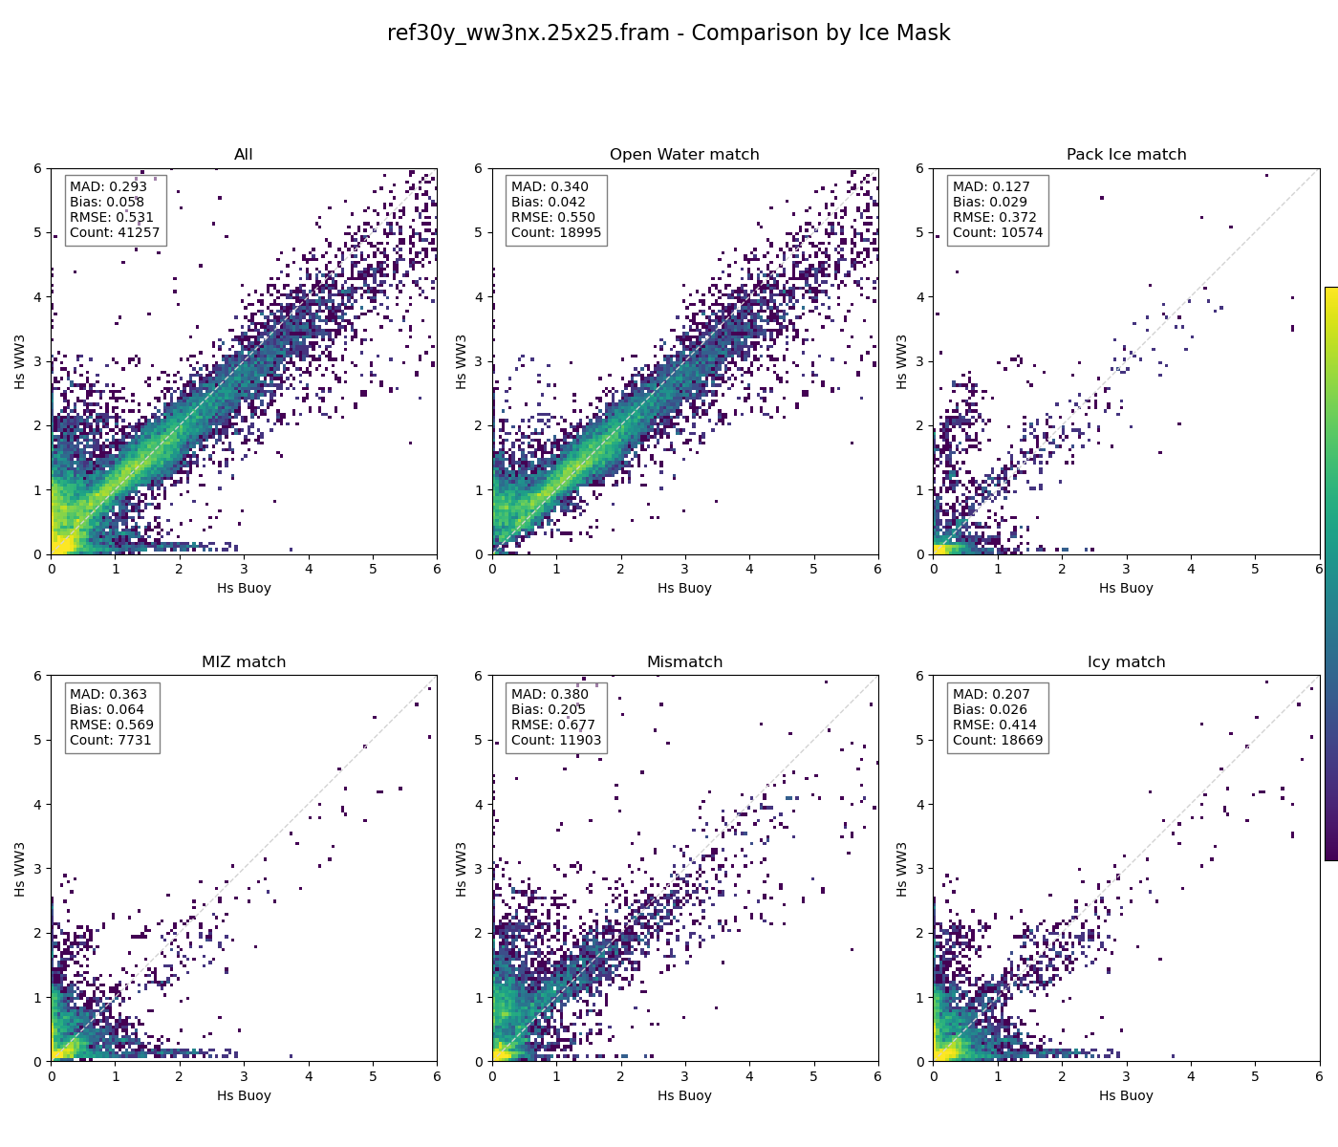
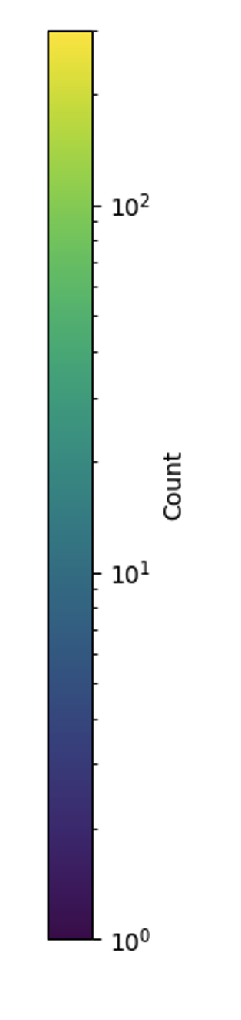
The road ahead: model vs a lot of in-situ observations
Most points are in open water. Higher waves a bit underestimated
I) Wave impact on ice dynamics with neXtSIM-WW3 II) Modelled MIZ extent III) The road ahead

Slide 35
The road ahead: model vs a lot of in-situ observations
Exploratory analysis suggests:
Bias in ice edge location is the 1st cause of error
→ Choice of ocean forcing strongly impact results
Model performs better with high, long waves (storm swells) than in calm conditions (Hs<1m, Tp<8s)

Slide 36
The road ahead: model vs a lot of in-situ observations
Why starting with OMB?
→ Lots of data in a (quite) consistent format, easy to find.
Data already processed for Hs, Tp and wave spectra.
Norwegian initiative, so hard for me to not hear about it, and easy access to information
(and also intense (friendly) lobbying from J. Rabault...)
What’s next?
No concrete plans right now, but would love to make one!
I would love to add data from Beaufort/Chukchi (Swift buoys, AWAC on WHOI moorings...)
I) Wave impact on ice dynamics with neXtSIM-WW3 II) Modelled MIZ extent III) The road ahead

Slide 37
The road ahead: interactions with the oceans
NFR Young Talent 2023
Already in there
For the mixing: I plan to use neXtSIM-WW3-NEMO.
Technically, a lot of things are there, just need to “connect the pipes”.
1st step: a case study?
January 2022, Barents Sea
October 2015, Beaufort Sea
MOSAIC? N-ICE2015?
I) Wave impact on ice dynamics with neXtSIM-WW3 II) Modelled MIZ extent III) The road ahead

Slide 38
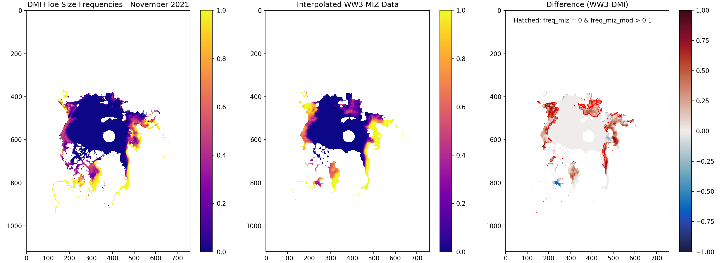
The road ahead: sea ice breakup
Comparing with automated ice charts (DMI product, available on CMEMS, 500m resolution)
Small Floes | Medium Floes | Large (and vast) floes
<100m | <500m | >500m (>2km)
https://doi.org/10.48670/mds-00343
I) Wave impact on ice dynamics with neXtSIM-WW3 II) Modelled MIZ extent III) The road ahead

Slide 39
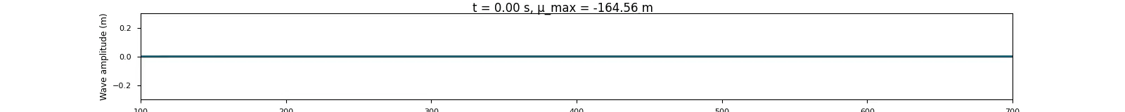
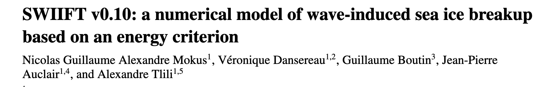
The road ahead: sea ice breakup
Uncertainties associated with the breakup representation:
How many big floes are broken?
And what is the threshold for breakup?
I believe everyone using a strain-based criterion, but it can also be turned into an energy problem.
Courtesy of Véronique Dansereau
How many small and medium floes are created?
Véronique and Nicolas have a preprint in review in GMD:
I) Wave impact on ice dynamics with neXtSIM-WW3 II) Modelled MIZ extent III) The road ahead

Slide 40
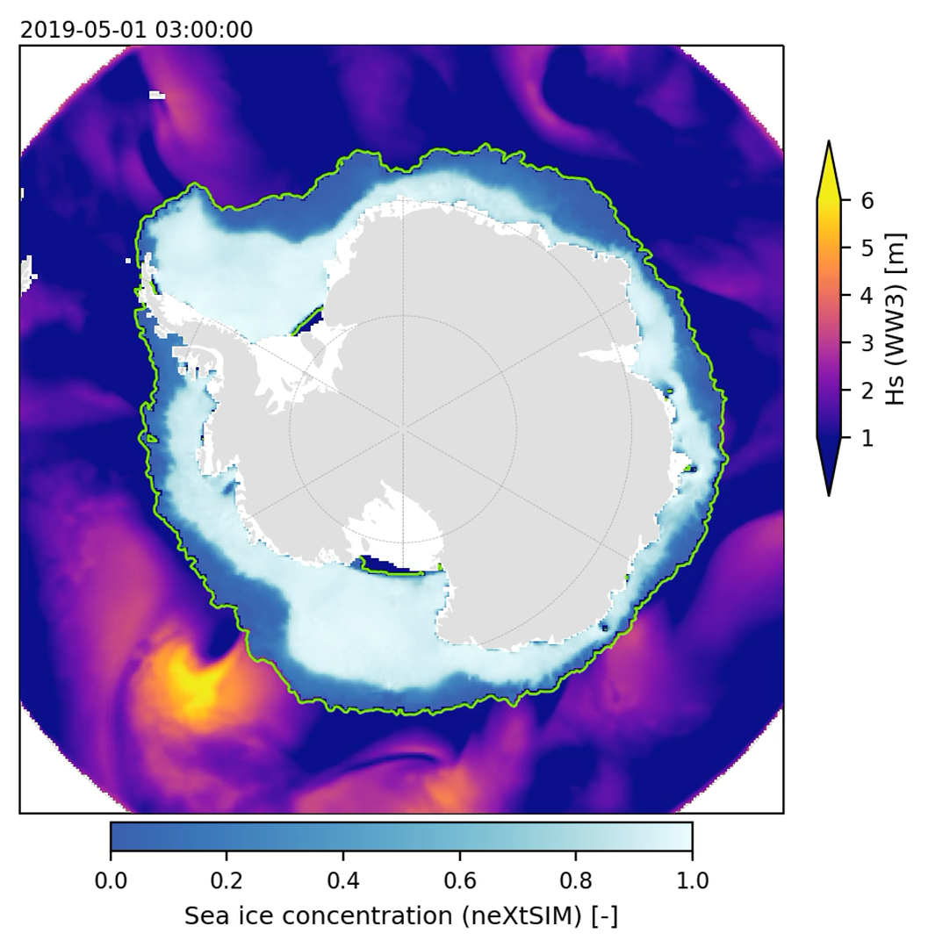
And also..
Damage is interesting, but not meant to represent MIZ rheology. How do we represent ice mechanics in the MIZ, in a large-scale model? How does it impact the momentum exchanges between the ocean and the atmosphere?
What about Antarctica?
I) Wave impact on ice dynamics with neXtSIM-WW3 II) Modelled MIZ extent III) The road ahead

Slide 41
Conclusions
Novel capabilities
Wave-ice coupled model, can run for a few months at ~10km resolution, for decades with ~20km. Close to operational in the Arctic, not quite there yet in Antarctic. My limitations are: WAVEWATCH III.
2) Time scales and impact:
Daily for forecast/ ice edge impact, up to decadal. Impact on longer timescales is unclear, likely larger in Antarctic. I am mostly interested in momentum fluxes, and how they transition between open water (not my focus) and pack ice (very much what my group cares about)
Cover Picture: Elie Dumas-Lefebvre,
Dany Dumont
References:
Boutin, G., Williams, T., Horvat, C., & Brodeau, L. (2022). Modelling the Arctic wave-affected marginal ice zone: A comparison with ICESat-2 observations. Philosophical Transactions of the Royal Society A: Mathematical, Physical and Engineering Sciences, 380(2235), 20210262. https://doi.org/10.1098/rsta.2021.0262
Boutin, G., Williams, T., Rampal, P., Olason, E., and Lique, C.: Wave–sea-ice interactions in a brittle rheological framework, The Cryosphere, https://doi.org/10.5194/tc-15-431-2021, 2021.

Slide 42
Conclusions
3) Relative impact against other processes in the pan Arctic/Antarctic system or full earth system?
Not first order, but may not be negligible and on the rise, at least in the Arctic.
Likely important for forecasting and human activities in polar regions.
4) Model resolution vs parameterizations?
Open question, depends on the application. Why do we want waves or a MIZ?
5) Steps needed
Pan-Arctic floe size would be a start.
Observations of the dynamics in the MIZ.
Cover Picture: Elie Dumas-Lefebvre,
Dany Dumont
References:
Boutin, G., Williams, T., Horvat, C., & Brodeau, L. (2022). Modelling the Arctic wave-affected marginal ice zone: A comparison with ICESat-2 observations. Philosophical Transactions of the Royal Society A: Mathematical, Physical and Engineering Sciences, 380(2235), 20210262. https://doi.org/10.1098/rsta.2021.0262
Boutin, G., Williams, T., Rampal, P., Olason, E., and Lique, C.: Wave–sea-ice interactions in a brittle rheological framework, The Cryosphere, https://doi.org/10.5194/tc-15-431-2021, 2021.

Slide 43
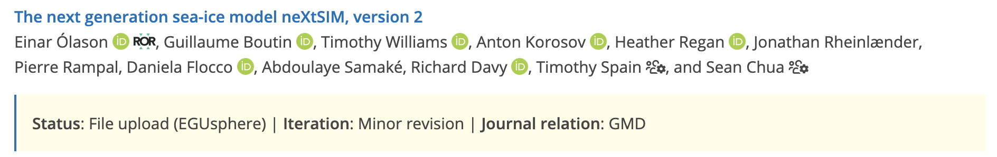
Supplement
The current model is not so expensive, but it does not scale well with the number of cores.
This is because 2 things are parallelized: remeshing, and interpolation of exchanged quantities on a fixed grid when couple
Future plans for the model:
Transition to a Eulerian (non-moving) grid model, using Discontinuous Galerkin method for advection
Parallelization of the remeshing in the Lagrangian model
Make it open source → Publication in GMD (discussion) starting anytime soon

Slide 44
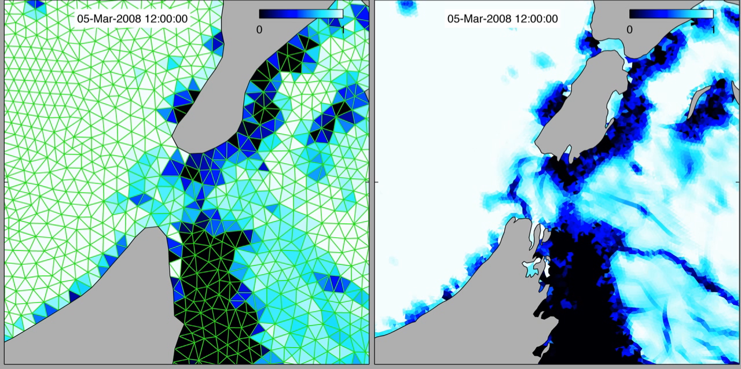
Supplement
An old video of the Lagrangian model. Most likely done by P. Rampal or S. Bouillon, or E. Ólason

Slide 45
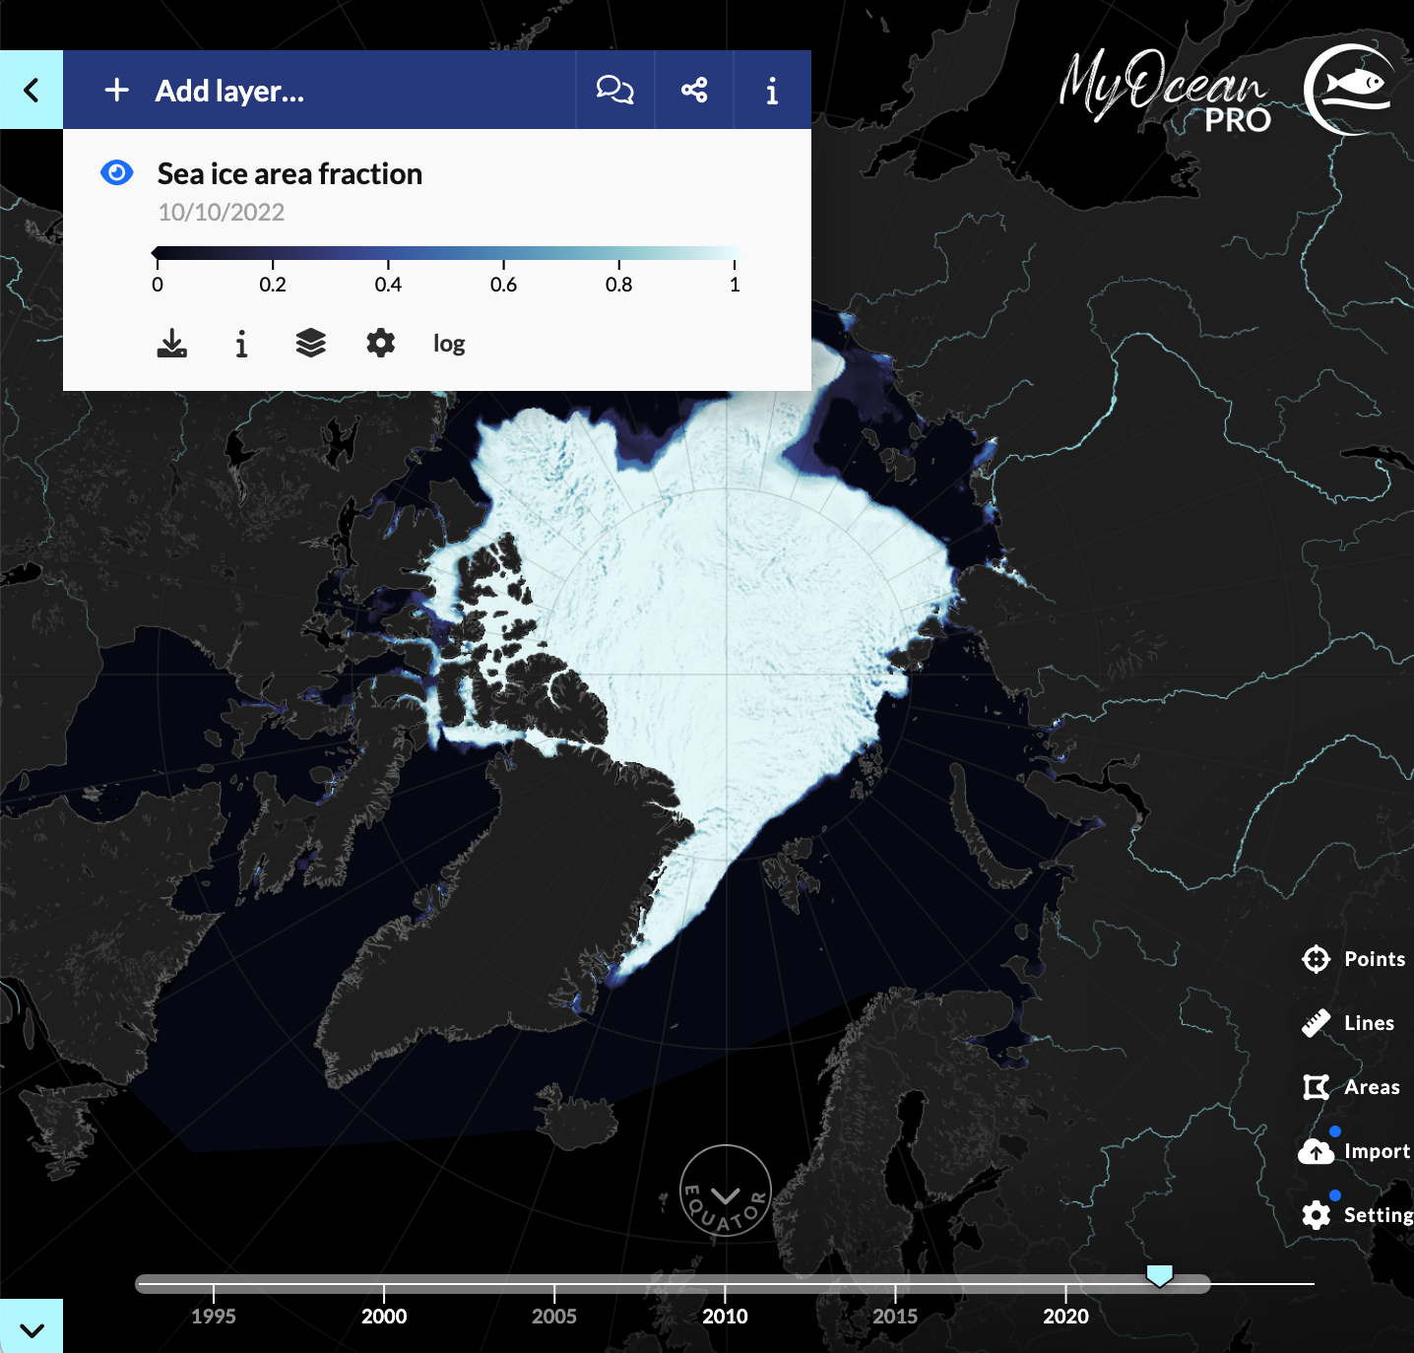
Supplement
neXtSIM is used in a forecast (neXtSIM-F)
https://data.marine.copernicus.eu/viewer/expert?view=viewer&crs=epsg%3A32661&t=1665324000000&z=0&center=-78.69006752597979%2C89.99999999999999&zoom=11.06583254756172&layers=H4sIAOgGmmcAAxXNQQuCMBQA4P.yzobbiILdxIQGCWJ2kIjHmK8abDNchSv679X1u3zHNzidaFIDSCjasl

