Slide 1

The geometry of perceptual spaces of textures and objects
J. Victor
Weill Cornell Medical College
ICERM workshop on Topology and Geometry in Neuroscience
Brown University
Providence, RI
October 2023
Suniyya Waraich
PhD candidate, Weill Cornell
Fred Plum Fellow
Support: EY07977
Notes:
Many slides from RepresentationalGeometry2023..pptx
Slides containing weighted calculations have been corrected for the bug that affected the “combine pairs” calculations (Jan 30 2018)

Slide 2
We can use geometry in (at least) two ways:
Dimension reduction
  We can acquire vast datasets, typically spatiotemporal, and need to make sense of it
  Vector-space formalisms are appropriate
Understand neural underpinnings of behavior and perception
  The guiding principle is that similar percepts correspond to similar activity patterns
  We need to think about what we mean by “similar”
  Vector space formalisms may, or may not, be appropriate

Slide 3
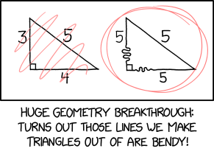
Outline
What kinds of models do we need to consider for perceptual spaces?
Testing these models experimentally
  Low-level (features) and high-level (semantic) content
  The influence of task
A complementary analytic strategy
Open questions
https://xkcd.com/2706

Slide 4
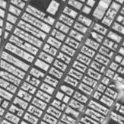





The Zoo
Locally Euclidean
Euclidean
Minkowski
Addtree
Ultrametric
Distances on
curved surfaces
Manhattan distances
Mileage
(no loops)
Hierarchy
Everyday life
coordinates?
local
continuous?
Pythagorean?
local
Isotropic?
Inequalities
triangle
“four-point”
ultrametric
And inhomogeneity.
And mixtures.
Notes:
Maine mileage chart from http://www.joshuahowe.com/2012/02/maine-mileage-chart-and-table-from-1988.html
City block image from https://www.nytimes.com/interactive/2016/12/21/upshot/Mapping-the-Shadows-of-New-York-City.html
Other images from Waraich Tubingen talk Tubingen_Talk 1.pptx

Slide 5
Toy Scenario
B₊
c
A₋
A₊
a
B₋
Euclidean: c² = 2a²
Comparing c and a constrains the geometry.
Spherical: c² < 2a²
Hyperbolic: c² > 2a²

Slide 6
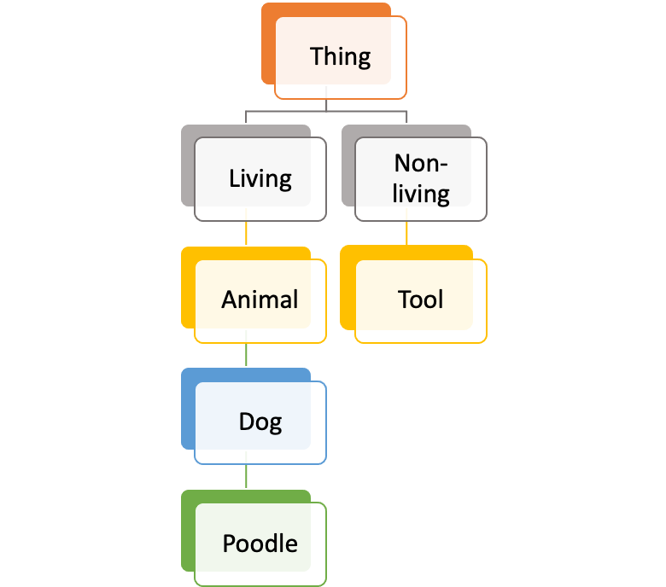

Are there qualitative differences between perceptual spaces?
color lies in a continuous domain
objects are often categorical

Slide 7
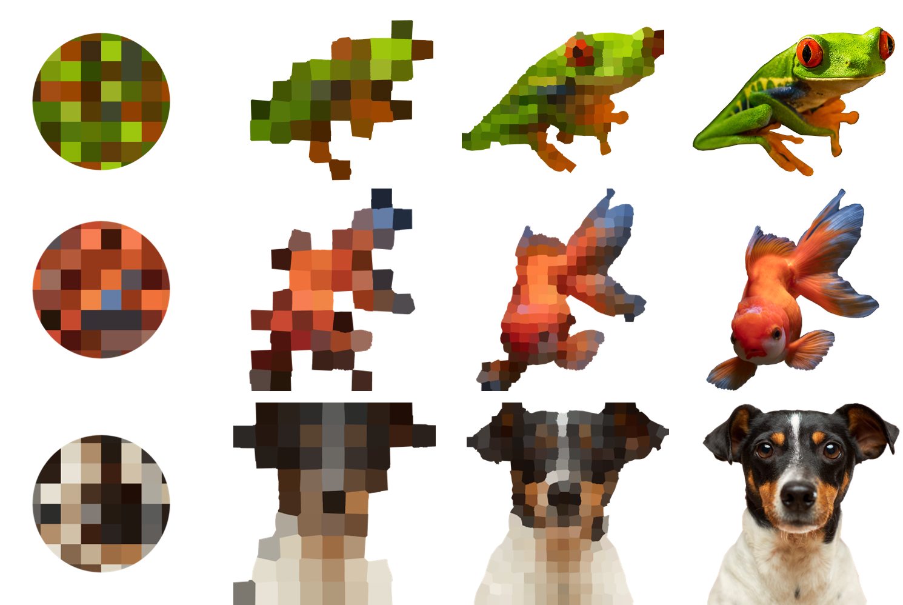
A range of stimulus domains
  frog
bluebird
goldfish
  dog
colored textures
common animal names
Stimuli correspond across domains.
Notes:
Choice of animals
37
All derived from common names, images. Vary in semantic information.
Need similarity judgments.

Slide 8
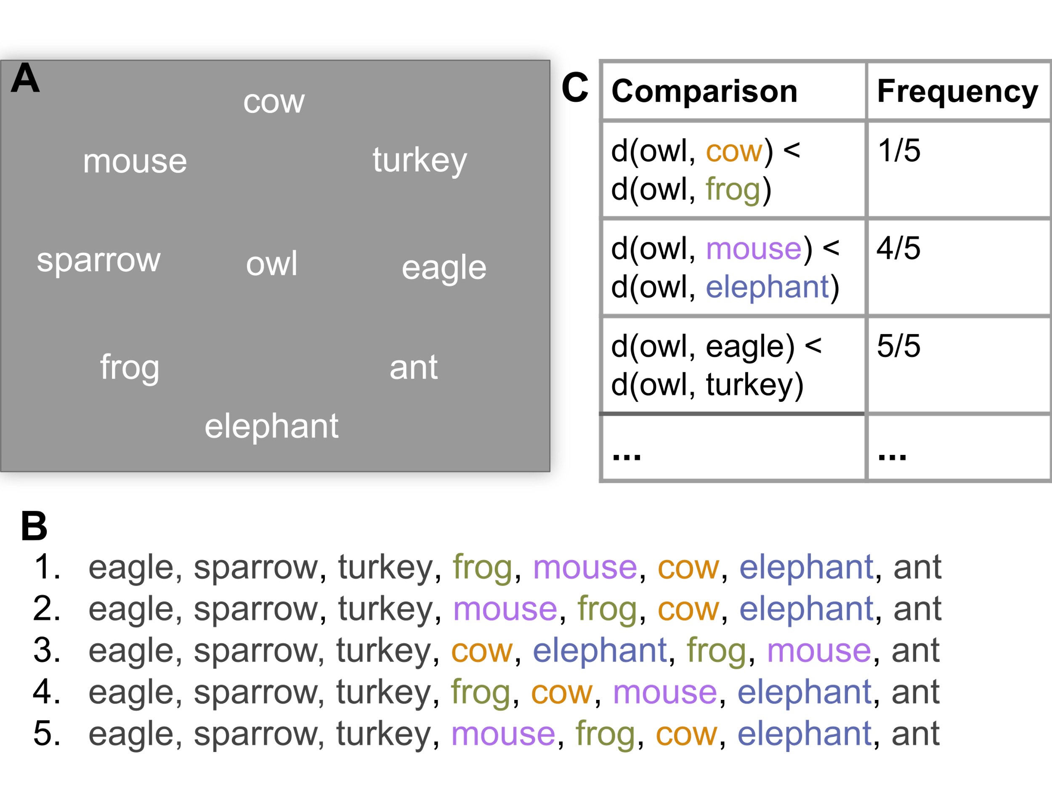
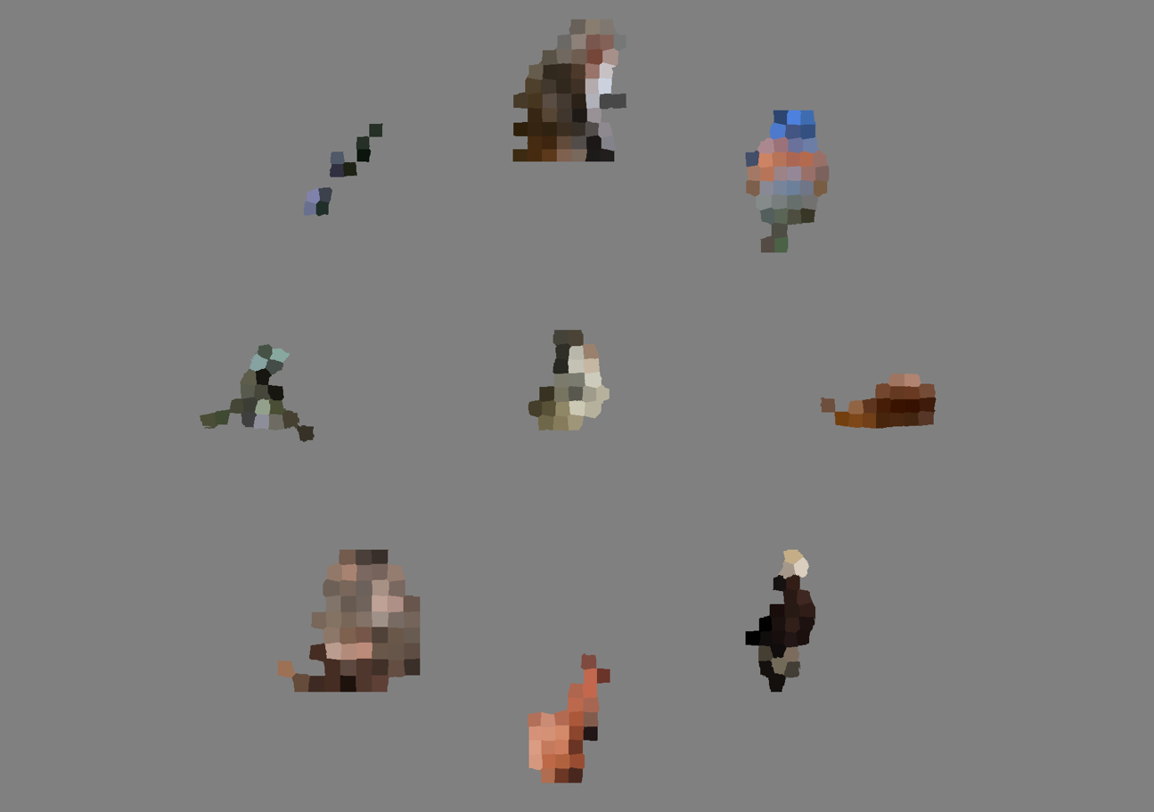
Collecting similarity judgments
Subjects click each of 8 comparison stimuli in order of their similarity to the central reference
bluebird
One trial yields a ranking of 8 similarities to the central reference, i.e., (8*7)/2=28 comparison pairs.
Waraich, S.A., Victor, J.D., (2022), J. Vis. Exp. (181)
Notes:
On choice of stimuli… needed stimuli that could be ultimately used to answer the overarching question of how representations are transformed so they had to be linked. On choice of animals… they had to be easy to categorize because our original hypothesis was that semantic domain would be more categorical, hierarchically organized and textures would be more continuous.
To study how the mental representations of purely sensory and semantic information are different, we study make use of five distinct stimulus domains. These stimulus domains differ in their level of semantic content, with textures on one extreme – devoid of meaning – and words on the other – an example of purely semantic information. We include an image domain – that carries both visual and semantic information, and In between we include two intermediate domains, one more texture-like and one more image-like. Understanding how representations change with the kind and relative amounts of visual or semantic information they carry, can help us understand at an algorithmic level how semantic representations are formed.
All the stimulus domains were derived from a set of 37 familiar animals chosen from WordNet.
We conducted a separate psychophysical experiment for each of five domains [list the domains].. In a typical experiment, subjects are shown stimuli from the same domain in different groupings, where one stimulus appears in the center surrounded by 8 others
The task is to select stimuli in the surround in order of similarity to the central reference, by clicking the stimulus most like the reference first and clicking the least similar last. Each of these configurations (a reference stimulus and 8 others) is repeated 5 times, over the course of 10 sessions of 111 trials each.
How many subjects? 9 subjects. 2 of them participated in a subset of exps and the remaining 7 participated in 5.
I am showing data collected so far from all of these subjects. I am waiting for 3 more datasets and then I will be done with the psychophysical data collection.
What happens to the data – trial to ranking to choice probs which form the basis for all analysis – show U shaped curve for one dataset

Slide 9
Design Details
In each domain
  37 stimuli
  222 unique trials
    Designed to include all (reference , comparison) pairs
    Designed to include some (reference, comparison) pairs in two contexts
    Otherwise “frozen” randomization
  One trial yields 28 distance comparison pairs
    222 trials x 28 distance comparison pairs = 6216
    << all possible d(A,B) vs d(A,C) comparisons [N(N-1)(N-2)/2=23310]
    << all possible d(A,B) vs d(C,D) comparisons [N(N-1)(N-2)(N-3)/8=198135]
    But large enough to constrain models
  Each unique trial repeated 5 times
    Allows estimation of choice probability
5 domains, 11-12 subjects per domain
  10 hrs/subject/domain
Notes:
(5994 are unique up to context)

Slide 10
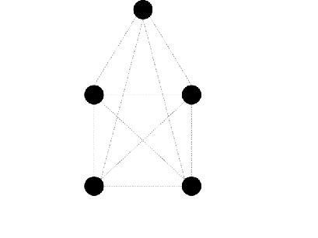
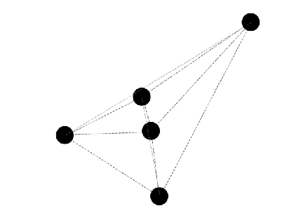
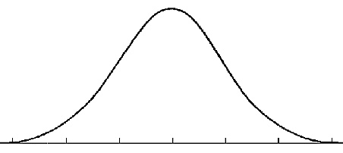
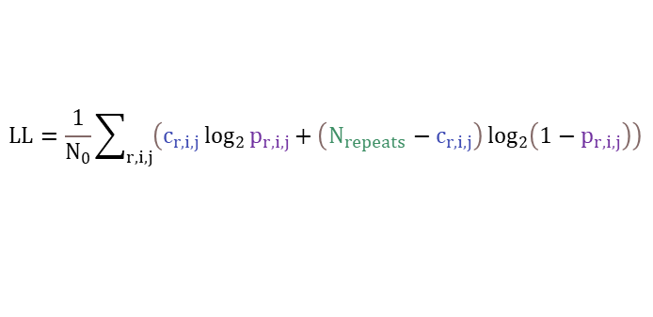


Inferring geometry from similarity judgments
Win/lose heuristic
standard multi-dimensional scaling
Predict trial-by-trial response using decision model
Calculate pairwise distances
Calculate log-likelihood of observed responses
adjust point coordinates
Get best coordinates
$$LL=\frac{1}{N_{0}}\sum_{r,i,j}{\left(c_{r,i,j}\log_{2}{p_{r,i,j}}+\left(N_{repeats}−c_{r,i,j}\right)\log_{2}\left(1−p_{r,i,j}\right)\right)}$$
$$−σ$$
0
$$σ$$
D = d(owl, cow) - d(owl, frog) + noise
r: reference
$$P(d(owl,cow)<d(owl,frog)=P(D<0)$$
i,j: comparison stimuli
Comparison | Empirical Choice Probability | Model Probability
d(owl, mouse) < d(owl, elephant) | 4/55 | 0.87
d(owl, cow) < d(owl, frog) | 1/55 | 0.15
... | ... | ...
Distances are measured w.r.t. a noise parameter σ
Notes:
Additive noise. Noise at the level of comparison not coordinates.
Size of distances compared to noise. We can fix sigma = 1. So distances are relative to noise, in units of jnd’s. -> Gives us a signal-to noise measure. -> tells us how big is the space in jnd’s.
Trying to predict choice probabilities not rank orderings.
Pegged internal noise to be 1, everything relative to that.
Clarify - we are not calculating feature-vector based distances.
Predict choice prob not just rank order.

Slide 11
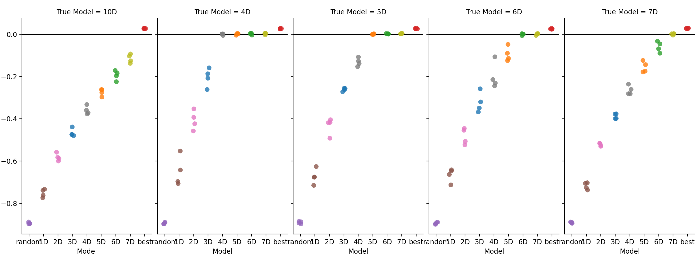
Validation: numerical simulations
ground-truth dimension
4 D
5 D
6 D
7 D
10 D
True Model: 4D
True Model: 5D
True Model: 6D
True Model: 7D
True Model: 10D
0.0
-0.2
-0.4
log likelihood relative to ground-truth model
-0.6
-0.8
5D
7D
Best
5D
7D
Best
1D
2D
3D
4D
5D
6D
7D
Best
5D
7D
Best
Rand
1D
2D
3D
4D
6D
1D
2D
3D
4D
5D
6D
7D
Best
1D
2D
3D
4D
6D
Rand
Rand
1D
2D
3D
4D
6D
Rand
Rand
model dimension
The analysis works for at least 7 dimensions.
Notes:
If points come from a 7D space, pipeline finds them.
If 10D points are taken and fit to a 5D model, it fails. (Negative control)
Since last time, I implemented gradient descent instead of Nelder Mead - now it works better! :)
Also this has extended it to work for up to 7 dimensions. Have not tried more dimensions.
If points come from a 7D space, pipeline finds them. If 10D points are taken,
Haven’t tried greater than 7D for fitting because sqrt(37) ~ 6, so I don’t see a good reason to. ??? Sochna ?
To anchor the LLs, add random LL and a best LL to gauge performance of models.
We know there is overfitting – how much is the overfitting. We can estimate – and show if you’re interested. – this will be a tangent which will require explaining the decision model, sigma’s role in it, how sigma could improve or decrease the bias – and the intuitive reason for why. (worth writing all this down anyways.
In the next slide I will show model LLs with bias correction as well.

Slide 12
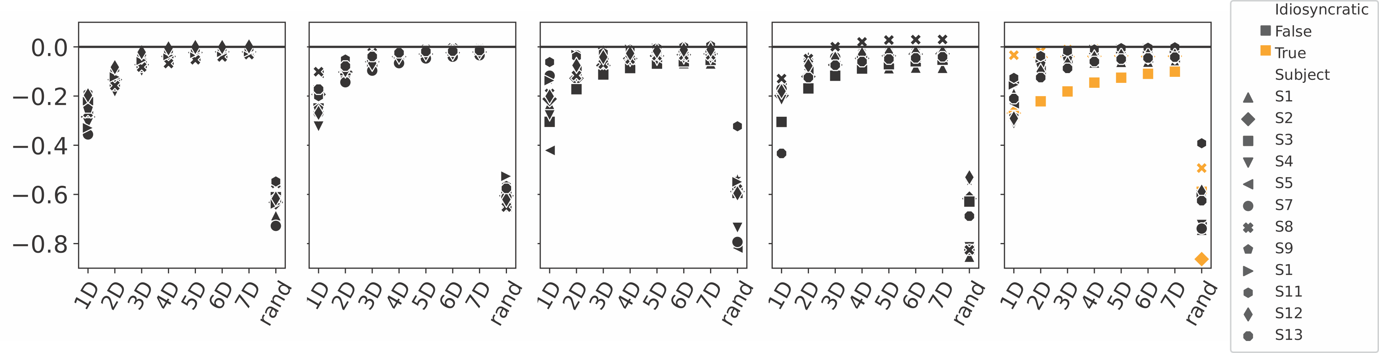
Results across the five domains
bluebird
log likelihood relative to geometrically-unconstrained model
bluebird
model dimension
Model
Idiosyncratic strategies
No clear difference in dimensionality across domains.
Notes:
Mention idiosyncratic subjects here

Slide 13
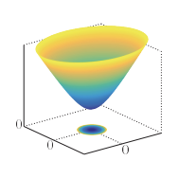
Do the domains differ in curvature?
Hyperbolic:
negative curvature
Euclidean: zero curvature
Spherical: positive curvature
N
O
S
Start with curvature=0; gradually increase (or decrease), optimizing coordinates at each step.
At each step, same analysis pipeline, just change how distances are computed.
Figures edited from
http://abyss.uoregon.edu/~js/cosmo/lectures/lec15.html
Wikipedia (Stereographic Projection)
Notes:
Given points in a euclidean space we can project them onto a spherical or a hyperbolic space.
Okay idea is similar to prev, give JV credit,
Introduce curvature.
Have a picture of flat curvature, negative and positive curvature.
Mention all hypotheses. Spherical is smaller and finite - the other two are progressively roomier spaces.

Slide 14

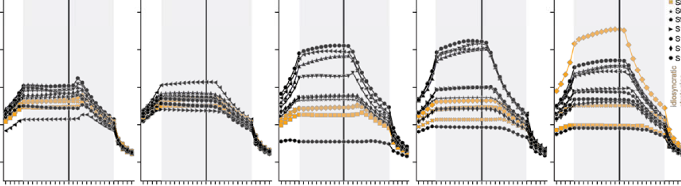
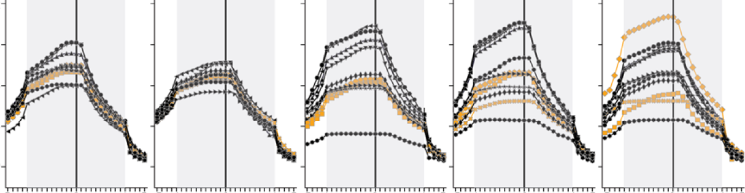
No
bluebird
-0.2
2D
-0.6
-1.0
log likelihood relative to geometrically-unconstrained model
-0.2
-5
-1
0
+1
+5
-5
-1
0
+1
+5
7D
curvature
curvature
curvature is in units of 1/σ
More hyperbolic
More spherical
More hyperbolic
More spherical
-0.6
-1.0
-5
-1
0
+1
+5
-5
-1
0
+1
+5
curvature
curvature
curvature is in units of 1/σ
More hyperbolic
More spherical
More hyperbolic
More spherical
Notes:
7D data shown, 2D data is similar. Note difference in coloring of subject labels, and missing S9, and subjects out of order.

Slide 15
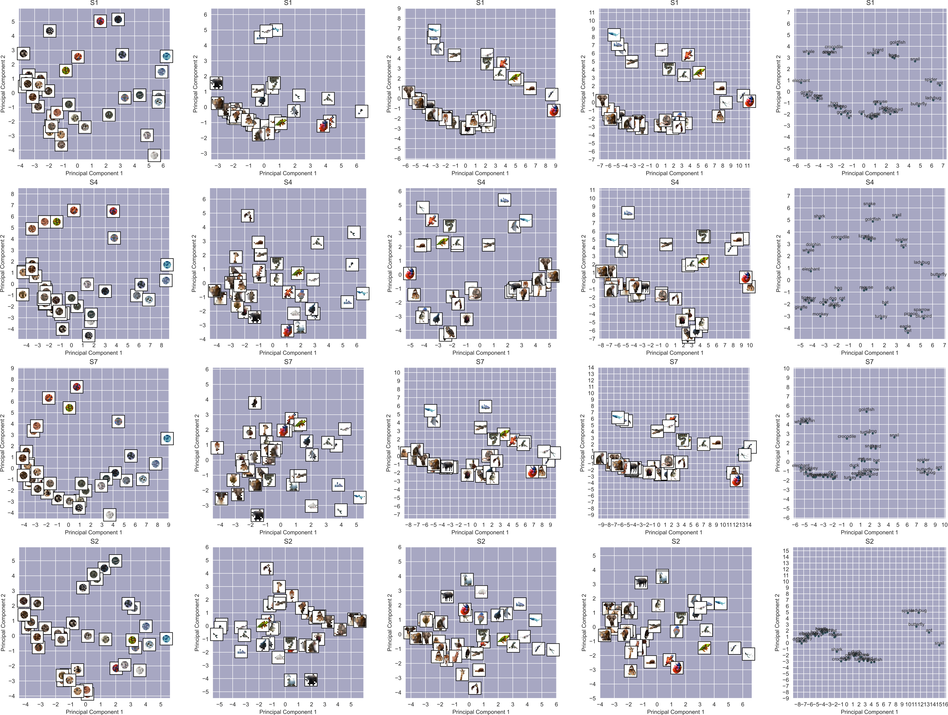
How are the points arranged?
bluebird
S1
S4
S7
S2
Notes:
Let’s look at the data -
I hope you can see some consistency across columns.
Checks - units of 1 jnd -> noise parameter = 1 unit.
So distances are relative to noise parameter

Slide 16
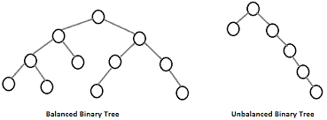

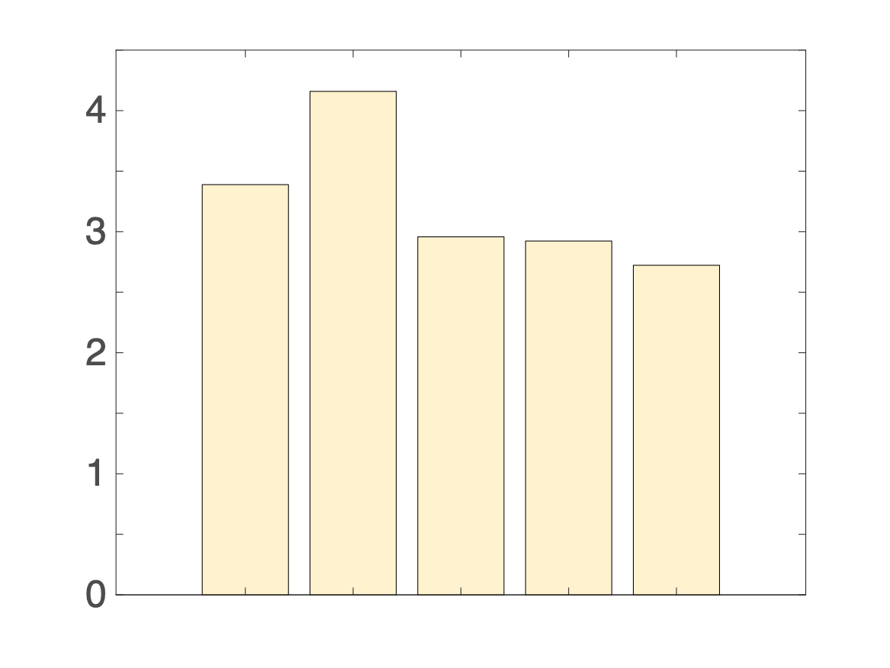
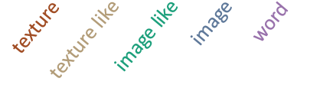

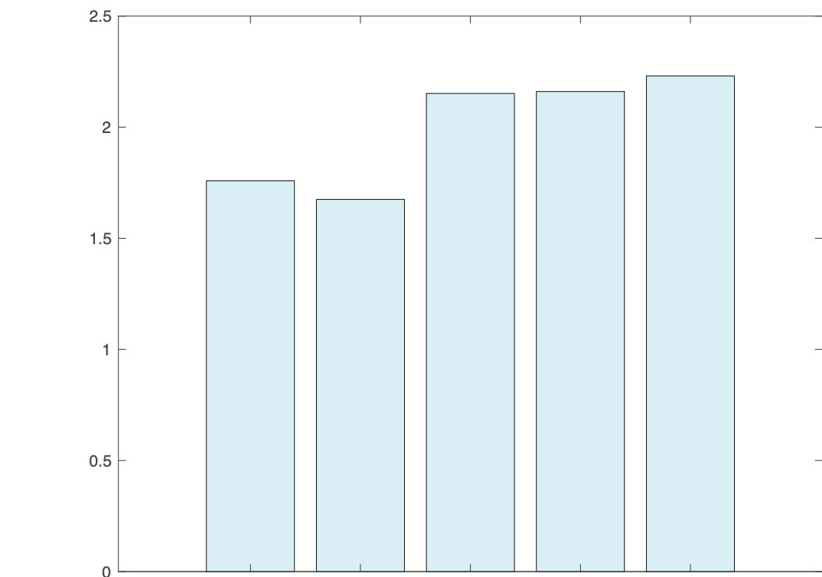
Analyze by hierarchical clustering
bluebird
bluebird
unbalanced tree
balanced tree
n=12
ratio of subtree sizes
subtree ratio
>>1
~1
information halfway down tree
2
low
Information (bits)
high
1
0
Notes:
Explain hierarchical analysis.
Hierarchical clustering to find trees that describe judgments.
Visual inspection to see which seems like the more natural tree.
Quantification of what we see
Indirect evidence of treeless motivates hyperbolic space route.

Slide 17
So far:
A way to acquire and analyze similarity judgments
  Euclidean models seem OK
  Domains differ, but need to look at (relatively) subtle aspects
Can we make better use of domain structure?

Slide 18
The Zoo
Locally Euclidean
Euclidean
Minkowski
Addtree
Ultrametric
Distances on
curved surfaces
Manhattan distances
Mileage
(no loops)
Hierarchy
Everyday life
coordinates?
local
continuous?
Pythagorean?
local
Isotropic?
Inequalities
triangle
“four-point”
ultrametric
Notes:
Maine mileage chart from http://www.joshuahowe.com/2012/02/maine-mileage-chart-and-table-from-1988.html
City block image from https://www.nytimes.com/interactive/2016/12/21/upshot/Mapping-the-Shadows-of-New-York-City.html
Other images from Waraich Tubingen talk Tubingen_Talk 1.pptx

Slide 19
Back to the Toy Scenario
B₊
c
A₋
A₊
a
B₋
Euclidean: c² = 2a²
Spherical: c² < 2a²
Minkowski (p>2): c² < 2a²
Hyperbolic: c² > 2a²
Minkowski (p<2): c² > 2a²
(p=1: Manhattan metric)

Slide 20
B₊
c
scale and rotate
c
a
A₋
A₊
a
Euclidean: c² = 2a²
B₋
Spherical: c² < 2a²
Hyperbolic: c² > 2a²
Minkowski (p>2): c² < 2a²
Minkowski (p<2): c² < 2a²
Minkowski (p<2): c² > 2a²
Minkowski (p>2): c² > 2a²
Rank order never helps to distinguish; in all cases, c>a!
We need quantitative distances, and rotation (or midpoints).

Slide 21
What we need is a perceptual space of high dimension, in which we can find midpoints.

Slide 22
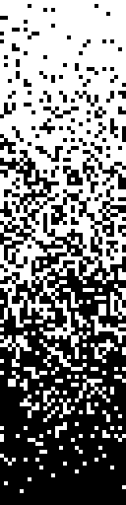
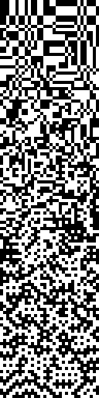
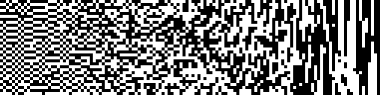

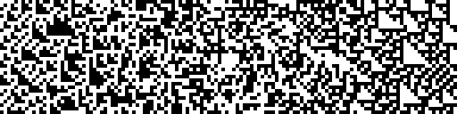
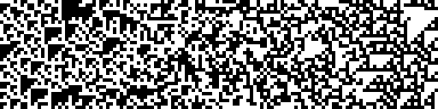
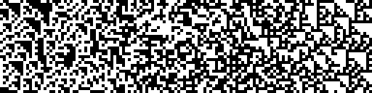
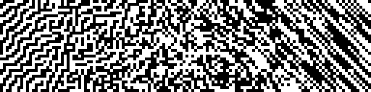
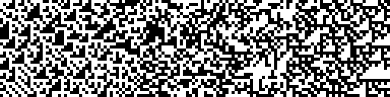
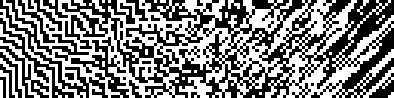
A space of visual textures: 10 degrees of freedom
+1
0
-1
single point
two points
three points
four points
γ
β_
β|
β\
β/
θ
θ
θ
θ
α
Victor & Conte, JOSA A 2012

Slide 23
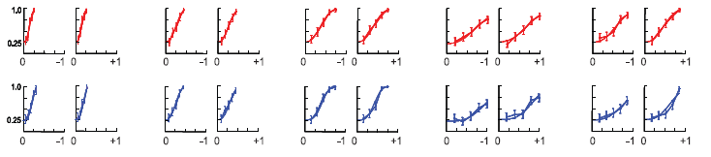
Sensitivity is selective, and similar across observers
MC
fraction correct
DT
-
+
-
+
-
+
-
+
-
+
γ
β_
β/
θ
α
1.0
12 normal subjects show a consistent pattern of sensitivities
(we now have data on 26 subjects)
0.5
threshold
AA
AO
JD
KP
0.2
CC
MC
TT
JK
RM
DT
DF
JB
-
-
-
-
-
0.1
+
+
+
+
+
γ
β_
β/
θ
α
Notes:
Note that N=12-graph is changed to have – values on left, + values on right.

Slide 24
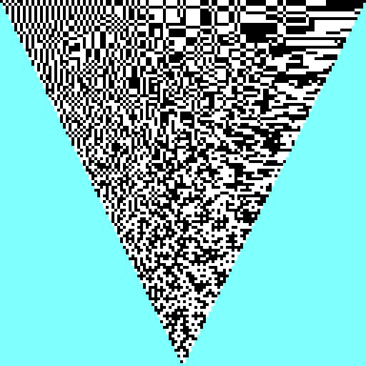
Pairwise interactions
S: DT
α
S: MC
β₋
S: DF
Victor, Thengone, Rizvi, & Conte, Vision Res 2015

Slide 25
A quadratic model accounts for perceptual thresholds
1
1
1
1
1
β_
β\
θ
α
β_
-1
-1
γ
1
-1
-1
γ
1
-1
-1
γ
1
-1
-1
γ
1
-1
-1
β|
1
1
1
1
1
1
β_
θ
α
β\
θ
data +/- 95%CL
model
-1
-1
β\
1
-1
-1
β_
1
-1
-1
β_
1
-1
-1
β/
1
-1
-1
β\
1
1
1
1
1
1
>95% of variance explained
θ
α
θ
θ
α
-1
-1
-1
-1
-1
S: MC
-1
β/
1
-1
β\
1
-1
θ
1
-1
θ
1
-1
θ
1
In each plane, isodiscrimination contours are approximately elliptical.
Distance to threshold =
c_{i} : the coordinates
Q_{i},_{j} : the metric
Victor, Thengone, Rizvi, & Conte, Vision Res 2015
Notes:
25
btc_allraysfixedb_mc_100surrs_thresh.emf

Slide 26
Select four approximately orthogonal coordinates…
+1
0
-1
single point
two points
three points
four points
γ
β_
β|
β\
β/
θ
θ
θ
θ
α

Slide 27
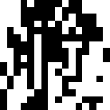

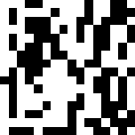

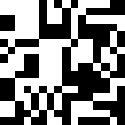
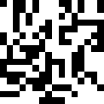

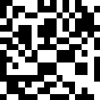


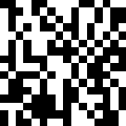


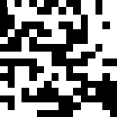




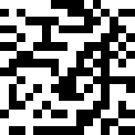
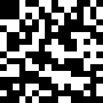

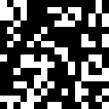

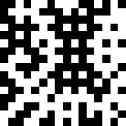
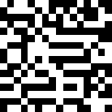
Stimuli
β|>0
s 9: c= 0.40
α> 0
γ>0
s 12: a= 0.80
s 8: c= 0.27
s 6: g= 0.20
s 11: a= 0.53
s 5: g= 0.13
s 7: c= 0.13
s 10: a= 0.27
s 4: g= 0.07
β_>0
s 15: b=-0.40
s 14: b=-0.27
s 13: b=-0.13
s 25: random
s 1: b= 0.13
s 2: b= 0.27
s 3: b= 0.40
β_<0
s 16: g=-0.07
s 22: a=-0.27
s 19: c=-0.13
s 17: g=-0.13
s 23: a=-0.53
s 18: g=-0.20
s 20: c=-0.27
s 24: a=-0.80
γ<0
α< 0
s 21: c=-0.40
β|<0
nchecks 16 contrast 1.00 pad factor 2 window hard nsubsamp 16 nchecks(pr&wh) 128
Notes:
27
btc_allraysfixedb_mc_100surrs_thresh.emf

Slide 28
Sample trial
Click on the peripheral stimuli in order of similarity to the central reference

Slide 29
999 trials later
geometry inferred from 28,000 pairwise comparisons
geometry predicted from threshold data
4
4
2
2
dim 2
dim 2
γ
0
0
β_
-2
-2
-4
-4
-4
-2
0
2
4
-4
-2
0
2
4
β|
dim 1
dim 1
4
4
α
2
2
dim 3
dim 3
0
0
-2
-2
S: MC
-4
-4
-4
-2
0
2
4
-4
-2
0
2
4
dim 2
dim 2
distances are disproportionate
rays are not orthogonal
trajectories bend at the origin
Notes:
RepresentationalGeometry2023_figs.zip, bgca paradigm, S: MC; 1-10 sessions; 3d data with 10d fit from generic subject qform after Procrustes

Slide 30
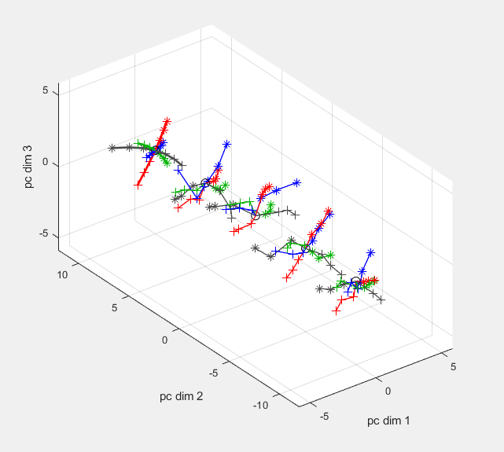
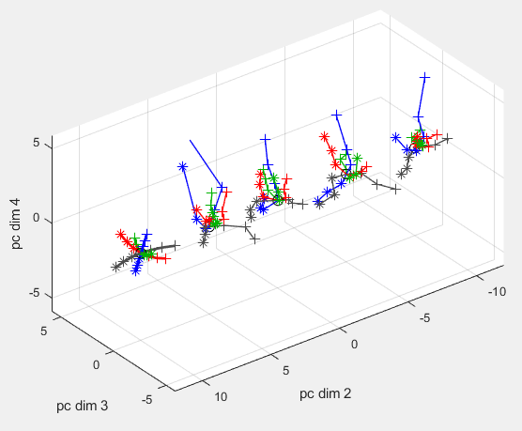

4 subjects
threshold model
dim 3
S: BL
S: MC
threshold model
S: ZK
S: SAW
dim 4
S: SAW
threshold model
S: ZK
S: BL
S: MC
dim 2
dim 1
dim 3
dim 2
γ
β|
The geometry of similarity judgments does not preserve the distances or angles of the geometry of threshold judgments.
β_
α
Notes:
fig_bgca_legacy_d123_d234.fig, screencopy, S: bl, mc, saw, zk; 1-10 sessions; 4d data with 10d fit from generic subject qform after Procrustes

Slide 31
Maybe we should shift the viewpoint?
One Geometry
Task B
Task D
What are the invariants?
Task A
(similarity)
(grouping)
(thresholds)
Task C
(working memory)
Multiple Geometries
Task B
Task D
Task A
(similarity)
(grouping)
What are the transformations?
(thresholds)
Task C
(working memory)

Slide 32
Transformations correspond to canonical neural operations
distances are disproportionate
Task A
Task B
rays are not orthogonal
(thresholds)
(similarity)
trajectories bend at the origin
Affine:
Gain changes
Piecewise linearity
Thresholds
Projective:
Divisive normalization
We need all of these to account for our data

Slide 33
A complementary analytic strategy

Slide 34
Dispensing with numeric distances
We postulated a model based on numeric distances.
We assumed that judgments reflect distances (d) – numbers – that can be added and multiplied.
Is d(spider, meatball) > d(flower, cat)+d(hat, tie)?
Is d(alligator, clothespin) > 2 x d(coffee, eggplant) ?
But what if judgments reflect dis-similarities (D) that can be ranked but not added or multiplied?
That is, we can ask if D(A,B)>D(A,C), but we can’t ask by how much. Can we still characterize the perceptual space?
Formally: we assume that triadic judgments of dis-similarities (D) indicate the rank-order of un-observable distances (d): D(A,B)>D(A,C)↔ d(A,B)>d(A,C).
Weaker than monotonicity … no claim that D=f(d).
What kinds of inferences can we make about the space that generates d?

Slide 35

We can still test models!
Locally Euclidean
Euclidean
Minkowski
Addtree
Ultrametric
Distances on
curved surfaces
Manhattan distances
Mileage
(no loops)
Hierarchy
Everyday life
coordinates?
local
continuous?
Pythagorean?
local
Isotropic?
Inequalities
triangle
“four-point”
ultrametric
Notes:
Maine mileage chart from http://www.joshuahowe.com/2012/02/maine-mileage-chart-and-table-from-1988.html
City block image from https://www.nytimes.com/interactive/2016/12/21/upshot/Mapping-the-Shadows-of-New-York-City.html
Other images from Waraich Tubingen talk Tubingen_Talk 1.pptx

Slide 36
Using ordinal relationships of dis-similarities
Ultrametric
Of d(X,Y), d(X,Z), and d(Y,Z), the largest two are equal.
Of D(X,Y), D(X,Z), and D(Y,Z), the largest two are equal.
X
Z
Y
Ordinal relationships preserved
Ultrametric inequality:
d(X,Y)≤max{d(X,Z),d(Y,Z)}
Addtree
W
X
Y
W
Ordinal relationships preserved
X
Z
Y
Z
Four-point condition:
Cannot have d(W,X)>max{d(W,Y),d(W,Z)} and d(Y,Z)>max{d(X,Z),d(X,Y)}
Cannot have D(W,X)>max{D(W,Y),D(W,Z)} and D(Y,Z)>max{D(X,Z),D(X,Y)}
Of d(W,X)+d(Y,Z), d(W,Y)+d(X,Z), and d(W,Z)+d(X,Y), the largest two are equal.

Slide 37
Implementation
Typically, judgements are uncertain.
So the relationship between D(X,Y) and D(X,Z) is revealed by the probability that a subject will judge D(X,Y)>D(X,Z), i.e., the choice probability p{D(X,Y)>D(X,Z)}.
>1/2,
=1/2
<1/2,
D(X,Y)>D(X,Z)
D(X,Y)=D(X,Z)
D(X,Y)<D(X,Z)
We assume that if p{D(X,Y)>D(X,Z)} is
then
.
We use a Bayesian approach to estimate p{D(X,Y)>D(X,Z)} from the choice data:
posterior
joint posterior
prior
c out of n judgments
that D(X,Y)<D(X,Z)
c=1 n=6
c=4 n=6
L(p)
p{D(X,Y)>D(Y,Z)}
assume independence
0
1
p
p{D(X,Y)>D(X,Z)}
p{D(X,Z)>D(Y,Z)}
Add a discrete component
Only some of this volume is consistent with the ultrametric inequality.
What fraction of the joint posterior is in the allowed region?
p{D(X,Y)>D(Y,Z)}
c=1 n=6
c=4 n=6
p{D(X,Y)>D(X,Z)}
p{D(X,Z)>D(Y,Z)}
Notes:
From dirichlet_dists.m and ori_char_sim*.pptx

Slide 38
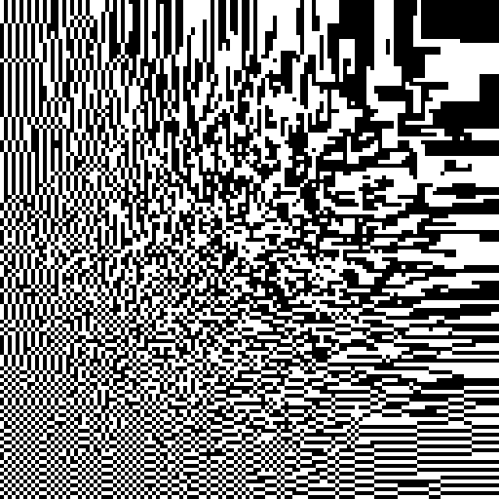
Addtree test case: Texture
addtree
0
β|
-0.5
-1
log likelihood ratio
BL
-1.5
MC
SAW
ultrametric
ZK
β₋
0.5
0
-0.5
-1
-1.5

Slide 39

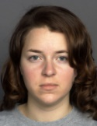


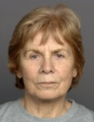


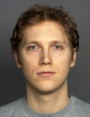
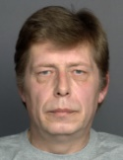





Ultrametric test case: Faces
M
F
young
mid
old
young
mid
old
…
…
examples
Ebner, N. C., Riediger, M., & Lindenberger, U., (2010). FACES. https://faces.mpdl.mpg.de/imeji/

Slide 40












Ultrametric test case: Faces
addtree
F
M
0
young
mid
old
young
mid
old
-0.5
F
-1
M
young
mid
old
young
mid
old
-1.5
ultrametric
log likelihood ratio
MC
SAW
F
M
0.5
young
mid
old
young
mid
old
0
-0.5
F
M
young
mid
old
young
mid
old
-1
-1.5

Slide 41
From here…
Ordinal relationships preserved
Ultrametric
Ultrametric inequality:
Of d(X,Y), d(X,Z), and d(Y,Z), the largest two are equal.
Of D(X,Y), D(X,Z), and D(Y,Z), the largest two are equal.
X
Z
Y
Four-point condition:
Cannot have D(W,X)>max{D(W,Y),D(W,Z)} and D(Y,Z)>max{D(X,Z),D(X,Y)}
Addtree
Of d(W,X)+d(Y,Z), d(W,Y)+d(X,Z), and d(W,Z)+d(X,Y), the largest two are equal.
Y
W
?
X
W
Z
X
Y
Z
What about graphs with limited cycle structure?
…

Slide 42
Summary
Methods
A practical approach to acquiring, and analyzing, similarity judgments that:
Provides metrical information
Allows inferences about geometry
Data
Perceptual spaces that represent similarity
Are high-dimensional but sparsely populated
Differ by degree of clustering rather than dimensionality or curvature
Differ from perceptual spaces inferred from threshold measures
Questions
Are we using the right kind of models?
How far can we go with rank-order judgments?

Slide 43
Thank you

